Slide 1
Sensory & Flavor of Different Specialty Malt
Aaron Hyde – Director of Homebrew
Briess Malt & Ingredients Co.

Slide 2
Overview of Discussion
Sensory basics
  What is sensory evaluation?
  How are malt flavors generated?
Applications for malt sensory
  Why is sensory evaluation important for maltsters and homebrewers?
Tools for malt sensory
  How to prepare malt for sensory evaluation
  How to describe malt flavors
  How to perform malt sensory evaluation and record perceptions
  How to build a sensory profile diagram

Slide 3
Overview of Discussion
Sensory
  Look at each malt style
  Sample malt and wort from each malt style
  Beer sampling from each malt style

Slide 4
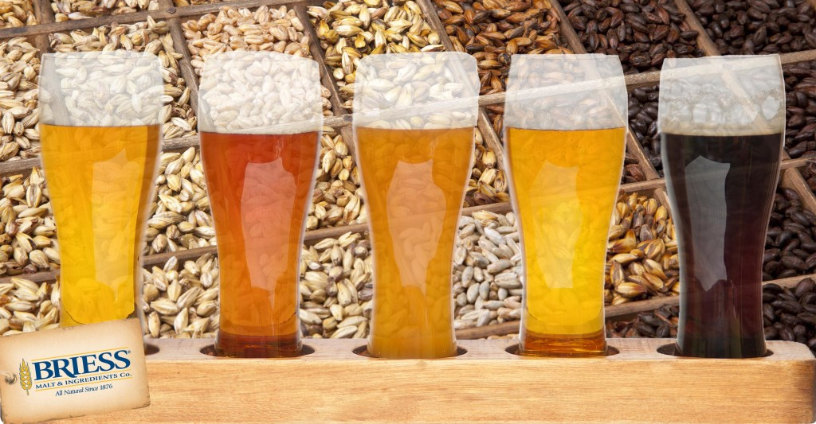
What is Sensory Evaluation?
Scientific discipline
For malt, our primary concerns are COLOR and extractable FLAVOR
Whole kernel TEXTURE is important for milling considerations
Notes:
DEFINITION OF SENSORY EVALUATION: “A scientific discipline used to evoke, measure, analyze, and interpret those responses to products that are perceived by the senses of sight, smell, touch, taste, and hearing (Stone and Sidel 1993).”
COLOR is measured analytically (degrees Lovibond), but HUE is what we visually perceive
FLAVOR is evaluated by smelling and tasting a standard wort sample
TEXTURE (or degree of hardness) is important to evaluate when quality has been compromised due to improper storage
can effect milling efficiency, which can cause a reduction in extract yield

Slide 5
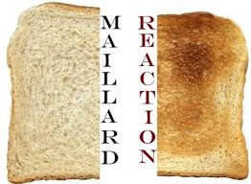
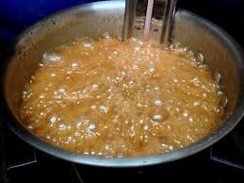
How Are Malt Flavors Generated?
Non-enzymatic browning reactions
  Maillard Reaction (amino acids and reducing sugars)
  Caramelization (sugars)
Notes:
NON-ENZYMATIC browning reactions occur under heated conditions to form unique compounds with various flavors and aromas
STRECKER DEGRADATION actually part of Maillard reaction, but is important enough to talk about because it is generally accepted that Maillard reaction intermediates and Strecker aldehydes have the greatest impact on malt sensory perception
CARAMELIZATION pathway relatively rare in malt production

Slide 6
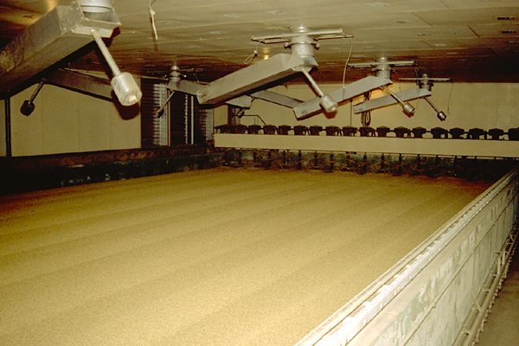
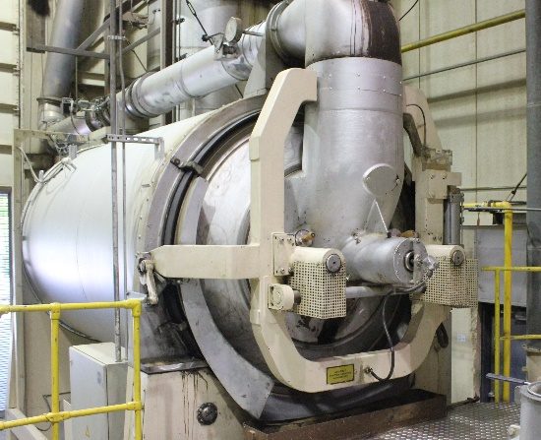
How Are Malt Flavors Generated?
Flavor can be creatively manipulated
For most malt styles, flavor is a result of the specific volatile compounds that are produced in thermal processing
Kiln
Or both
Roaster
Notes:
FLAVOR can be creatively manipulated by selection of drying conditions (equipment, duration, temperature, and moisture)
EXAMPLE: flavors are uniquely different in roasted malt, kilned malt, and malt that is both roasted + kilned

Slide 7
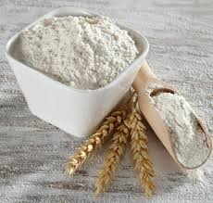
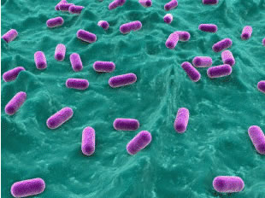
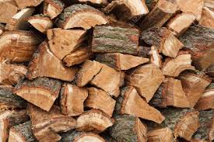
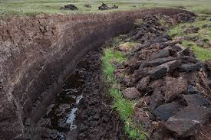
How are Malt Flavors Generated?
Other ways of affecting malt flavor…
Modification
Souring
Smoking
Notes:
UNDERMODIFIED malts associated with doughy, starchy, flour-like flavors
Low color base malt flavor can be noticeably influenced by modification processes
SOUR malts associated with sour, tangy, and lactic flavors
Flavors are achieved from processes that intentionally promote the growth of lactic acid bacteria
SMOKED malts associated with various wood and peat flavors
Flavors are achieved from processes that introduced smoke during the drying process

Slide 8
Color & Hue – Key Points
In malting and brewing we tend to regard color as a measurement in degrees lovibond or SRM (considered nearly identical).
We use spectrophotometers measure the absorbance at single wavelength (430 nm) through standard sized sample.
Actual color or hue (what our eyes see) in wort and beer may vary compared with our interpretation of measured SRM or degrees lovibond.
Assuming suggested usage rates (~1-15%)
Caramel 10 – 40L
Color: Golden hues
Caramel 60L – 120L
Color: Deep golden, reddish orange hues

Slide 9


Color & Hue
What measured color (SRM) is sample A?
What measured color (SRM) is sample B?
Notes:
Both of these samples are a 10L

Slide 10
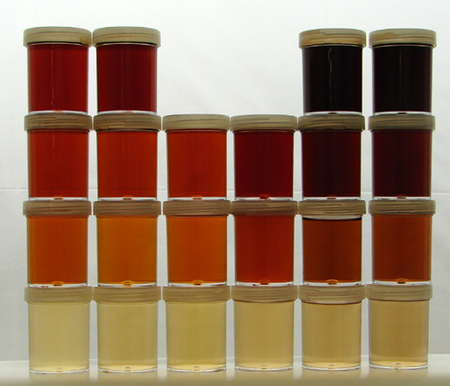
Spectrum of Roasted Worts
Left - Kilned/Caramel Right - Dry Roasted
orange-reddish amber-brown
30 SRM
20 SRM
10 SRM
2 SRM
Notes:
Every row is the same lovibond
2
10
20
30

Slide 11
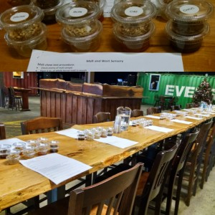
Applications For Malt Sensory - Brewers
Why is malt sensory important for Homebrewers?
Quality Assurance –
Is the malt slack/off?
Recipe Design –
Know your tools!
Style Understanding –
Malt is a critical tool to brew
certain styles.
Malt sensory event at Highland Brewery in Asheville, NC
Notes:
QC: Evaluating malts of compromised condition - nearing “best by” date or improperly stored in humid/moist environment
QA: was the beer flavor issue related to the malt?
R&D: blind comparison of malt suppliers and exploring unique malts for potential flavor contributions to beer

Slide 12
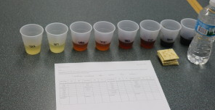
Applications For Malt Sensory - Maltsters
Why is malt sensory important for Maltsters?
Quality Control –
Batch to batch consistency.
Quality Assurance –
To investigate issues.
R&D –
Exploring new flavors,
processes, and products.
Congress wort sensory evaluation at Briess in Chilton, WI
Notes:
QC: batch to batch consistency!
Sometimes certain malts are only made a few times a year – make sure flavor is consistent by having a “typical” sample to compare with
QA: good tool for investigating customer complaint for flavor issues – was it our malt?
R&D: exploring unique flavors and trialing new processes/products, evaluating sensory on pilot scale batches

Slide 13
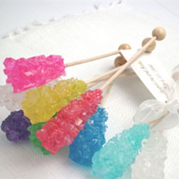
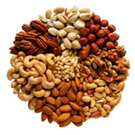
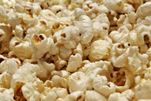
Tools For Malt Sensory
How To Perform Evaluation
Whole Kernel Malt – chew to evaluate TEXTURE, AGE & QUALITY.
…not accurate for flavor.
Crystal Malt
Hard
Non-Crystal Malt
Crunchy
“Slack” Malt
Soft
Notes:
MALT TEXTURE influences how efficiently the grain will be milled, may reduce extract yield
CRYSTAL MALTS should be hard, glassy
think of crystaline sugar candy
NON-CRYSTAL MALTS should be relatively easy to break with teeth, mealy
think of snack nuts
SLACK MALT has picked up moisture in storage, relatively soft
think of stale popcorn
Moisture can migrate in and out of malt. Slack malt can be stored in an environment with low RH to reduce moisture content of kernels.

Slide 14
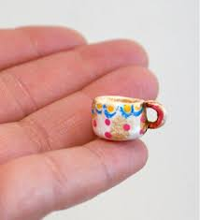
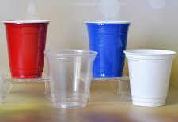

Tools For Malt Sensory
How To Perform Evaluation
Standard wort – smell, taste, and swallow to evaluate malt FLAVOR
Use a small cup so that your nose can be close to the wort
Ok, maybe a little bigger
Serve 30-50 mL
  If you have been judging malt flavor by the whole kernel chew, wort sensory will introduce you to a whole new world…
Notes:
STANDARD WORT for flavor because whole kernel flavor is influenced by husk material, starch, and insoluble compounds (not representative of extractable flavor)
SMALL CUP because aromas will not volatilize in the same way they do for beer (not carbonated/nitrogenated)
COMMENT on:
hue (visual perception of color),
aroma,
taste (sweet, sour, bitter)
mouthfeel (thick, thin, astringent, mouth coating, clean, etc.

Slide 15
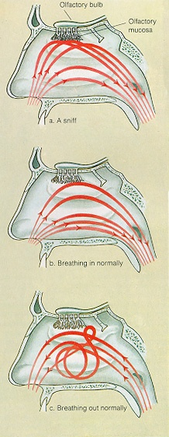
Sense Of Smell
The human nose is very sensitive, more sensitive than a gas chromatograph
Perception changes based on situation
Smell with sniffs in short bursts for 1-2 seconds. After this receptors become saturated and can require 20 +/- seconds to reset
Don’t forget to exhale: retronasal

Slide 16
Wort Tasting Procedure
Aroma:
Begin by sampling the aroma. Swirl the glass and take several short “rabbit” sniffs rather than one long sniff.
Record aromas as you perceive them. Sniff all samples before tasting.
Taste:
Take a sip, slosh it around in your mouth allowing full contact and swallow slowly.
Record overall taste character and additional aroma notes.
Take a smaller sip and evaluate the basic tastes (sweet/sour/bitter).
Take another small sip and work it over the back of the tongue to determine mouthfeel. Record types and intensity of mouthfeel.
Take a fourth sip, work it over the tongue, throat, and other mouth parts to determine aftertaste. Record type and duration of aftertaste.

Slide 17

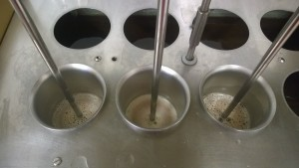
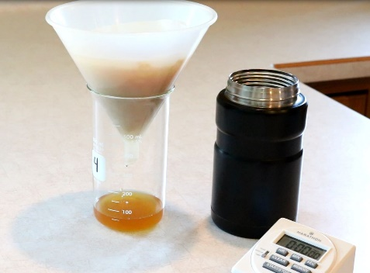
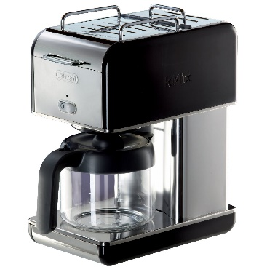
Types of Sensory Wort Mashes
Traditional industry wort preparation
  ASBC Mash
  Congress Mash
In home, brewery & industry wort preparation
  Coffee pot wort
  Hot steep method
  ASBC Mash
  Congress Mash
  Hot Steep Method
  Coffee Pot Wort
Notes:
CONGRESS MASH is industry standard method for wort preparation
Required equipment is expensive and method time consuming
A standardize, alternate, fast, and inexpensive malt sensory method has been needed for some time

Slide 18
Tools For Malt Sensory Evaluation – Standard Wort Preparation
Briess has recently developed a relatively fast and inexpensive standard wort preparation method for brewers
HOT STEEP METHOD
Notes:
HOT STEEP
Currently being validated by the American Society of Brewing Chemists (ASBC) Sensory Technical Subcommittee
If published, the Hot Steep method will be the first raw material sensory method standardized for the brewing industry
Craft brewing community has embraced it for their own sensory evaluation needs
COMMENTS for video: PDF file on Briess website gives full details of method – video is a general overview.

Slide 19
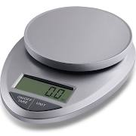
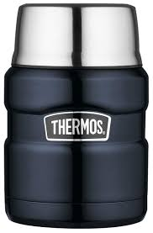
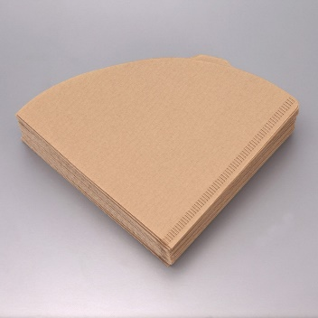
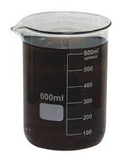
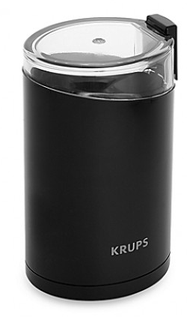
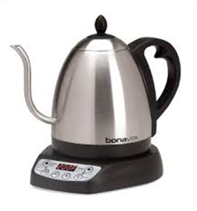
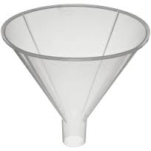
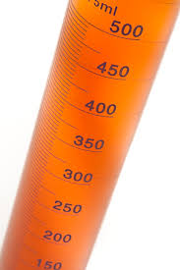
Tools For Malt Sensory Evaluation – Hot Steep Method
Supplies can be purchased from a general retailer…
scale
filter paper
insulated thermos
tall glassware
electric grinder
electric kettle (optional)
graduated cylinder
plastic funnel
Notes:
GLASSWARE: does not have to be a lab grade glass beaker – could use a tall drinking glass with the 100 mL volume line drawn on the side
ELECTRIC KETTLE: Water can be heated slowly on the stove and monitored with a thermometer or heated very quickly to the specified temperature with an electric kettle. How the water is heated is not important, but reaching the temperature of 65C is important!

Slide 20
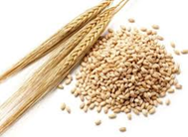
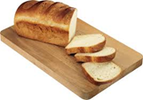
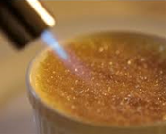
Malt Sensory Lexicon
You can’t really begin to describe the sensory aspects of malt without the proper language…
grainy
bready
burnt sugar
Briess malt sensory lexicon is available on the Briess website
Notes:
One of the most difficult aspects of sensory is finding words to describe your experiences – necessary to have a specified vocabulary
Currently, the industry does not have a standard lexicon to describe malt flavors
Briess malt sensory lexicon: It is an ever-evolving list of descriptors with associated words and pictures that we use to communicate our malt sensory perceptions

Slide 21
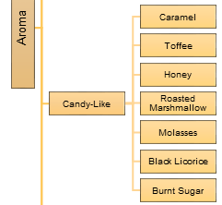
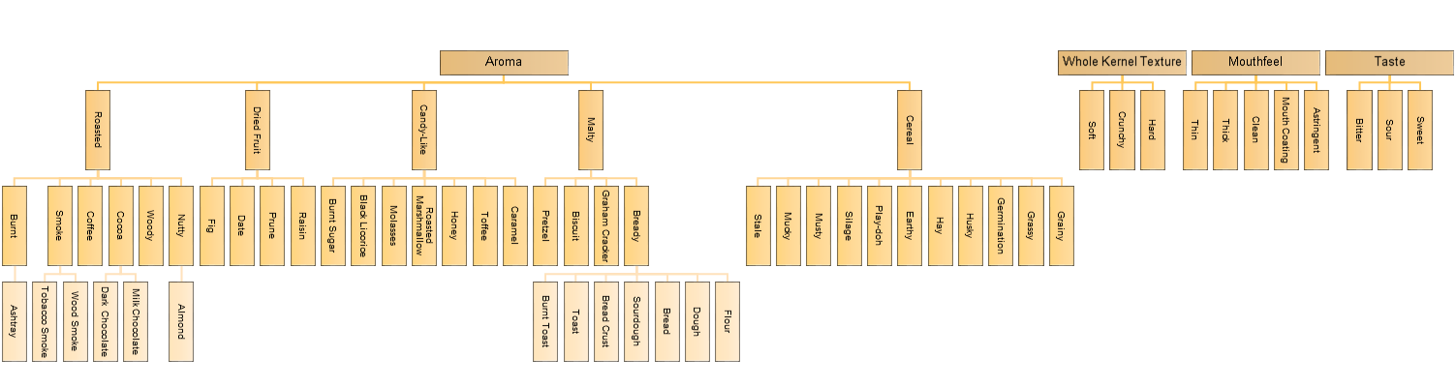
Tools For Malt Sensory
Malt Sensory Lexicon
Use the Briess hierarchical diagram of descriptive terms to build your malt sensory vocabulary
Diagram is available on the Briess website
Notes:
Hierarchical diagram PDF is available on Briess webiste

Slide 22
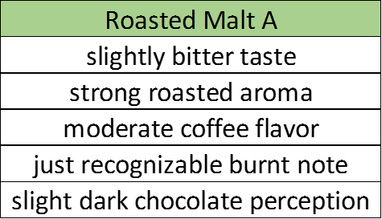
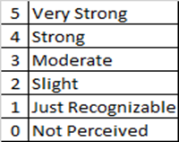
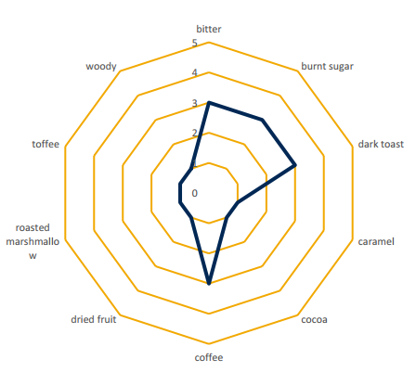
Tools For Malt Sensory
Recording your perceptions by using
qualitative data / comment based data
Build a sensory profile diagram
  Create a perceived flavor/aroma
  intensity scale
  Record your data in a spreadsheet
  Develop a visual profile with a spider
  web diagram
Notes:
QUALITATIVE DATA: Use adjectives like slight, moderate, and strong to describe the intensity in which you perceive specific flavors such as bready, caramel, and coffee, or tastes such as sweet, sour, and bitter
Rather than reading a series of comparative statements and descriptions, a radar diagram will illustrate the differences you perceive.
Excellent tool for side by side comparisons
You can SEE how the flavor profile evolves through the color range of Briess Caramel Malts
DESCRIPTORS: What kind of malt are you evaluating? Select terms that are relevant
SCALE: Briess uses a word anchor scale and represents the words as numbers 0-5 so that the data can be graphed
The scale is NOT numerical, so don’t try to apply statistics
Enter your sensory evaluation data into Microsoft Excel as shown in the example table below
Use the word anchor scale shown below, or make your own
The data table shown on the previous slide now looks like this…
The flavor differences between Caramel Malt A and Caramel Malt B are visually summarized

Slide 23
Tools For Malt Sensory – Sensory Profile Diagram
Enter your data in Microsoft Excel…
Perceived flavor intensity
Notes:
Enter your sensory evaluation data into Microsoft Excel as shown in the example table below
Use the word anchor scale shown below, or make your own

Slide 24
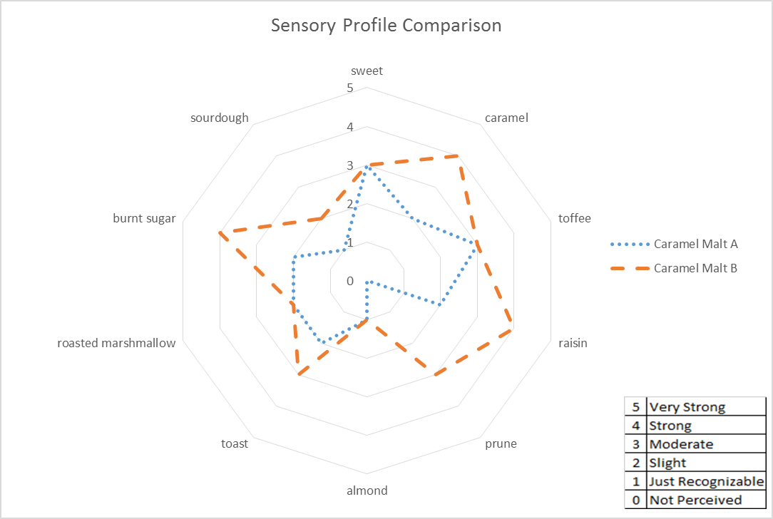
Tools For Malt Sensory – Sensory Profile Diagram
  Excel : select data, click insert tab, and choose to create a radar diagram.
  Add scale, title, and key
Notes:
The data table shown on the previous slide now looks like this…
The flavor differences between Caramel Malt A and Caramel Malt B are visually summarized

Slide 25
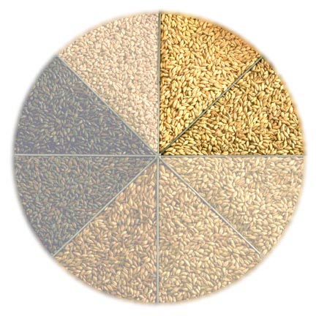
Types of Kilned Specialty Malts
Pilsen – Clean, sweet delicate malty - 1.0L
Pale Ale– Malty, slight biscuit – 3.5L
GoldPils® - Malty, bready biscuit - 3.5L
Rye Malt – Spicy rye - 3.7L
Ashburne® Mild - Rich malt, soft toastiness - 5.5L
Carapils® - Enhanced mouthfeel - 1.3L
Bonlander® Munich - Rich sweet maltiness - 10L
Aromatic Munich – Intense malt with toast - 20L

Slide 26
Kiln Produced Specialty Malt Characteritics
Enzymatic Power: DP 0 -160 Degrees Lintner
Color: 1 – 20L Golden/Amber Colors
Flavor: Slightly Sweet, Malty, Biscuity, Intense Maltiness
Kernel Characteristics: Mealy (powdery) with enzyme preservation
Provide fermentable starches, sugars and amino acids needed by yeast for fermentation
Usage rates for kilned produced specialty malt can be to 100% inclusion* in a grist bill
* Caution must be used with the above statement with regards to lower DP Aromatic as well as Carapils which has no DP
Notes:
The workhorse of the malts

Slide 27
Kilned Produced Specialty Malts

Slide 28
Kilned Produced Specialty Malts
What should this diagram look like?

Slide 29
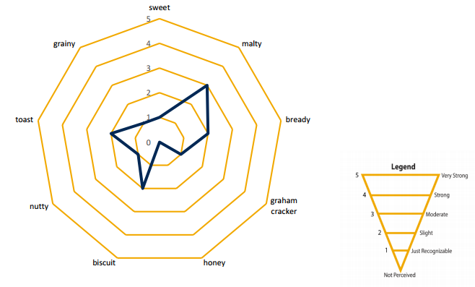
Briess Aromatic Munich 20L
Average Sensory Profile
Flavor: Very smooth, clean, slightly sweet, rich intense malty
Color: Deep golden with orange hues

Slide 30
Franco-Belges Special Aromatic Malt
What should this diagram look like?

Slide 31
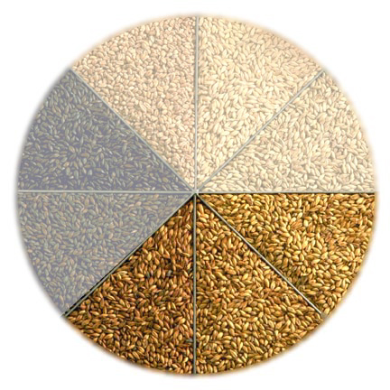
Caramel-Style Malts - Flavors & Aromas
Caramel 10-20L: Mild Clean Sweetness
Caramel 30-50L: Sweet Caramel, Mild Toffee
Caramel 60-70L: Sweet, Pronounced Caramel
Caramel 80-90L: Pronounced Caramel,
Slight Burnt/Brown Sugar
Caramel 120L: Very pronounced Caramel,
Slight Burnt/Brown Sugar, Raisiny, Prunes
Ex Special 130L: Toasted Marshmallow, Prune, Figs, Dates, Woody
Note, ES has a shorter starch conversion in roaster prior to roasting. This yields its unique flavor profile,
with some biscuity notes, but also fig/prunes/dates compared with Caramel malts.

Slide 32
Caramel-Style Malts – General Characteristics
Color: 10L – 140L
Hue: Golden, orange to deep red, mahogany tones
Flavor: Sweet, toffee, caramel, roast, raisin, molasses
Mouthfeel: Add body to finished beer due to non-fermentables
Foam: Promote foam development and foam retention
Endosperm: >90 % of kernels glassy / crystallized
Mashing Within Each Kernel of Green Malt
Unique to Caramel Style Malts

Slide 33
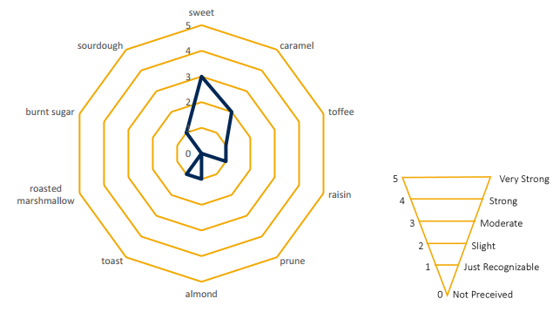
Caramel Malt 20L
Average Sensory Profile
Flavor: Candy-like sweetness, mild caramel
Color: Contributes golden hues

Slide 34
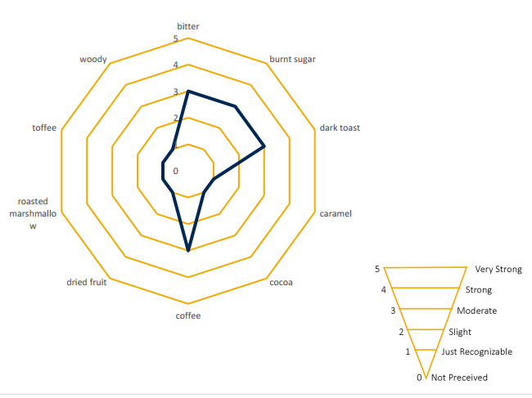
Extra Special Malt
Average Sensory Profile
Moderately bitter with moderate burnt sugar, dark toast, and coffee flavors, complimented by hints of caramel, cocoa, dried fruit, roasted marshmallow, toffee, and woody notes

Slide 35
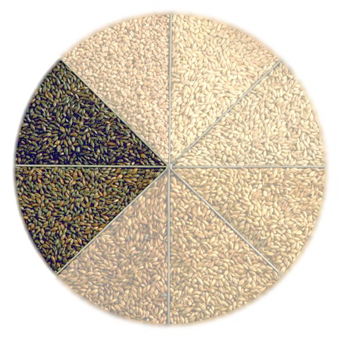
Dry Roasted Malts and Grains
Light Roast
Victory® Malt 28°L
Special Roast Malt 50°L
CaraBrown Malt 55°L
Caracrystal Wheat 55°L
Dark Roast
Chocolate Malt 350°L
Dark Chocolate Malt 420°L
Roasted Barley 300°L
Black Malt 500°L
Black Barley 500°L
Black Prinz® 500°L
Midnight Wheat 550°L

Slide 36
Roasted Malts & Grains
Roasted Green Malt
Not kilned
Malt transferred from germination directly to roaster
Higher % moisture helps facilitate conversion
More caramelization of sugars yields distinctive brown sugar/caramel flavors
Dry Roasted Malts
Kilned, then malt transferred to roaster
Lower % moisture than green malt, but just enough to initiate Maillard reactions (sugar + protein / amino acids)
Browning results in bready/biscuity/nutty flavors.
Dry Roasted Grains
Un-malted, barley transferred directly to roaster
Some hydration via roaster jets

Slide 37
Types of Roasted Malts & Grains
Roasted Green Malt
Caramel Malt
Extra Special Malt
Caramel Vienne Malt
Caramel Munich Malt
Dry Roasted Malts
Victory Malt
Special Roast Malt
Chocolate/Dark Chocolate Malt
Black Malt
Dry Roasted Grains
Roasted Barley
Black Barley

Slide 38
Light Roasted Malt Flavors
Victory® Malt 28°L : Biscuity, Baking Bread, Nutty
- usage rates 2% to 25%
Special Roast Malt 50°L : Toasty, Sourdough, Tangy
- usage rates 5% to 10%
Carabrown Malt 55°L : Intense Toast, Nutty, Graham Cracker Flavors, Slightly Dry Finish
- usage rates 5% to 25%
Caracrystal Wheat 55°L : Sweet, Malty, Subtle Caramel/Toffee
- usage rates 5% - 25%

Slide 39
Dark Roasted Malt and Grain Flavors
Chocolate Malt 350°L : Rich cocoa
Dark Chocolate Malt 420°L : Dark, smooth cocoa
Roasted Barley 300°L : Intense coffee, roasted, dry
Black Malt 500°L : Very dry, sharp, acrid at high levels
Black Barley 500°L : Coffee, intense bitter, roasted, dry
Black Prinz® 500°L : Dry, delicate, mild roast, neutral
Midnight Wheat 550°L : Clean, starts sweet, neutral, smooth
Need to pay attention to specs and NOT select just by brand or style!

Slide 40
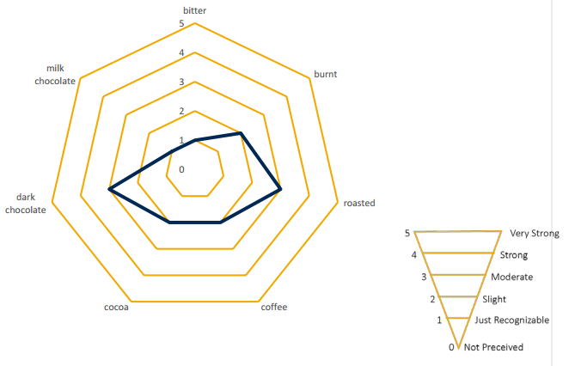
Briess Dark Chocolate Malt
Average Sensory Profile
Flavor: Rich smooth coffee
Color: Brown hues

Slide 41
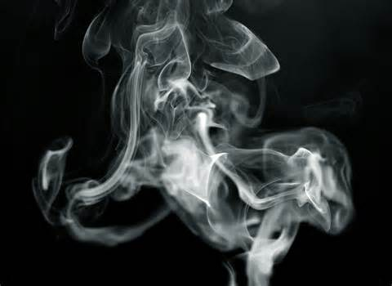
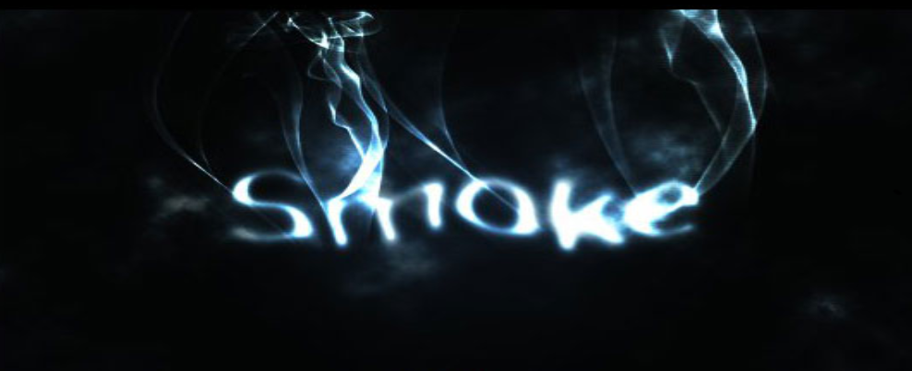
Other Unique Specialty Malts
Mesquite Smoked and Cherry and Apple Wood Smoked Malt
2R enzymatic base malt using Cherry Wood or Mesquite
DP - 140 Phenols - 15-30ppm
Used in Scottish/Scotch Ales and Rauch Beers though splendid in Porters! Doppelbock?
Usage rates – 5% to 60% or more!

Slide 42
Malt Sensory – Key Takeaways
Sensory evaluation is a scientific discipline
Key sensory aspects of malt are:
  Color
  Flavor
  Texture
For most malt styles, flavor is a result of non-enzymatic browning reactions that occur during thermal processing
  Maillard Reaction
  Caramelization
Notes:
COLOR: or, more appropriately, HUE – perceived by visual interpretation of color
FLAVOR: perceived by smelling, tasting, and swallowing wort
TEXTURE: perceived by chewing whole kernel malt
MAILLARD REACTION: largely responsible for malt flavor
Strecker degradation is part of this, but is specifically mentioned due to the flavor impact of Stecker aldehydes
CARAMELIZATION: comparatively rare in malting, but still noted

Slide 43
Malt Sensory – Key Takeaways
Malt sensory has important applications for maltsters and homebrewers.
Hombrewers can especially benefit from malt sensory in situations that involve:
  Malt supplier comparisons
  Recipe development
  Assessment of quality
  Developing a deeper understanding of malt flavors

Slide 44
Malt Sensory – Key Takeaways
Malt sensory evaluation can be performed with knowledge and use of the following:
  Hot steep method
  Malt sensory lexicon
  Record your sensory perceptions!
  Build a sensory profile diagram when you brew with malt- it’ll make you a better brewer, beer judge, and beer drinker!
Notes:
STANDAR WORT PREP:
LME & DME: 10% solution with distilled water, mix until fully dissolved
WHOLE KERNEL and PRE-GROUND: Hot Steep method
MALT SENSORY LEXICON: important to use appropriate descriptors
Briess lexicon is an evolving list of descriptors with associated words and pictures that we use to describe malt sensory perceptions
RECORDING PERCEPTIONS: write down descriptive and meaningful comments
DIAGRAM: not necessary, but provides a good visual representation of your perceptions, makes it easy to illustrate malt comparisons

Slide 45
Thanks! Questions? aaron.hyde@briess.com
920-418-3109

