Slide 1
Non-Enzymatic Mashing (NEM) or New Cold Mashing
Concept by Dan Bies | Technical Services
Presented by Aaron Hyde | Director of Homebrewing
Notes:
When I first started work on this presentation I titled the concept that I had as Cold Steeping, and that is the title listed in your conference literature. But as searched for literature on the subject I turned up a bunch of reference to coffee and dark roasted malts. And the idea in these references was that you could change the flavor of you coffee or dark roasted malts by not extracting bitter components with heat.
This is not the objective of my talk, so I decided to give my concept a new name.
Which is Non Enzymatic Mashing, a title that better describes this the goal of this method, namely as a replacement for or supplementation to traditional mashing.

Slide 2
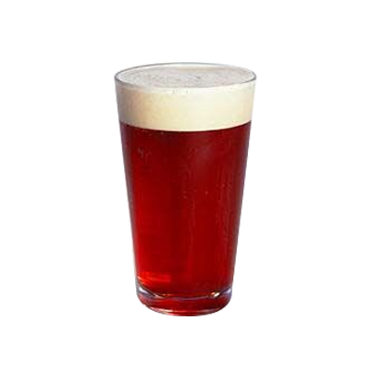
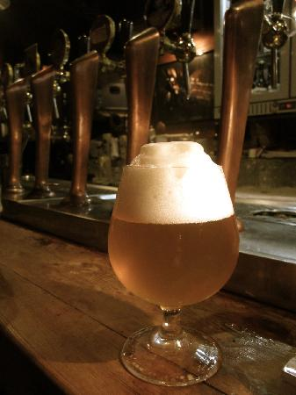



Non-Enzymatic Mashing : Why do it?
Big malty flavor & color, without the gravity
Increase Flavor
Increase Color
Improve Head Retention
Improve Mouth Feel
Reduced Gravity
*stays with spent grain

Slide 3

Non-Enzymatic Mashing : Why do it?
The Biggest Reason?
BLOW YOUR MIND NEW MALT FLAVORS!!

Slide 4
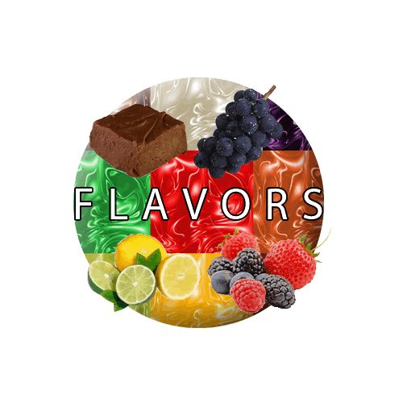
Non-Enzymatic Mashing : Why do it?
How are you getting new flavors
Density (Concentration)
Intensity (Perceived Level)
Specific flavors become much more intense.

Slide 5
Outline: Non Enzymatic (Cold) Mashing
How to NEM
*Don’t worry It’s Simple
Why NEM works
*The nature of malt
Why use NEM
*What’s in it for you
Example Brew
*A malt divided against itself…
Pilot Brew
*Crank it up to 11
With Munich
Applications
& Summary
Notes:
I hope to convince you that this method can be used to create unique characteristics in beer. My goal in giving this presentation is that next year, when I return to homebrewcon, that someone will be serving a beer utilizing this method.
I will attempt to accomplish this by describing………

Slide 6
100% NEM/Cold Mash
Traditional Mash
Milled Malt
Cold Water
Milled Malt
Hot Water
Mash Cold
Mash
Lauter
Cold Wort!
Lauter
Spent Grain
Mash@Temp
Waste
Lauter
Spent Grain
Wort
Boil &
Ferment
Wort
Waste
Boil &
Ferment

Slide 7
NEM + Trad. Mash
Milled Malt
Cold Water
Milled Malt
Hot Water
Mash Cold
Mash
NEM Wort
Lauter
Lauter
Spent Grain
Spent Grain
Wort
Waste? Starch!
(All Malt Adjunct)
Waste
Boil &
Ferment

Slide 8
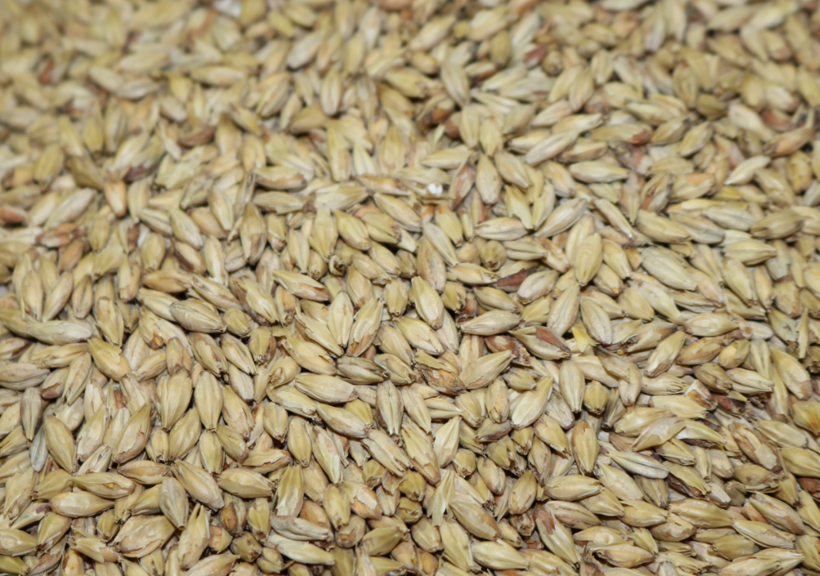
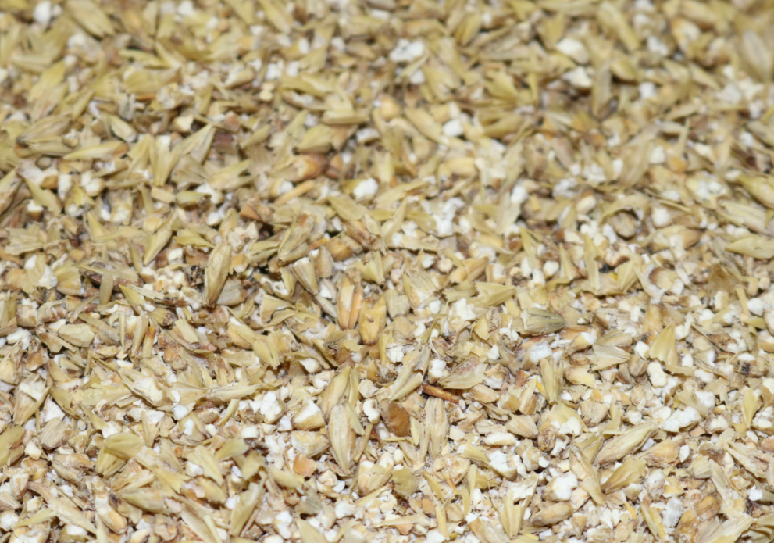
How to N.E.M.
Mill Grain
Notes:
Let’s look at how we NEM.
Big surprise, we start with malt.
This malt needs to be ground, nothing tricky here just use your standard brewing grind. The coarser the better, as I is favorable to not create excessive amounts of flour due to fine grinding.

Slide 9
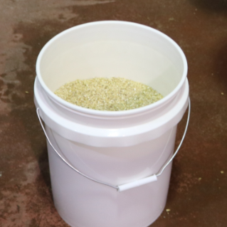
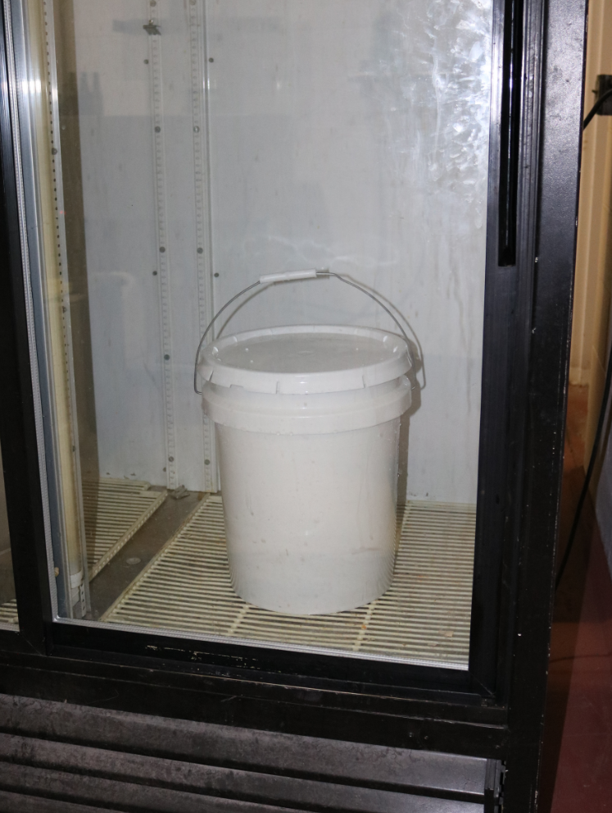
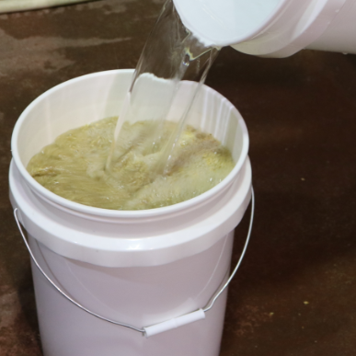
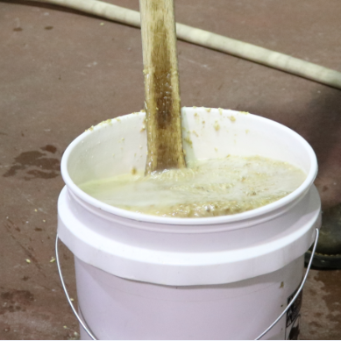
How to N.E.M.
Soak in cold/cool water
8 -16
Hours
Mix for 1-2hr or…
Notes:
Place your milled malt in a sealable container.
Add about 3-5 times as much weight in water as malt.
Mix the grain and water
Seal container
And store in refrigerator, about 8 hours is required for desired results
-alternately in place of prolonged cold storage you could vigorously agitate, or continuously vorlauf the malt and cold water for 30-120minutes.
-both methods should achieve similar results.

Slide 10
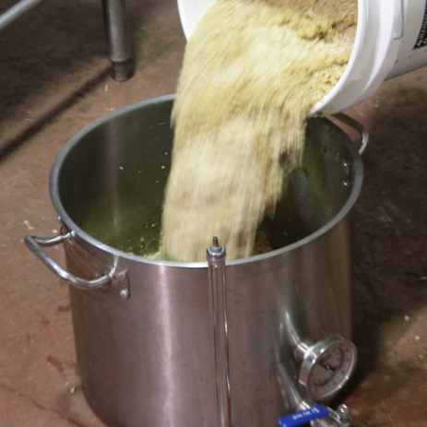
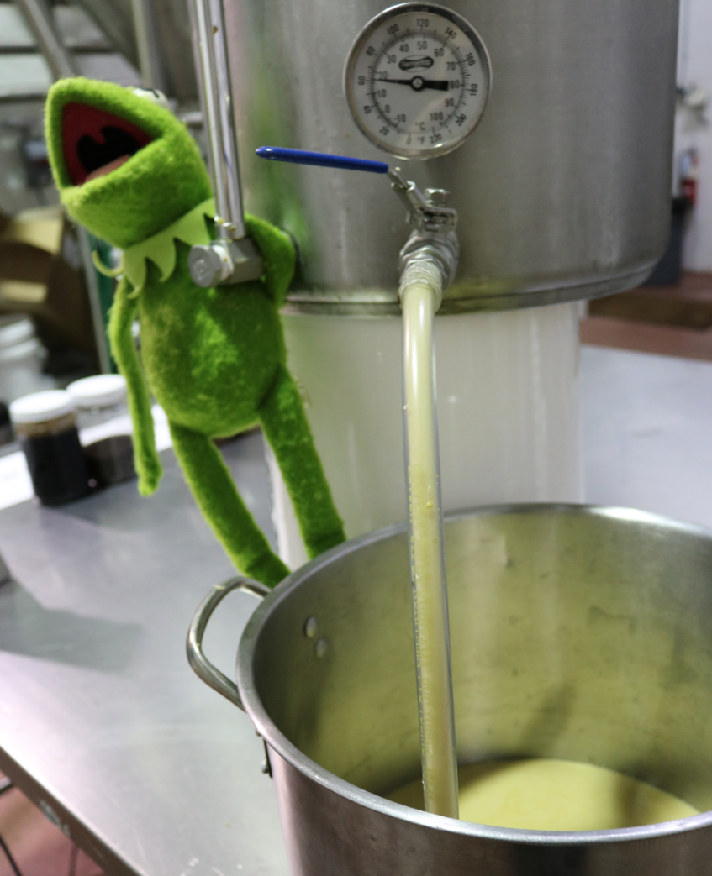
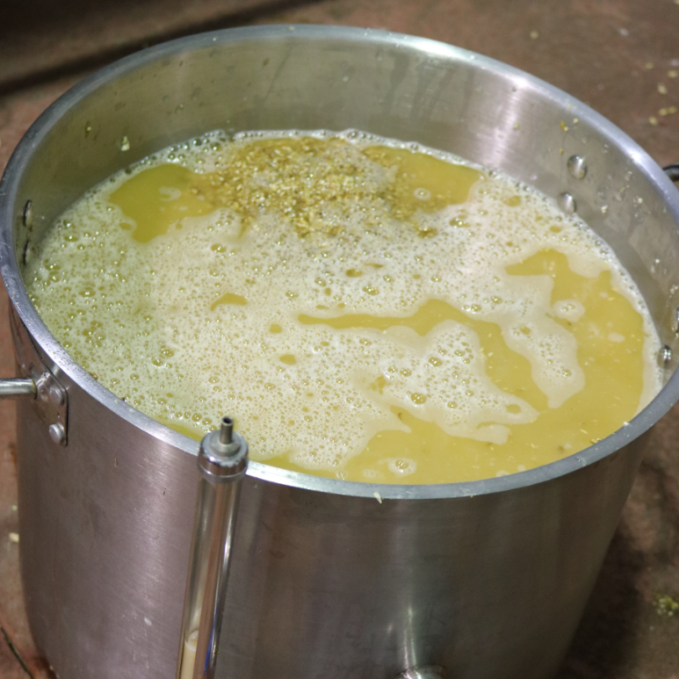
How to N.E.M.
Separate grain from liquid
Notes:
Next pour the grain and liquid into a lauter tun, or pull grain bag. And lauter.
The wort will not look like a typical wort, it will most likely be quite hazy, which is why I’ve inclueded Kermit on this slide…to distract from the wort.

Slide 11
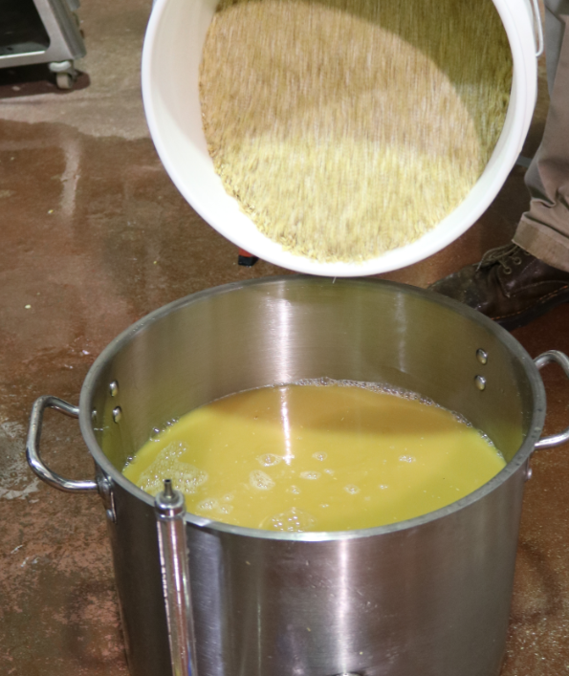
How to N.E.M.
Use Wort as Mash Water or
Heat to Convert (100% NEM)
Notes:
Now you can finish the brew as usual, utilizing the NEM wort as you mash water,
Or use this wort for another NEM mash to further concentrate the cold dissolvable compounds in you malt.
or you can convert the NEM wort as if grain was included, by heating to your desired mash temperatures.
And we will

Slide 12
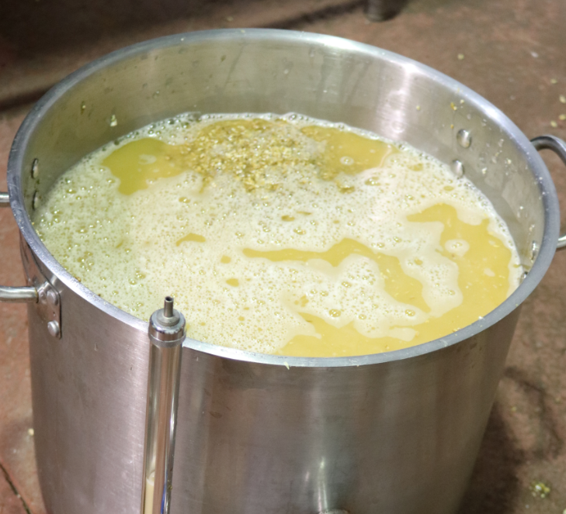
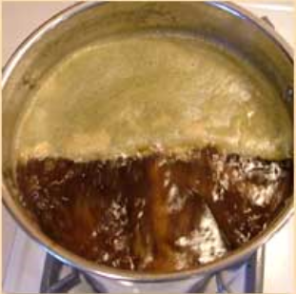
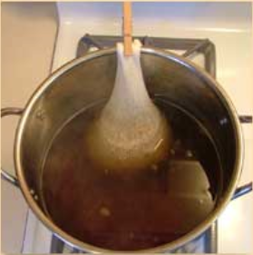
How to N.E.M.
Brew As Usual
Notes:
Finish brew as usual

Slide 13
Why N.E.M. Works
Malting :
Raw Starch (Growing Barley Food Store)
Endosperm
Enzymes
Notes:
I feel it is important to show you why NEM works, so hopefully you don’t think that this is VooDoo science.
And maybe it will give you the knowledge base required to utilize and expand on this method.
So, just as with any seed , water is the magical substance that makes things grow, it is the solvent that allows the enzyme mobility, and thus is necessary for virtually all reactions in malting.
Since water is the solvent that makes the magic, logic would dictate that any compound that is liberated in the malting process would be readily soluble water. And those compounds that are not liberated are essentially the portions of the kernel that are raw barley.

Slide 14
Why N.E.M. Works
Malting:
Soluble, Refined Malt Components
Raw Starch
Notes:
Enzymes liberate compounds as they begin breaking down the protein and polysaccharide layer that protects the growing kernels food source, or starch.
As the enzymes work on this raw barley food store, they are breaking down protein to form the smaller protein and amino acids necessary for good yeast health, head retention, and full mouth feel.
If I’ve lost you, just let me say that you do not an enzymatic mash to obtain good head retention, mouth feel, or yeast health.
Once the Maltster is satisfied with the amount of degradation to the formerly raw barley the will of remove water with heat to stop kernel growth
And they typically do this by applying heat in a kiln or roaster.

Slide 15
Why N.E.M. Works
Malting:
Soluble, Refined Malt Components
Raw Starch
Notes:
Heat causes a reaction between protein and sugar to create color and flavor
Water is necessary in this reaction, as it is the solvent in which the reaction takes place. Without water these compound would not have mobility, and could not interact with one another. These are Maillard compounds, and they are responsible for the majority of color and aroma in every malt aside from those that are dark roasted.
Again, If I’m loosing you, just let me say that you do not an enzymatic mash to the malt color and aroma.
Refined malt components are readily soluble in water:
Aroma (flavor), Color, FAN, Small Proteins (foam), Enzyme
Coarse starch binding structures need to be liberated in an enzymatic mash:
Large Proteins, Beta Glucans, Complex unfermentable sugars, Dextrins

Slide 16
Why Use N.E.M.:
What You Get: Water Soluble Refined Malt Components
•Aroma (Flavor)
•Color •FAN
•Enzymes
•Small Proteins (Foam)
25%
Gravity
What you don’t get: Coarse Starch Binding Structures
•Dextrins •Beta Glucans
•Large Proteins (Haze)
75%
Gravity

Slide 17



Why Use N.E.M.

Slide 18
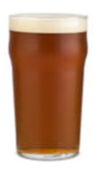
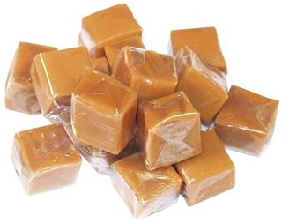
Why Use N.E.M.

Slide 19
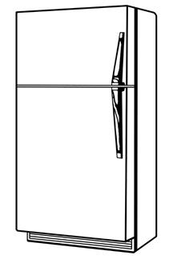

Example Brew 1
Fractionating Specialty Malt
4# Pale Ale
4# Victory
2# Caramel 80
1# Caramel 120
4 gal water

Slide 20
Example Brew 1
Fractionating Specialty Malt
Specialty Malt
Cold Water
Wort
Water &
3.5# Pale Malt
Cold Mash
8# Pale Malt
Hot Mash
Hot Mash
Lauter
Lauter
Boil
Ferment
Lauter
Boil
Ferment
Spent Grain
Pale Ale
Amber Ale

Slide 21
Example Brew 1A & 1B
Fractionating Specialty Malt
Lauter
Grain-Out

Slide 22
Example Brew 1A & 1B
Fractionating Specialty Malt

Slide 23
Example Brew 1A & 1B
Fractionating Specialty Malt
Lauter, Boil
& Ferment
Convert with Heat
Notes:
Left: Amber Ale made with wort from 11# cold steeped specialty malt and converted with 7# Brewers malt. 1.055 to 1.012, 78% apparent attenuation. Bravo 60min, Centennial 15min.
Malty, biscuit, toasty, toffee, dryer finish, tart
Full mouthfeel, thicker
Right: Pale Ale made with grain left over from 11# cold steeped specialty malt and converted with 5# Brewers malt. 1.058 to 1.011, 81% apparent attenuation. Same Hops as Amber.
Floral, slight malty, estery,
Thin, light mouthfeel,

Slide 24
Example Brew 1A & 1B
Cold Brew/NEM Amber Ale
NEM Wort: Color, Flavor, Protein
1/3 the Gravity 37 SRM
1.055 to 1.012
78% Apparent Attenuation
Malty
Biscuity
Toasty
Dry
Full Mouthfeel
Spent Grain Adjunct Pale Ale
NEM Spent Grain: Carbohydrates
2/3 the Gravity 10 SRM
1.058 to 1.011
81% Apparent Attenuation
Estery
Slight Maltiness
Floral
Thin/Light
Slightly Cloying
Same Malt, Hops, and Yeast
Notes:
Gravity From NEM, 1.014
Gravity From Re-Brew,1.041
Gravity From Sent Grain, 1.030
Gravity From Re-Brew, 1.028

Slide 25
Pilot Brew : Malt Monster
Malt Monster
Munich Malt
Cold Water
More Munich Malt
Cold Mash
Cold Mash
Wort Cold Mash
Lauter
Wort Cold Mash
Spent Grain: Waste
Lauter
Hot Convert Wort,
Boil, Ferment

Slide 26
Pilot Brew
Malt Monster
35# Munich 15°L
7gal Water 32 - 45°F

Slide 27
Pilot Brew
Malt Monster
Lauter / Sparge
3.5 gal for N.E.M.
3.5 gal for N.E.M.
Collect ~10.5 gal
3.5 gal for Sparge

Slide 28
Pilot Brew
Malt Monster
35# Munich 15°L
3.5 gal for Sparge

Slide 29

Pilot Brew
4 X Munich
Malt Monster
Lauter / Sparge
5 gal
75 SRM*
1.046 sg
*equiv. color of 1.210sg / 46P Trad. Mash
Collect 5 gal
3.5 gal for Sparge
Convert & Boil
Notes:
Heat to 144F and hold for 20 minutes, Heat to 157F and hold for 40 minutes. Starch negative before was confirmed before 157 was reached. 1.046 to 1.016 (4%ABV) a session ale.
Achieved 75 SRM with < a 12 Plato beer, would need to brew at 46 Plato or 1.210 SG to get the same color and would finish around 1.055.
Attenuation is lower because roughly a 3x concentration in unfermentable protein.

Slide 30
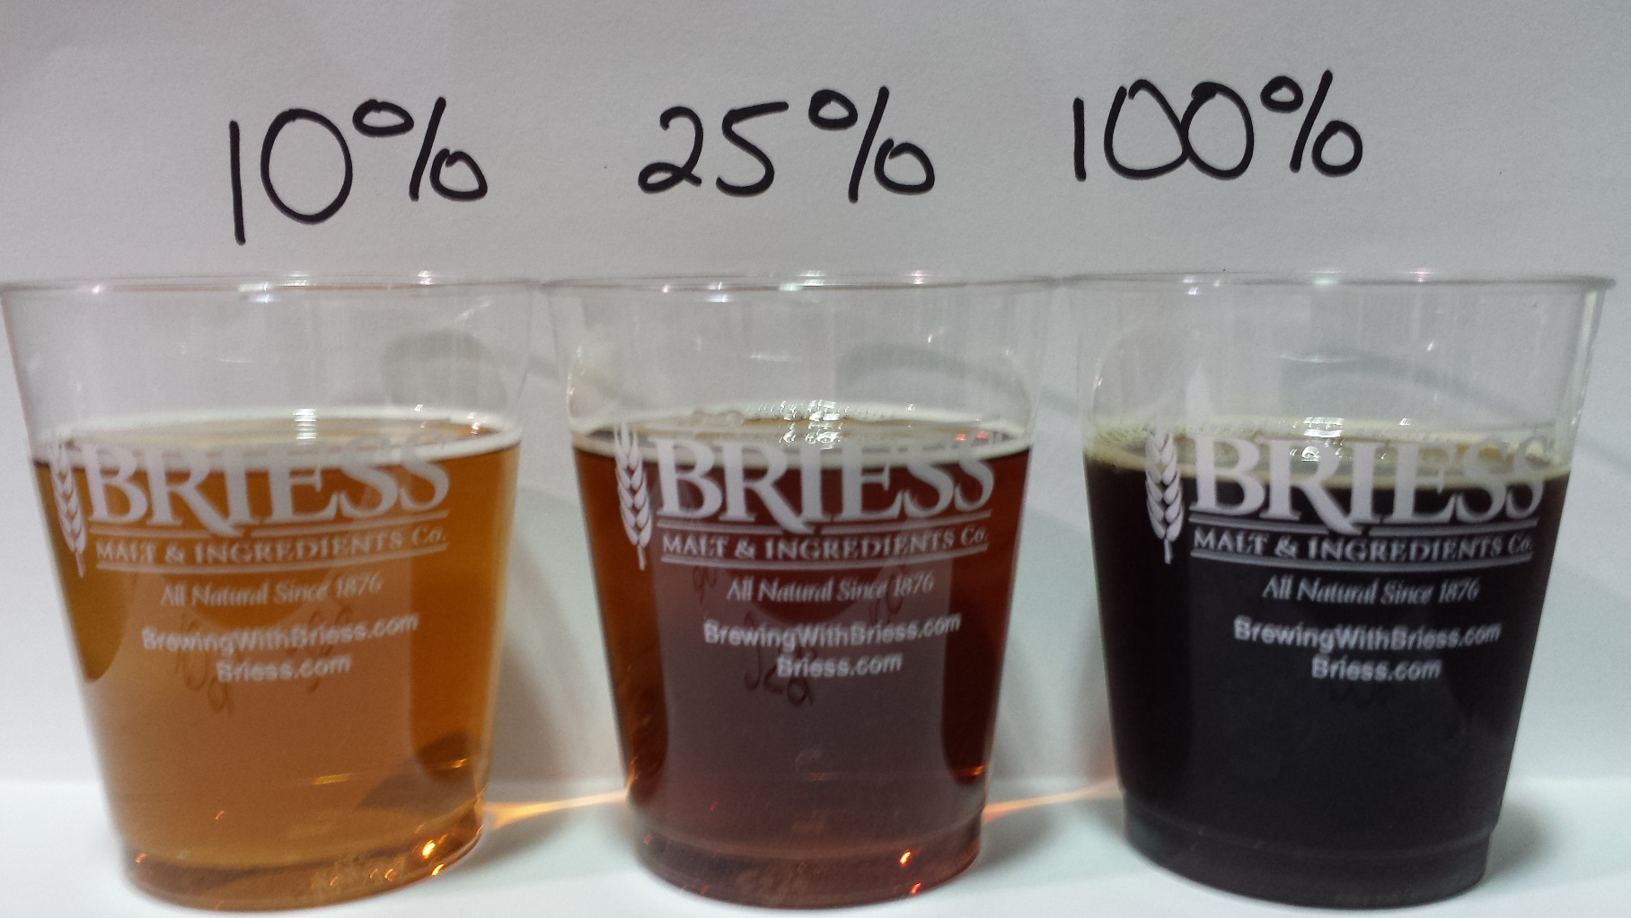
Pilot Brew
Malt Monster
75 SRM
1.046 to 1.016
4% abv “Session Beer”
65% apparent attenuation
Dark Fruit
Burnt Raisin
Lingering Maltiness
1.2 Plato 2.9 Plato 11.5 Plato
7.5 SRM 19 SRM 75 SRM

Slide 31
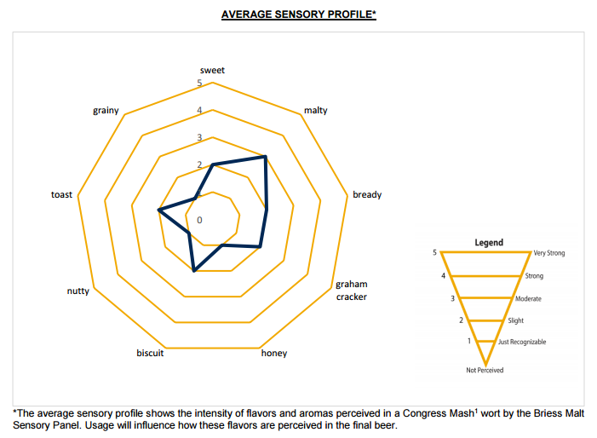
Sensory
Malt Monster
Notes:
Heat to 144F and hold for 20 minutes, Heat to 157F and hold for 40 minutes. Starch negative before was confirmed before 157 was reached. 1.046 to 1.016 (4%ABV) a session ale.
Achieved 75 SRM with < a 12 Plato beer, would need to brew at 46 Plato or 1.210 SG to get the same color and would finish around 1.055.
Attenuation is lower because roughly a 3x concentration in unfermentable protein.

Slide 32
Sensory #2
Belgian Golden Strong: all malt adjunct beer
Showcase all malt version of style
BJCP: The light color and relatively light body for a beer of this strength are the result of using Pilsner malt and up to 20% white sugar. Noble hops or Styrian Goldings are commonly used. Belgian yeast strains are used.
Only Pilsen malt used no sugar.
9 pounds of NEM (cold mash) Pilsen used.
Liquid from mash discarded saving only the mashed (spent) grain – now devoid of most protein, color and flavor. Leaving only starch!
Notes:
Heat to 144F and hold for 20 minutes, Heat to 157F and hold for 40 minutes. Starch negative before was confirmed before 157 was reached. 1.046 to 1.016 (4%ABV) a session ale.
Achieved 75 SRM with < a 12 Plato beer, would need to brew at 46 Plato or 1.210 SG to get the same color and would finish around 1.055.
Attenuation is lower because roughly a 3x concentration in unfermentable protein.

Slide 33
Sensory #2
Belgian Golden Strong
Recipe –
9 pounds Pilsen NEM mashed
8 Pilsen pounds hot mashed with spent grains from NEM mash grain.
2 ounces Perle hops
2 packs White Labs WLP570 Belgian Golden Ale.
See Blog at brewingwithbriess.com to find out more information about “Holiday Gold” Belgian Strong Ale.
Notes:
Heat to 144F and hold for 20 minutes, Heat to 157F and hold for 40 minutes. Starch negative before was confirmed before 157 was reached. 1.046 to 1.016 (4%ABV) a session ale.
Achieved 75 SRM with < a 12 Plato beer, would need to brew at 46 Plato or 1.210 SG to get the same color and would finish around 1.055.
Attenuation is lower because roughly a 3x concentration in unfermentable protein.

Slide 34
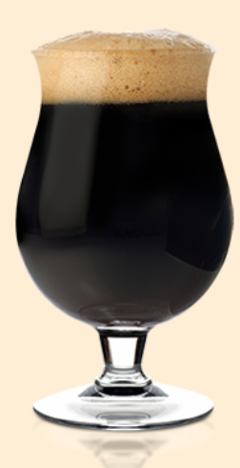
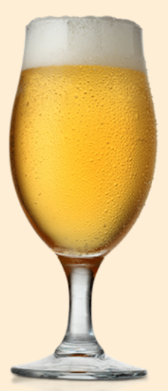
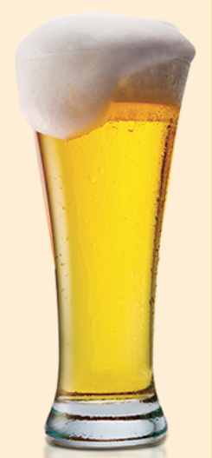
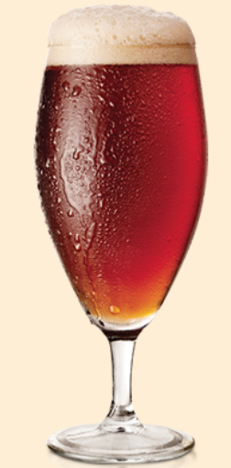
Homebrewing with NEM
Strong Ales, Dark Lagers, Big Stouts, Irish Reds…
All “Malt Adjunct” Beer (Very Light)
*Using NEM spent grain
‘Barley Adjunct’ Brews
(Your Wort is Loaded with Enzymes )
Flavorful Low Alcohol
Session Beer!
Notes:
Boost Color and Flavor in Big Beers with out the cloying & viscous effects of Dextrins & Beta Glucans
*Use NEM to make cleaner/dryer stouts, strong ales and big lagers
▪ Great foam and mouthfeel in low alcohol beer
*Make standard recipe with NEM only for ~1/4 the alcohol
▪ Concentrate enzymes for high adjunct brews
*NEM base malt to get all FAN and Foam with limited complex sugars
▪ Remove color, flavor, and FAN for an estery golden ale
*Use spent grain from NEM to make low color, estery beers
*Spent grains function as an adjunct

Slide 35
Applications
Low Alcohol / Session
Specialty Malt
Cold Water
Cold Mash
Wort:
Convert With Heat
Boil
Ferment
Lauter
Spent Grain
Waste

Slide 36
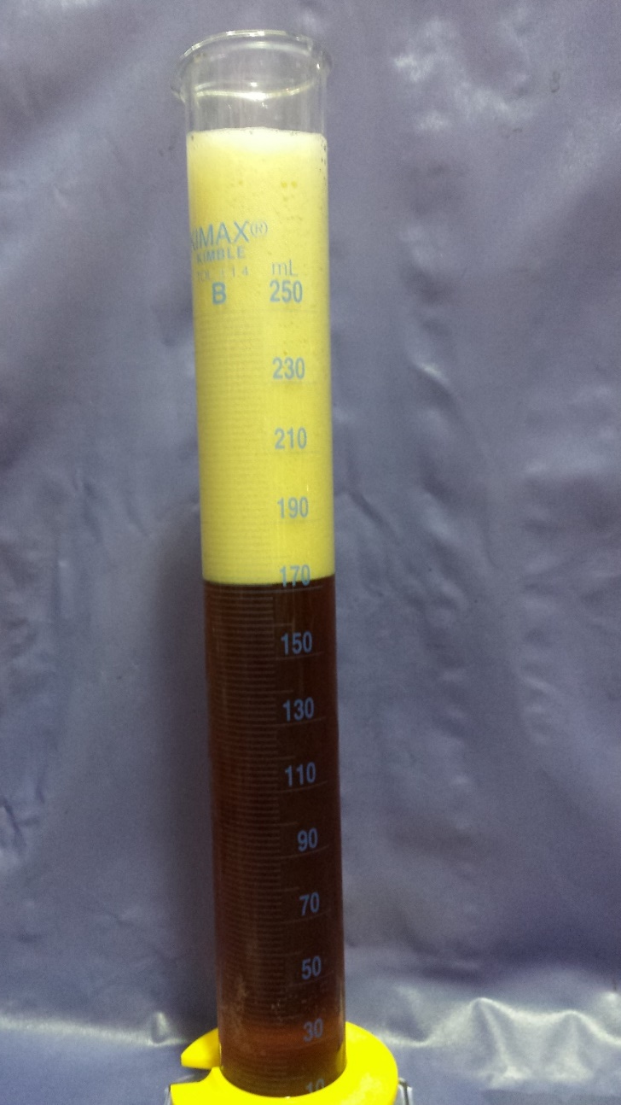
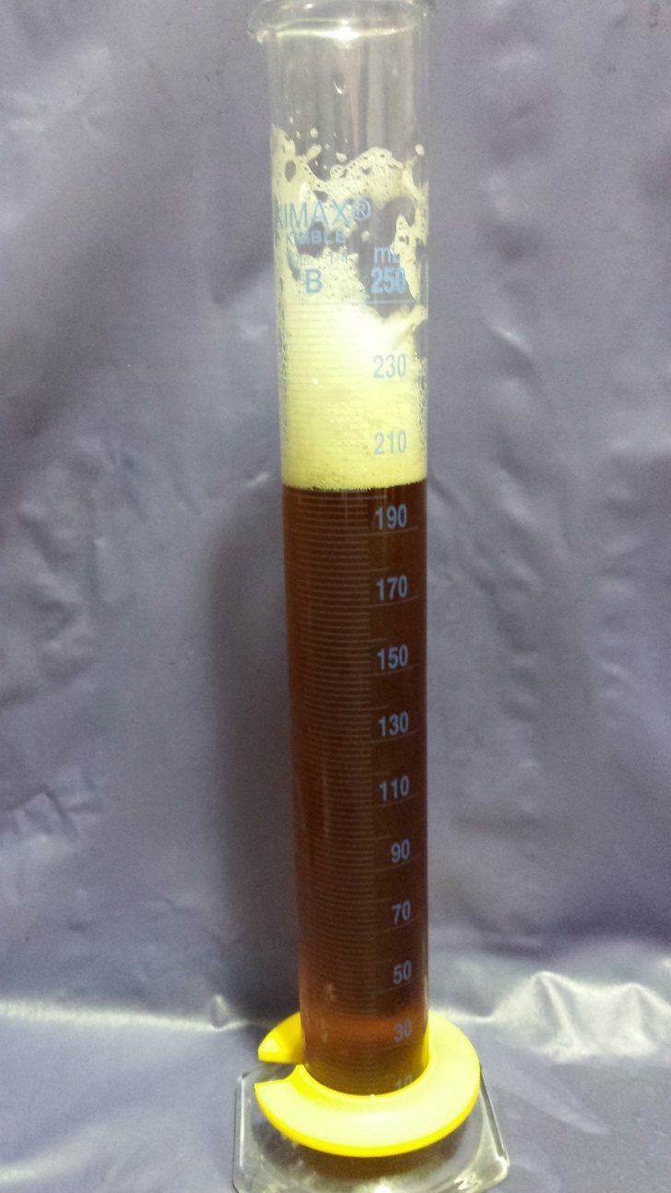
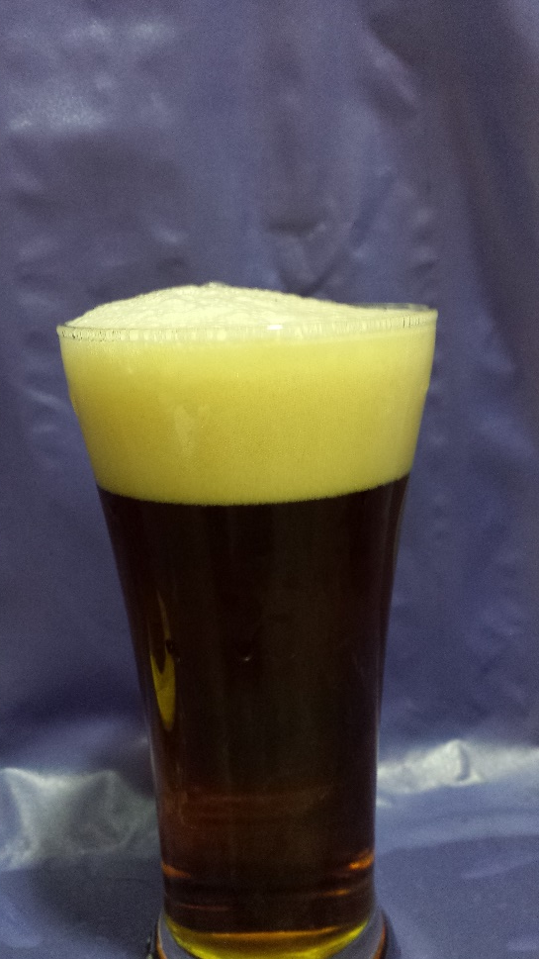
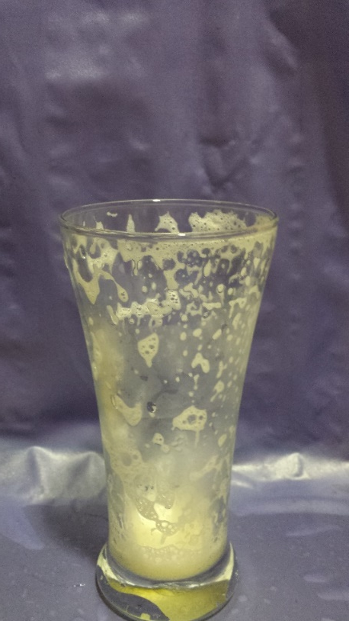
Applications of
Non Enzymatic Mashing
Head Retention at 6 minutes
Flavorful Low Alcohol / Session Beer
Traditional 1.056 Amber Ale Recipe
NEM to get 1.016 OG, 1.006 FG
1.3%ABV

Slide 37
Summary Flow Chart
Non Enzymatic Mashing Flow
Specialty Malt
Cold Water
Use as Mash Water For:
100% NEM Beer (Sessions & Malt Monsters)
Or As
Additional NEM (Cold) Mash (Big Flavor)
Cold Mash
Lauter
Spent Grain
Cold Wort
Use as an All Malt Adjunct
Convert for a Low Alcohol
Session

Slide 38
Summary in a Sentence
Non Enzymatic Mashing
impart subtle to extreme
characters
unique from
traditional mashing
Non Enzymatic Mashing
A method of brewing that can be used as a stand alone process or as a method to impart subtle to extreme specialty malt characters that are unique from the characters produced through traditional mashing.
Non Enzymatic Mashing is…
A method of brewing that can be used as a stand alone process or as a method to impart subtle to extreme specialty malt characters that are unique from the characters produced through traditional mashing.

Slide 39
Questions? aaron.hyde@briess.com 920-418-3109 (call or text)

