Slide 1
Mead: Delicious Historic Beverage or
Wretched Bee Vomit?
Tim Vandergrift
Beverage Consultant

Slide 2
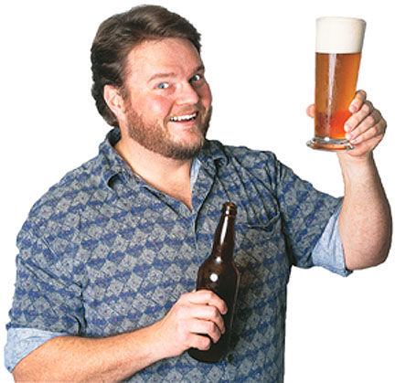
Who the Hecking Heck is Tim Vandergrift?
Home brewer for 40 years
BJCP Certified Judge 0257
Professional Winemaker
Brewing, winemaking consultant
Winexpert
Northern Brewer (BOO!)
Hates honey, thinks bees are stupid
Has judged mead for AHA nationals

Slide 3
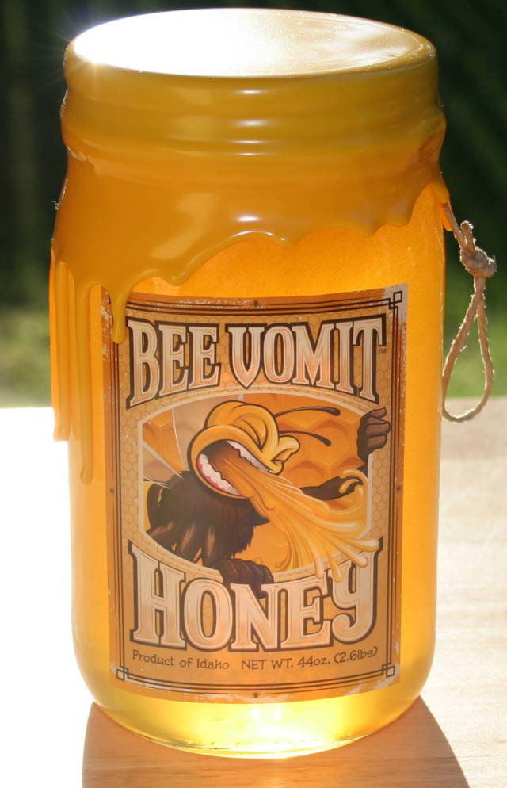
Mead & Meadmaking
Bit-O-Honey
What Is Mead?
Mead Variations
Making Mead
Resources
Questions

Slide 4
Mmm, Honey
Honey is bee vomit by most definitions.
Foraging bees collect nectar from flowers and store it in a special stomach (crop)
In the process of foraging the bees pollinate plants, including most of our food crops
The enzymes and acids in a bee’s crop break sucrose down into fructose and glucose
Back in the hive the foragers regurgitate the partially processed nectar to worker bees who are tasked with finishing the processing of it
After more processing the worker bees then regurgitate the nectar into the hive and flap their wings on it to remove the moisture and make what we know as honey

Slide 5

Bees are Communists
In order to produce 1 pound of honey, 2 million flowers must be visited. A hive of bees must fly 55,000 miles to produce a pound of honey. One bee colony can produce 60 to 100 pounds of honey per year. An average worker bee makes only about 1/12 teaspoon of honey in its lifetime.

Slide 6
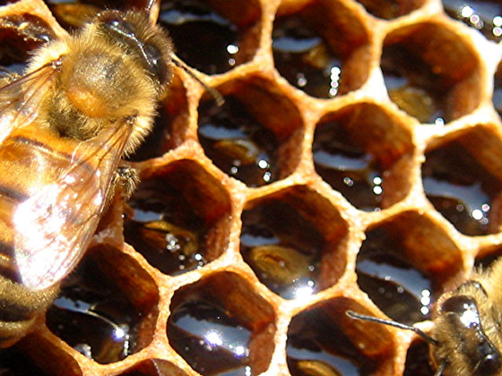

Slide 7
The Sweet Science Of Honey
Honey is anti-microbial due to an enzyme involved in its production that results in small amounts of hydrogen peroxide in the finished honey
Honey is hygroscopic, which means it absorbs moisture from its environment
Honey contains small amounts of electrolytes and is mildly electrically conductive
Honey typically has a low pH (~ 3.9)
Honey can be stored for decades, even centuries when kept cool and dry
Honey contains botrycin
Honey actually does not spoil when stored properly
There is an African bee that makes honey out of blood

Slide 8
Not All Honeys Are The Same
The types of flowers bees acquire nectar from greatly influences the end result including:
  Color
  Sugar content
  Flavors & Aromas
The most common types of honeys are clover and wildflower. The sources for these honeys are varied and are not discretely tracked
Specific types of honeys are called “varietal” like wine and grapes. Examples are:
  Orange blossom
  Tupelo
  Fireweed
  Blueberry
  Sagebrush

Slide 9
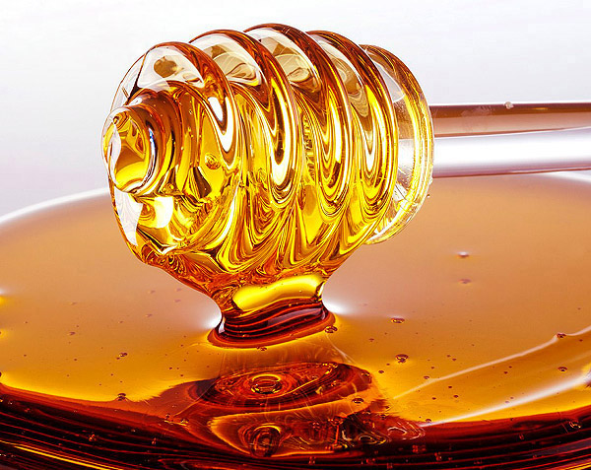

Slide 10
Mead
Mead is fermented honey
Mead is an old beverage. Archaeometric evidence suggests that the earliest fermented beverages, included honey as well as fruits and grains
Patrick McGovern, an archeochemist, and Sam Calgione from Dogfish Head Brewery recreated one such beverage based on evidence from 9000 year old pottery fragments found in the Jihau region of China.
Mead in its most basic form contains honey diluted with water, and yeast

Slide 11
Mead and Honey Folklore
Because mead is old beverage there is plenty of folklore about it
Quite a few early cultures have words for fermented honey beverages from which the word mead is derived
Beowulf is an example of a folktale in which mead and the mead hall (gathering place) is prominently featured.
Authors such as Tolkein, George R. R. Martin and Neil Gaiman have included it in their writings
Honeymoon describes a gift of mead that newlyweds were given. It was believed their consumption of it over the following month would increase fertility and happiness
A gift of mead has long been considered a cherished act because honey is traditionally expensive and mead is revered as a gift from the gods
Renn Faire . . .

Slide 12
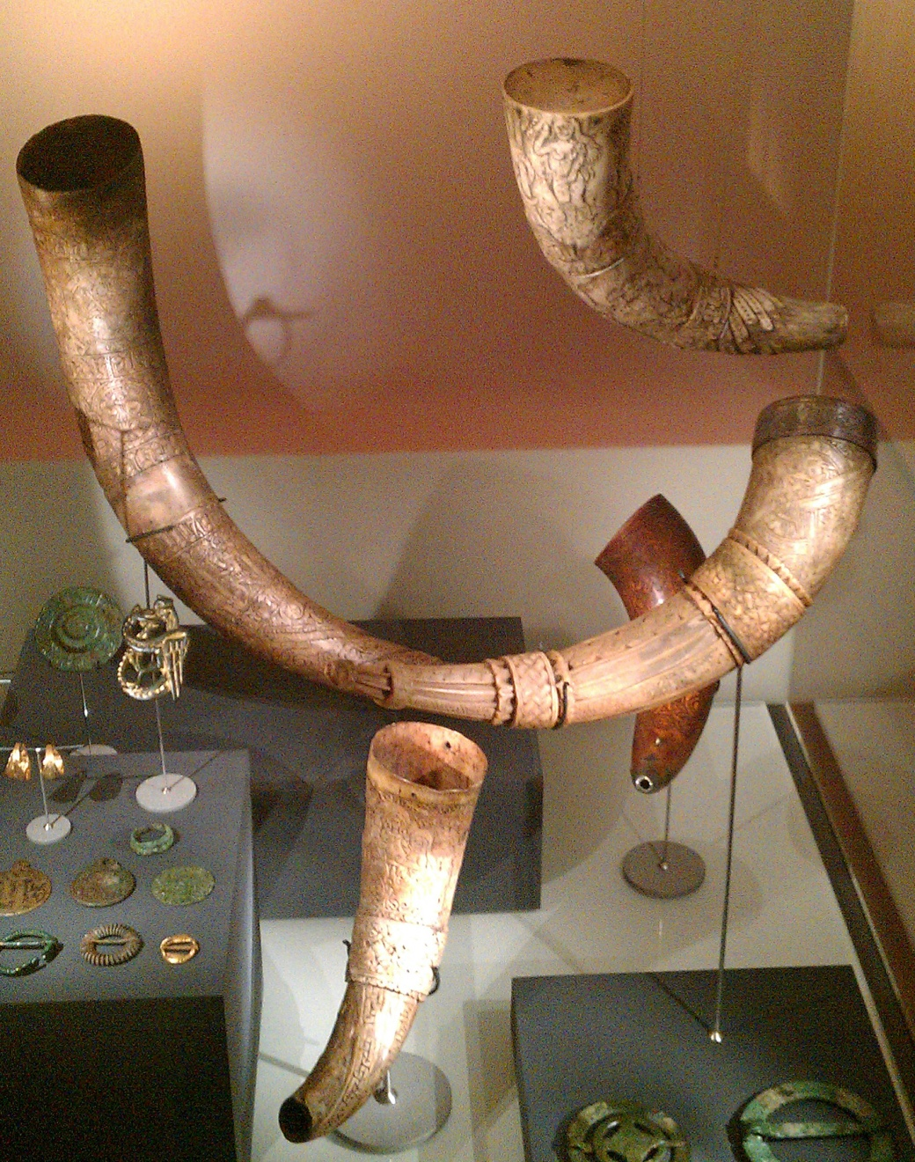


Slide 13
Mead Variations
Mead can be dry, semi-sweet or sweet and will also vary in alcoholic strength from hydromel to standard to sack
Meads made with other ingredients have specific names:
  Melomel (fruit, except apple)
  Cyser (apple)
  Methleglin (herbs and spices)
  Capsumel (chili pepper)
  Acerglyn (maple sap/syrup)
Combinations of styles are quite common. Think of melomel with chilies or a cyser with cinnamon

Slide 14
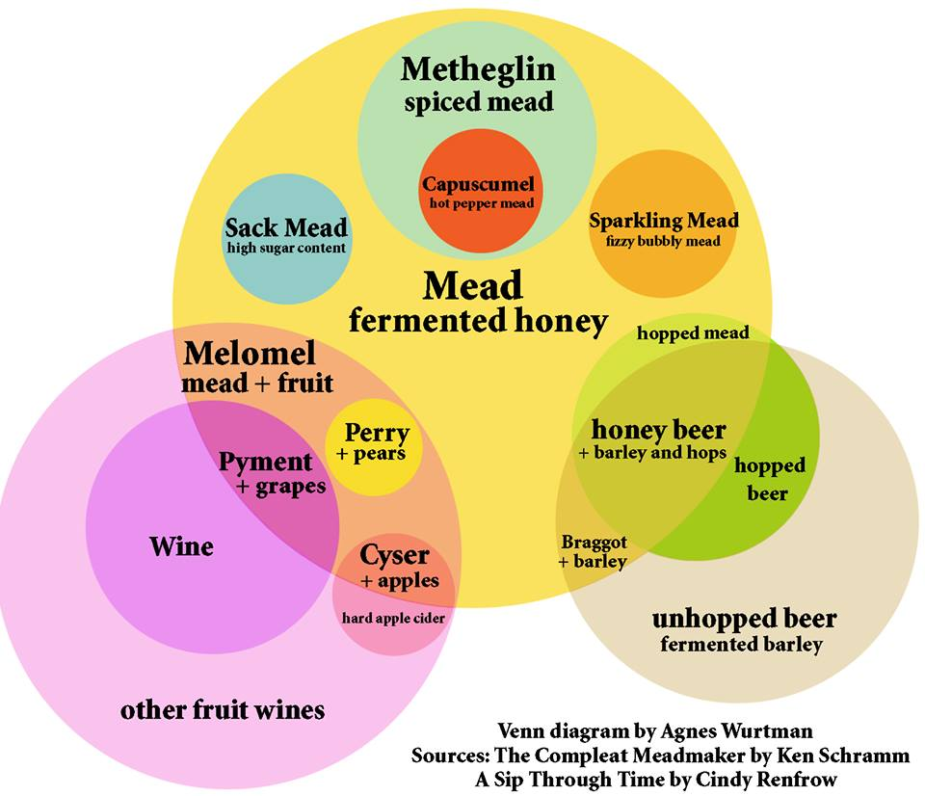

Slide 15
Making Mead
I’m not a commercial producer of mead
I don’t eat honey (bee puke)
Mead is dead simple to make . . . badly.
Don’t make mead like a brewer
Make mead like a winemaker
Primary conditions, fermentation, clearing finishing
Serendipity versus control versus finishing

Slide 16
Getting Started
To start you will need honey, water, yeast and nutrient
Food grade bucket and a big spoon
The most important principle is sanitation. Everything that touches your mead must be clean/sanitized
Use PBW and StarSan, two very common cleaning agents in home-brewing
You start by mixing the honey with a small amount of hot water to help liquefy it further.
The act of mixing also aerates the mead.
Oxygen = increased yeast activity

Slide 17
How Much and How Do I Know?
Sack/strong mead finishing a bit sweet use a 2:1 water to honey ratio
4 pounds of honey and 2/3 of a gallon of water to 1 gallon of target volume
If you are making a fruit mead (melomel or pyment) some of the volume will come from the fruit. Do the math
Use a hydrometer.
Use yeast and yeast nutrient
Mead made to this strength has an original gravity of about 1.140
It usually tastes like butt
Seriously. Butt. How can you drink this crap?

Slide 18
I Have Trillions of Friends
Who are they? Yeast cells of course! And we have a very close relationship
Some of these friends have names like 71B-1122, EC-1118 and D-47 (these are not the droids you are looking for)
Feeding yeast so they have a healthy environment to do what they were bred for is very important
Honey does not contain the quantity and types of nutrients yeast need that are commonly found in beer wort
When making mead, yeast nutrient additions several times during the fermentation is essential for healthy and productive outcomes
Skip this, stuck mead, bee puke taste.

Slide 19
What Next?
One you add the yeast nutrient and pitch your yeast the bucket needs to be closed up and fitted with an airlock (rarely needs blowoff)
Three phase life cycle
Lag influenced by temperature, sugar content and the amount of yeast pitched

Slide 20
Great Expectations
A sack strength mead has lots of sugar and the yeast will take some time to consume all of it
The lower the temperature (but not too low to kill the yeast) the longer it will take to ferment
At 60-65 F sack strength meads take at least 30 days to fully ferment
Fermentation will initially be quite vigorous and then will taper off, slowly subsiding as the sugars are consumed and the alcohol level rises to the point it is toxic to the yeast.
This is why you need repeated nutrient additions
Got a stir plate?

Slide 21
When Can I Drink It?
Once the fermentation is complete you will have a cloudy mead that will need some time to settle or fall clear
Use a fining agent
Post-clarification add spices and adjuncts: vanilla, orange peel, oak chips, etc
Traditional mead needs time to mellow because, butt.

Slide 22
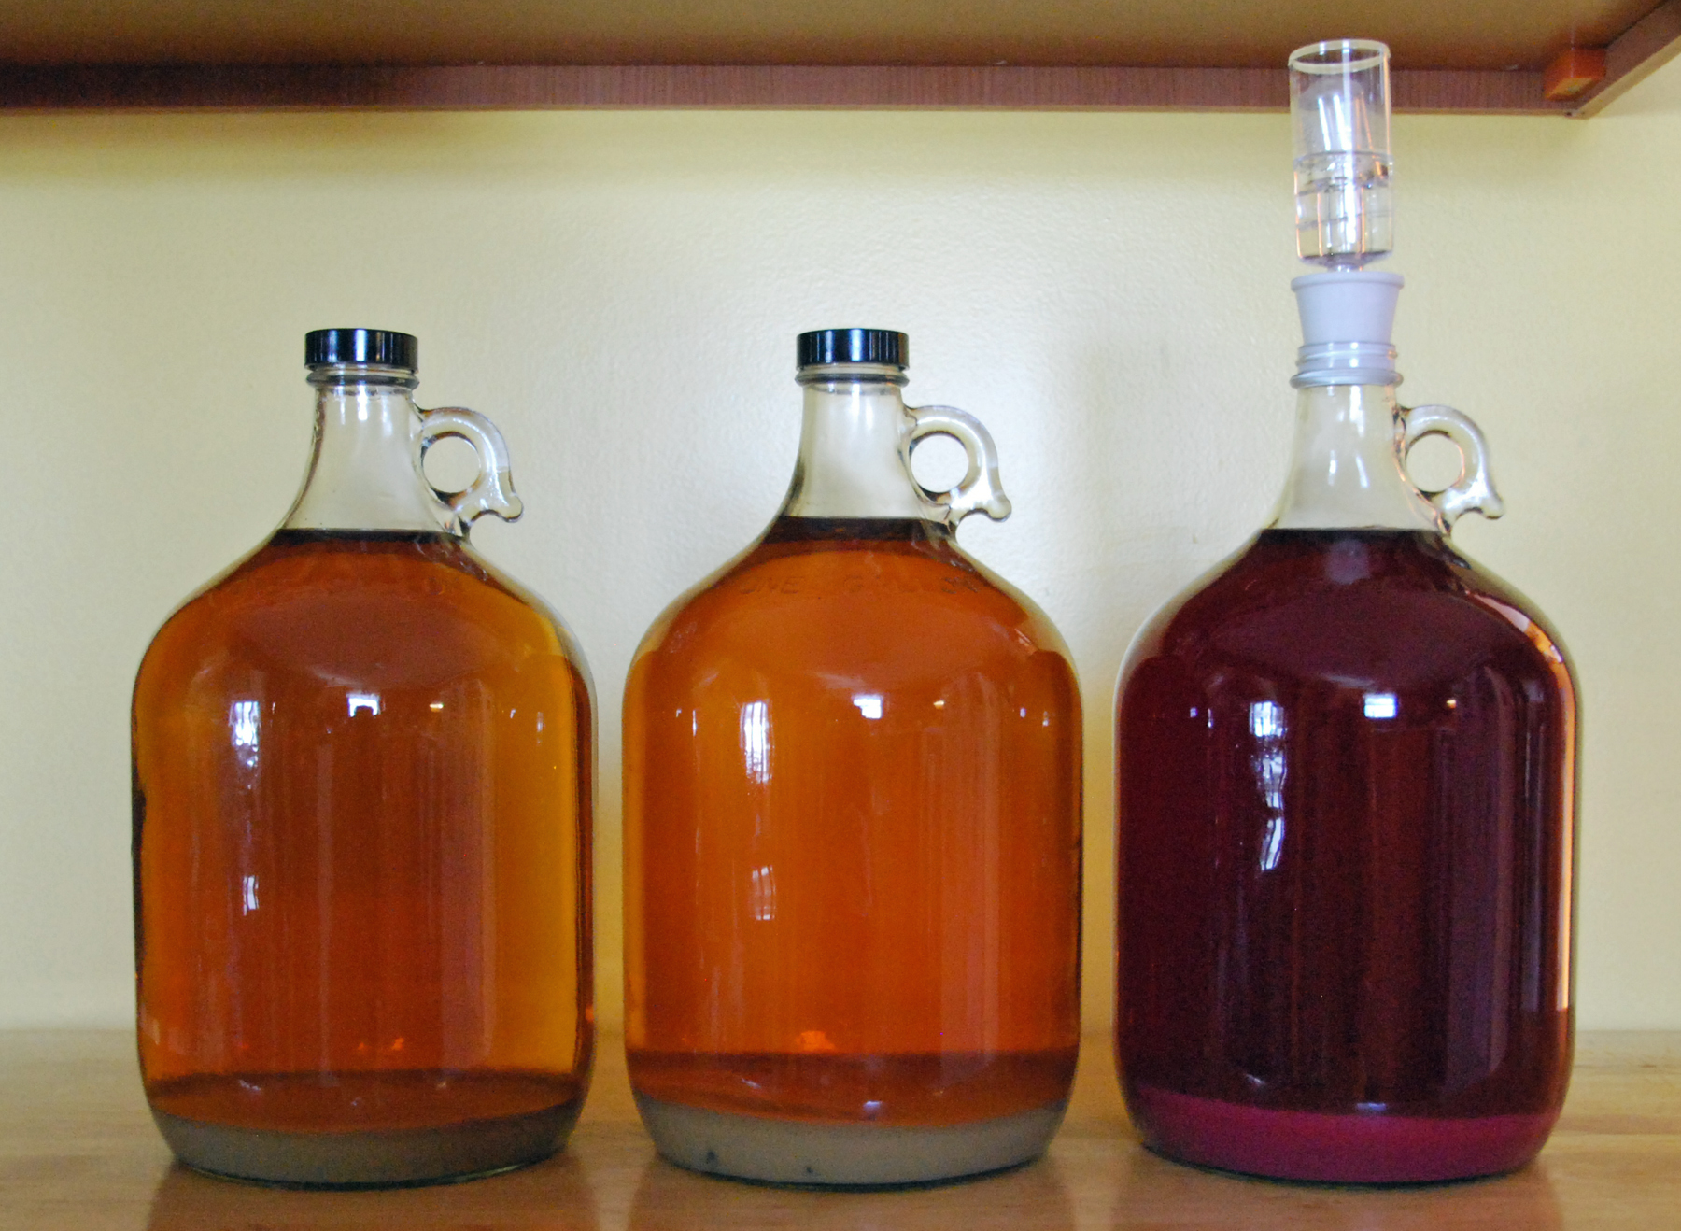

Slide 23
Clearing and Aging
At this stage you will want to allow your mead to clear
When making mead at home you also need to consider how you will stabilize it
Most home mead makers don’t use a sterile filtration apparatus which both clarifies and sterilizes beverages
This is a shame. They’re stupid. If you’re making mead, get a filter.
Two additives are used to prevent ongoing fermentation, potassium metbisulfite and potassium sorbate
The sulfite is an anti-microbial/anti-oxidant.
Sorbate is birth control for yeast
Sulfite is good for you.
Human beings CAN NOT BE ALLERGIC TO SULFITE. IT DON’T HAPPEN. BET YOU A DOLLAR.
Don’t want to use sulfite? Your mead will taste like butt.

Slide 24
Finishing Your Mead
Once you have a clear and stable mead the best way to preserve it for future enjoyment is to bottle it
Or keg it. Kegs are way better than bottles at preserving fermented beverages. Bottling sucks.
Store finished mead in a cool, dark place
Well made mead will age for many years!
Because most of them taste like butt forever.
Eventually they lose most of their character (butt) and you can choke them down without gagging.
Well-made and finished meads can be drank in a few weeks.

Slide 25
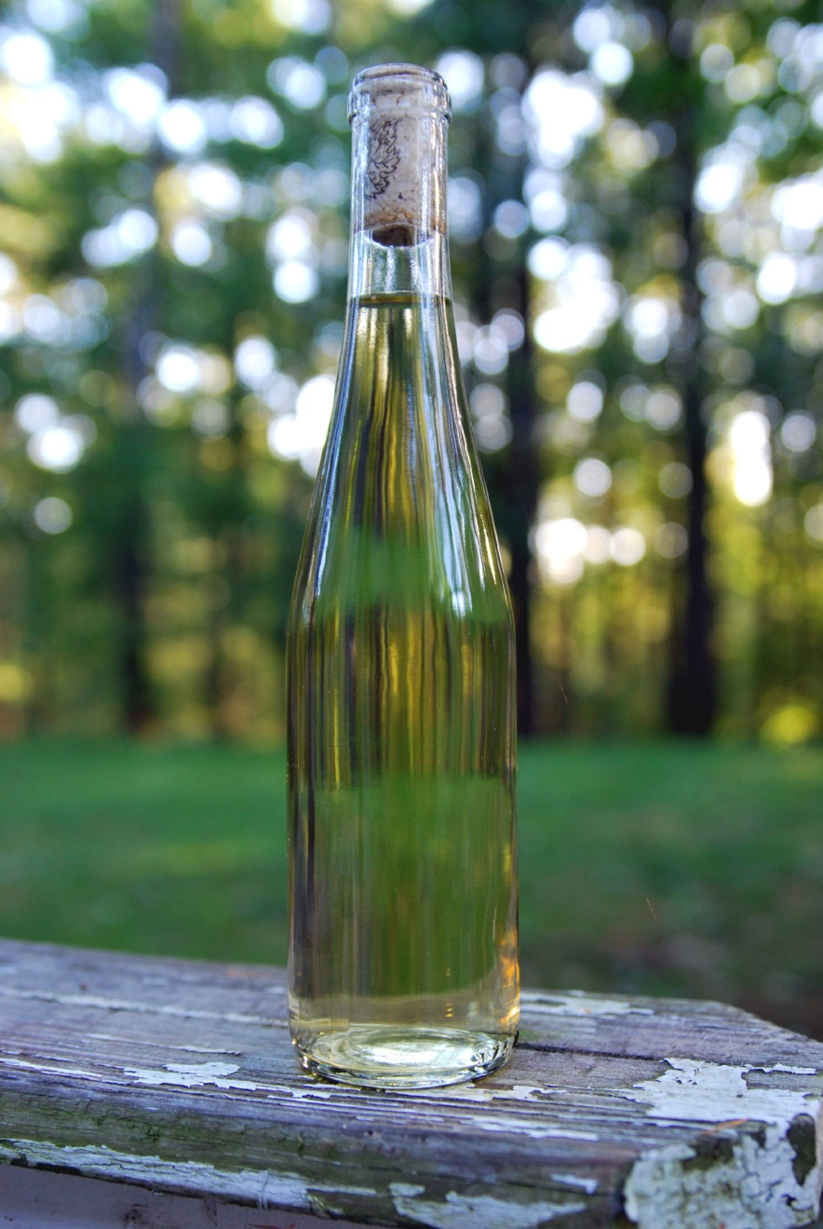

Slide 26
Drink some mead
Rhubarb-Strawberry-Raspberry Ginger mead
Sack mead (butt)
Jason’s mead
Marionberry/Blackberry
Thistle
Chili pepper

Slide 27
Resources & Information
E-mail jasonphelps@yahoo.com .Dude is a mead genius—this is his Powerpoint, except where I say mead tastes like butt.
The Compleat Meadmaker by Ken Schramm – this is “the book” on meadmaking. (http://www.amazon.com/The-Compleat-Meadmaker-Production-Award-winning/dp/0937381802)
GotMead.com – varied resources including forums where you can get advice and ideas
BJCP.org – resources on mead styles specifically for competition considerations
The Mazer Cup – a mead only competition (http://www.mazercup.com/)

Slide 28
Questions?

