Slide 1
Greetings From Haas Innovations Brewing LLC.
March 18th, 2016
Jeff Barnes
© John I. Haas, Inc. All rights reserved. Proprietary and confidential.

Slide 2
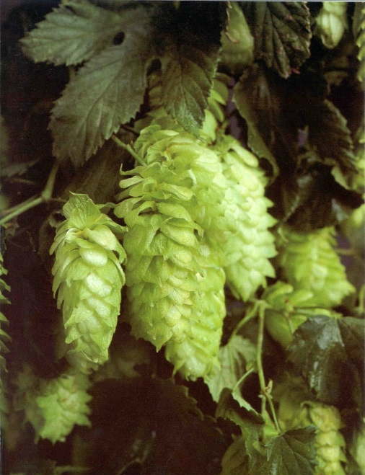
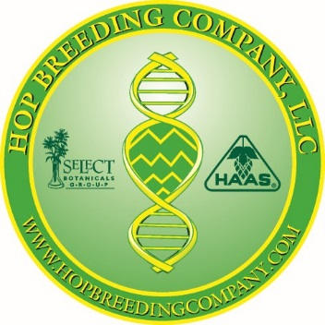
R Review of Plant Breeding and Variety Development of Hops
From Field to Brew:

Slide 3

Hop Breeding Company LLC (HBC)
Joint venture between the hop breeding programs of John I. Haas, Inc. and Select Botanicals Group, LLC (formerly Yakima Chief Ranches).
Formed in 2002 with the goal of producing superior hop varieties with maximum efficiency through: consolidation of efforts and resources, elimination of redundancy, and sharing of knowledge and innovation.
This pairing of two premier breeding programs combines over 40 years of breeding experience.
Focus is the development of premium hop varieties for all segments of the brewing industry, as well as, customized contract breeding for companies with specific needs.
Notes:
3

Slide 4


Hop Variety Development
Early in hops usage in brewing, it was recognized that hops provided a number of beneficial functionalities in beer.
Aroma characteristics
Bitterness
Foam enhancement
Microbiological stability
Hops were probably initially selected for their aroma characteristics without regard to bitterness, i.e. all hops were aroma hops.
Brewing knowledge and the application of hops has progressively advanced over time. Hops being selected for their brewing purpose; bitter, aroma and flavor.

Slide 5
Female Flowers

Slide 6
Female Flowers

Slide 7
Male Flowers

Slide 8
Male Flowers

Slide 9
Breeding Objectives
Disease tolerance
Yield
Alpha-acids
Beta-acids
Cohumulone
Storage of Alpha-acids
Total oil
Aroma
Beer Flavor
Harvest Maturity

Slide 10

Selection of Parents
Determine Breeding Objectives: Male and female parents are selected based on desired traits and pedigree diversity. Analyze characteristics of both lineages. Establish heterotic groups and patterns of heritability.

Slide 11
Pollen Collection
Male flowers collected and allowed to dry. Pollen settles to bottom of bag where it is collected and stored in vials.

Slide 12
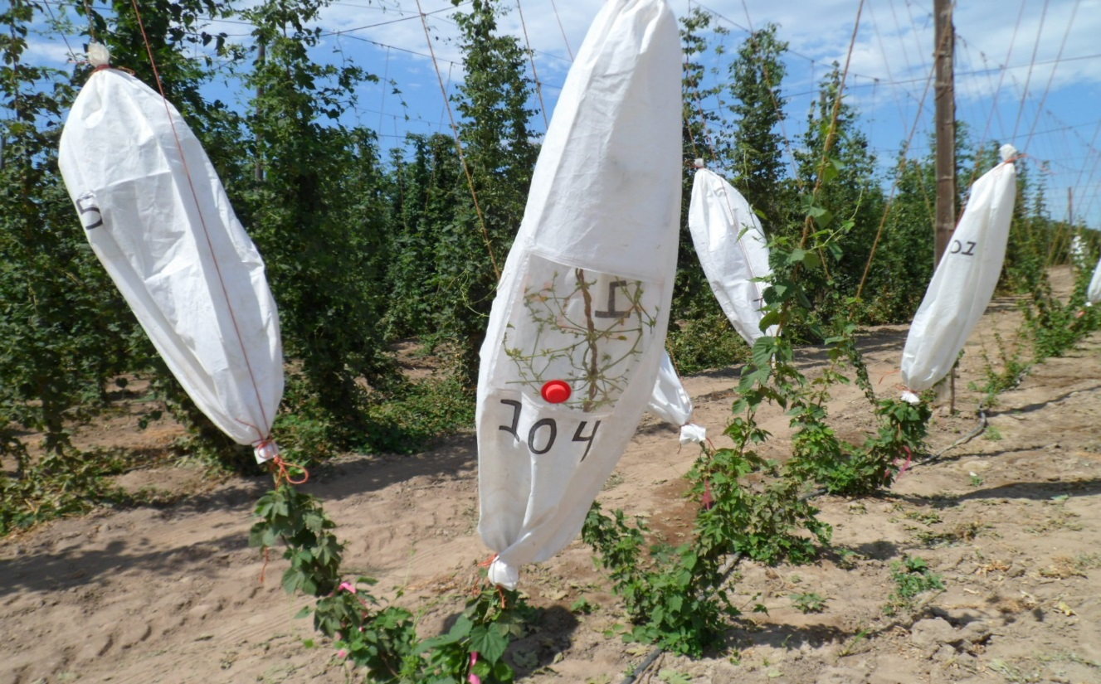
Females Ready for Pollination

Slide 13
Cone Bracteole and Seed

Slide 14
Collecting Seeded Hop Cones

Slide 15
Hop Seeds

Slide 16
Stratification of Hop Seeds
GERMINATED SEEDS
After harvest, hop seeds are dormant and remain so
until they have been subjected to a cold and wet treatment for six weeks,
only then will they germinate.

Slide 17
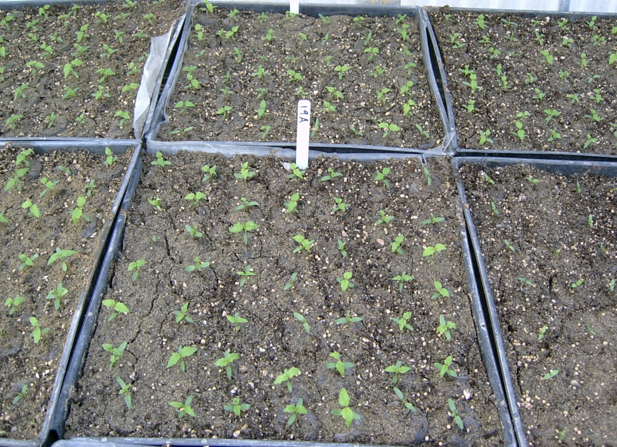
Seedlings in Greenhouse

Slide 18
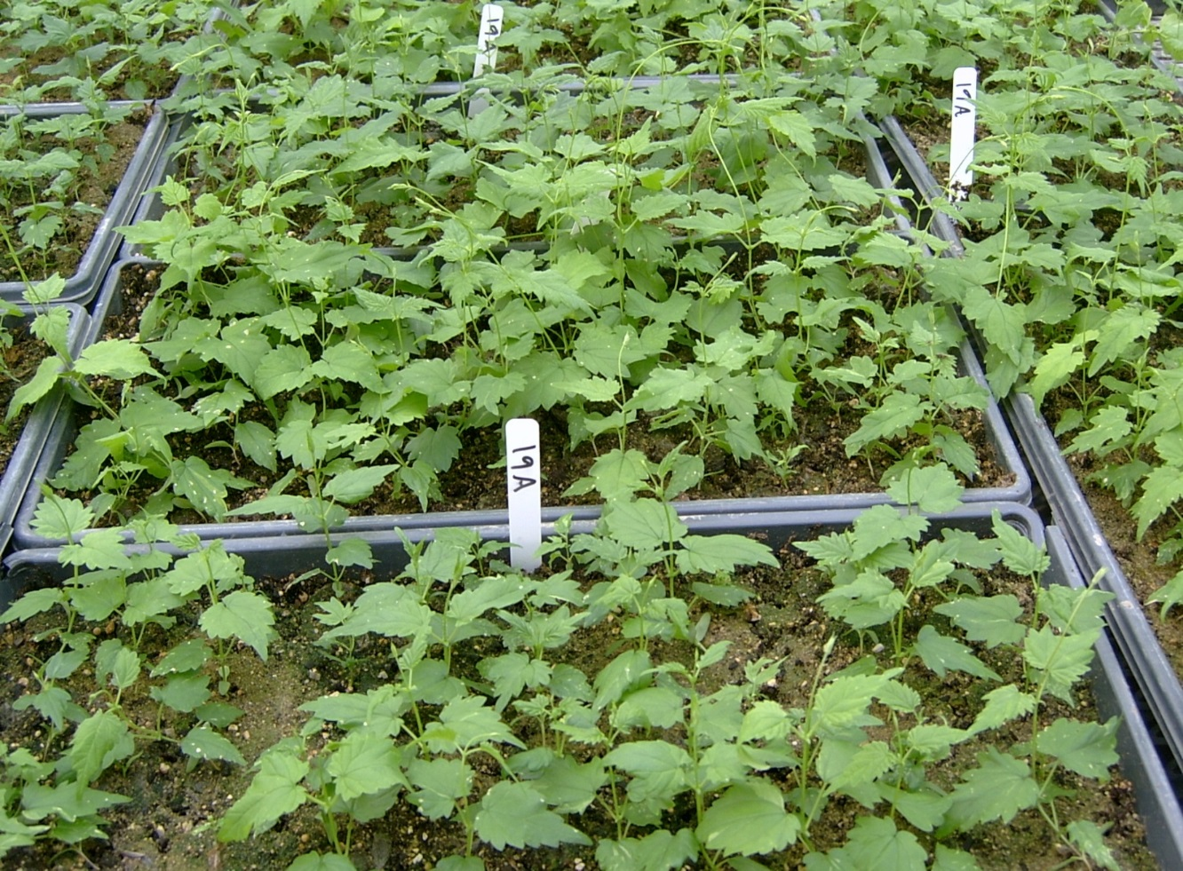
Screening for Hop Powdery Mildew

Slide 19
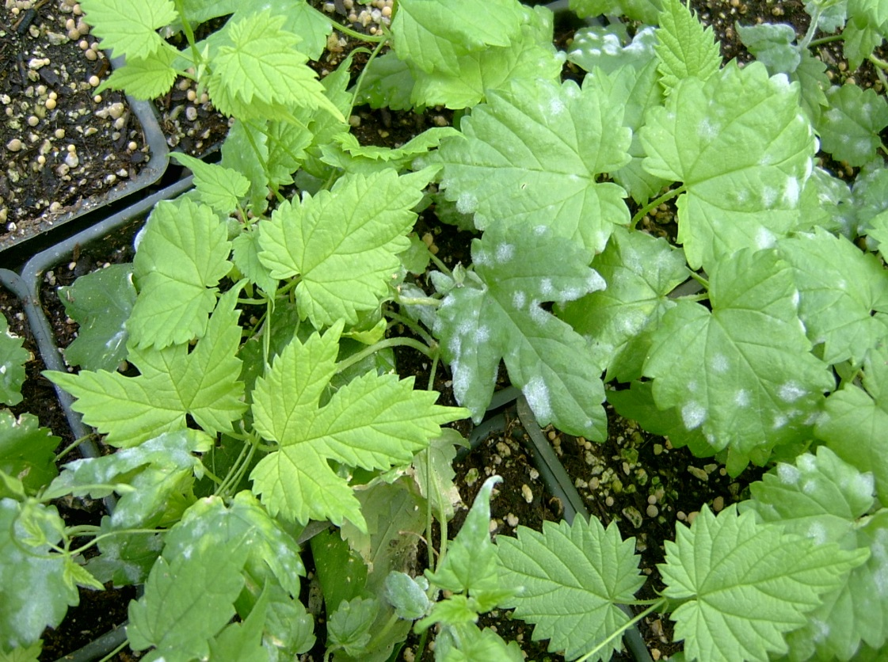
HPM Resistant and Sensitive

Slide 20
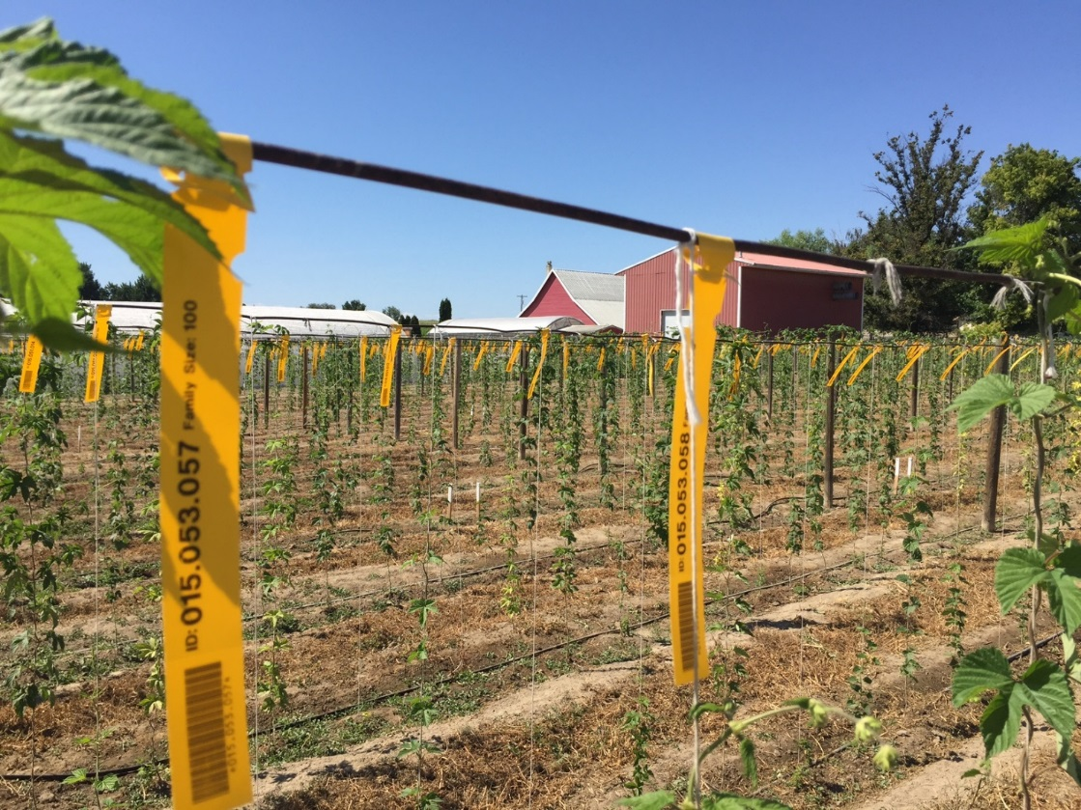
Hop Seedlings on High Density Short Trellis
Evaluation of Many Seedling Genotypes as Single Plants for One Year on Low Trellis and Three Years on High Trellis

Slide 21
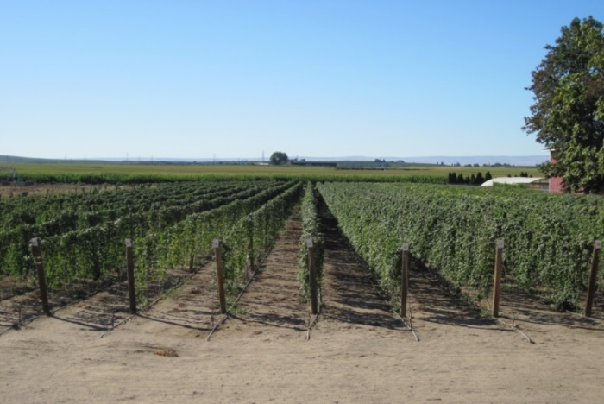
HBC Typical Year
Typically evaluating 35,000 genotypes in any given year
50 crosses (families)
25,000 genotypes screened for HPM
10,000 genotypes planted to the field
3,000 genotypes on tall trellis for year 1
3,000 genotypes on tall trellis for year 2
3,000 genotypes on tall trellis for year 3
30-40 genotypes advanced to advanced plots (7-30 plants)
0 – 5 genotypes selected for elite plots (1 acre)
Notes:
21

Slide 22
Time Frame for New Variety Development
Year 1 Cross pollination
Year 2 Short trellis
Years 3-5 Evaluation of single plants
Years 6-8 Multiple plant trial (growing/brewing)
Years 9-11 One-acre trial (growing/brewing)
Years 12-14 20+ acre trial (growing/brewing)
Year 15 Commercial acreage expansion

Slide 23
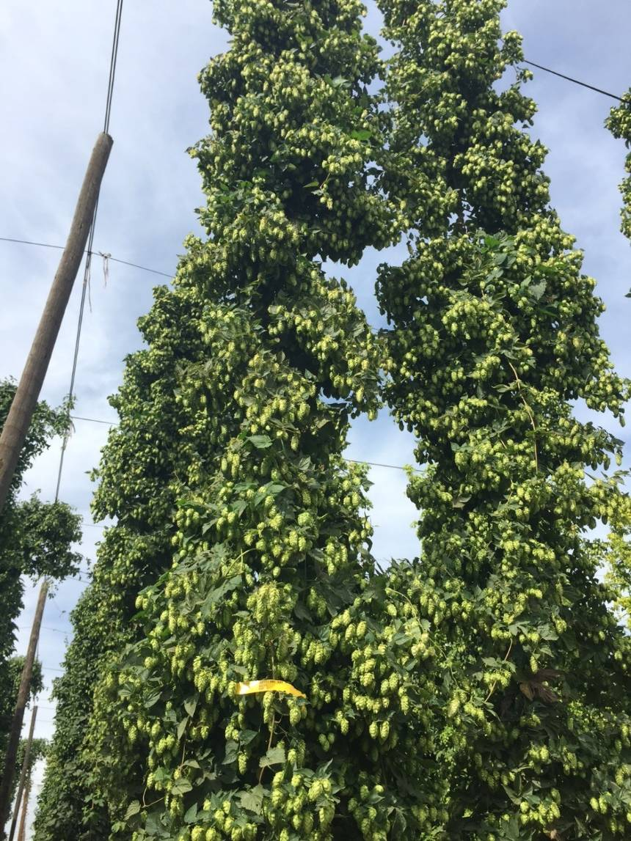
Field Selection: Observation/Phenotyping
Plant Vigor and General Fitness
Cone Density
Internode Distance
Lateral Morphology
% of flowering lateral bud break
Leaf Morphology (Leaf/Cone Ratio)
Diameter of Bine
Aroma

Slide 24
Objective Traits of Importance and Observed Value Range
Alpha Acids 0.1 – 22.0 %
Beta Acids 1.9 – 17.0 %
Cohumulone 11.0 – 57.0 %
Total Oils 0.1 – 4.0 %
Storage Stability (loss) 10.0 – 60.0 %
Yield (lbs/acre) 200 – 4000

Slide 25
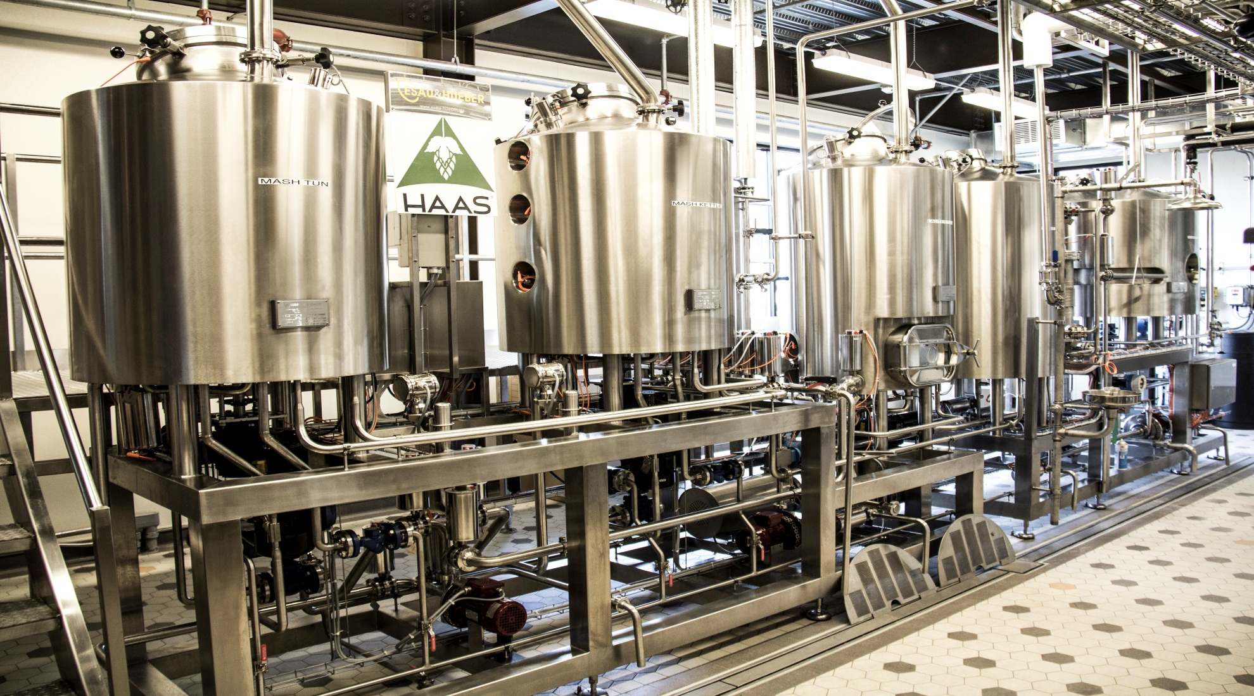
BrewHouse

Slide 26
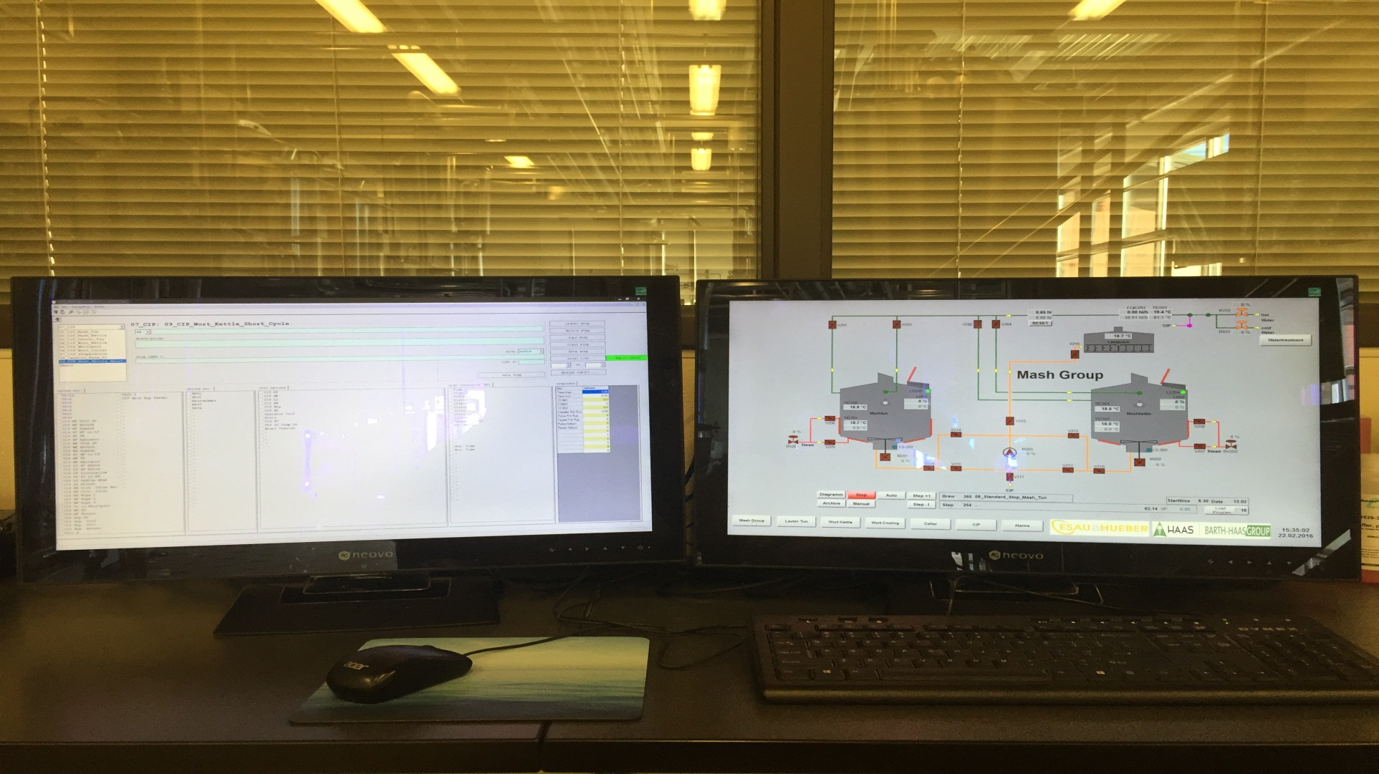
Winbrew

Slide 27
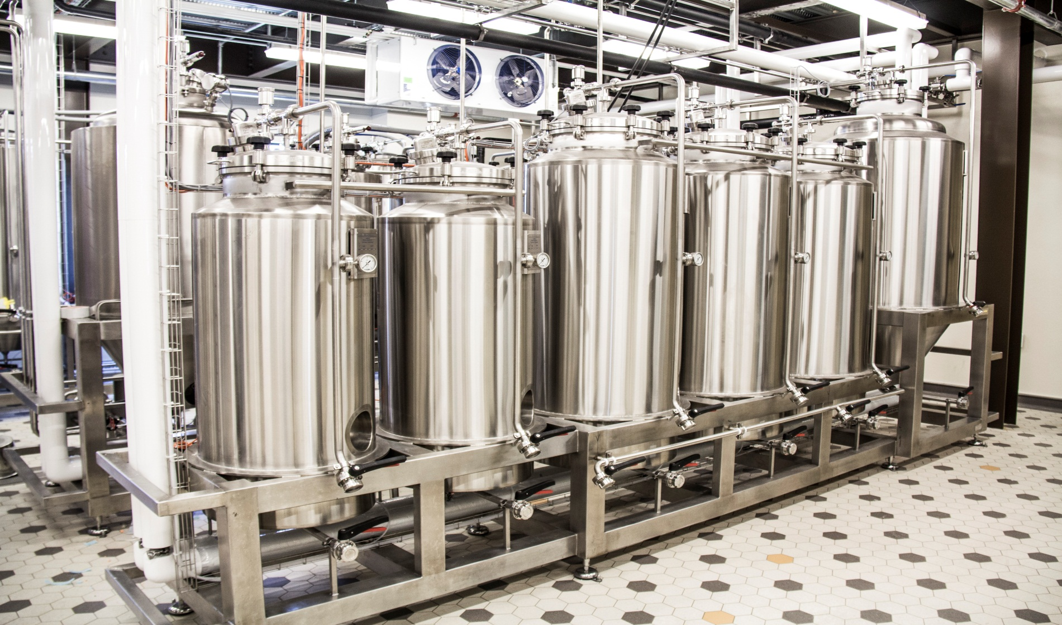
Cellar

Slide 28
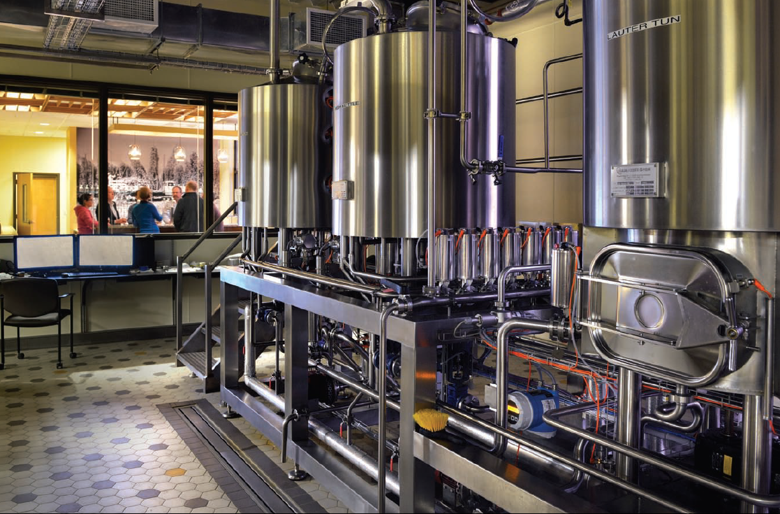
Tap Room

Slide 29
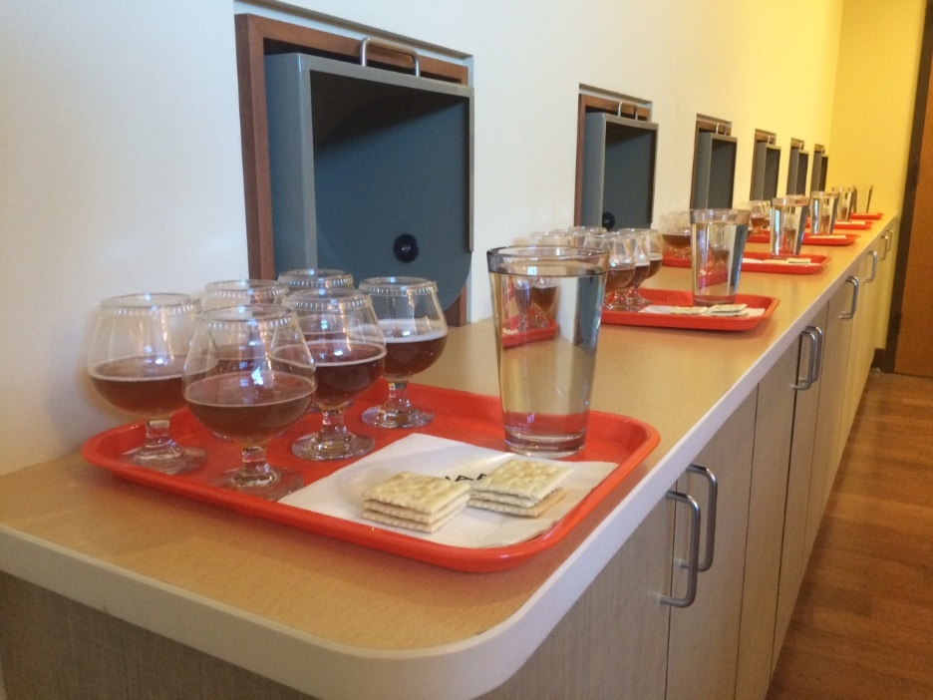
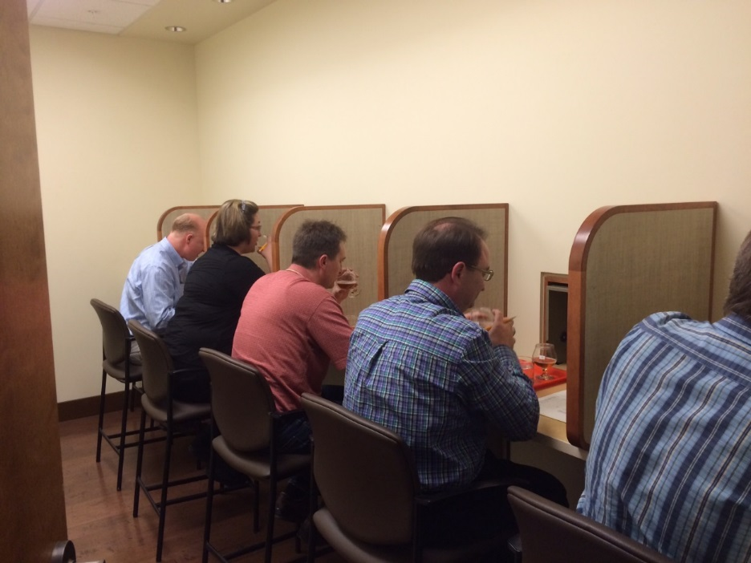
Sensory Panel: Blind Evaluation

Slide 30
Brewer Driven Operation
Brewer feedback and involvement is an absolute!
Development of New and Novel Hop Derived Flavors
Improve efficiency of traditional hop flavor profiles
Improve production efficiency of hop resins
Brewer demand drives every part of the process!!!

Slide 31
HBC Cultivars and New Varieties
I. D. | Acres 2015 2016 |  | Production (lbs) 2015 2016 |  | Alpha (%) | Beer Flavor Descriptors
Citra® | 3,055 | 4,740 | 4,490,000 | 6,900,000 | 11 – 13 | strong citrus
Mosaic® | 1,769 | 2,742 | 3,636,400 | 5,600,000 | 10 – 12 | citrus/tropical fruit
Ekuanot™ | 390 | 1,038 | 780,000 | 1,700,000 | 13 – 15 | spice/tropical fruit
Loral™ | 58 | 197 | 69,000 | 298,000 | 10 – 12 | floral/fruit/citrus
431 | 30 | 45 | 50,000 | 80,000 | 14 – 16 | herbal/fruity/earthy
438 | 0 | 1 | 0 | 2000 | 15-16 | Trop fruit/wood/U
472 | 10 | 24 | 11,500 | 31,000 | 10 – 12 | bourbon/coconut/U
682 | 72 | 288 | 141,000 | 454,000 | 18 – 20 | earthy

Slide 32
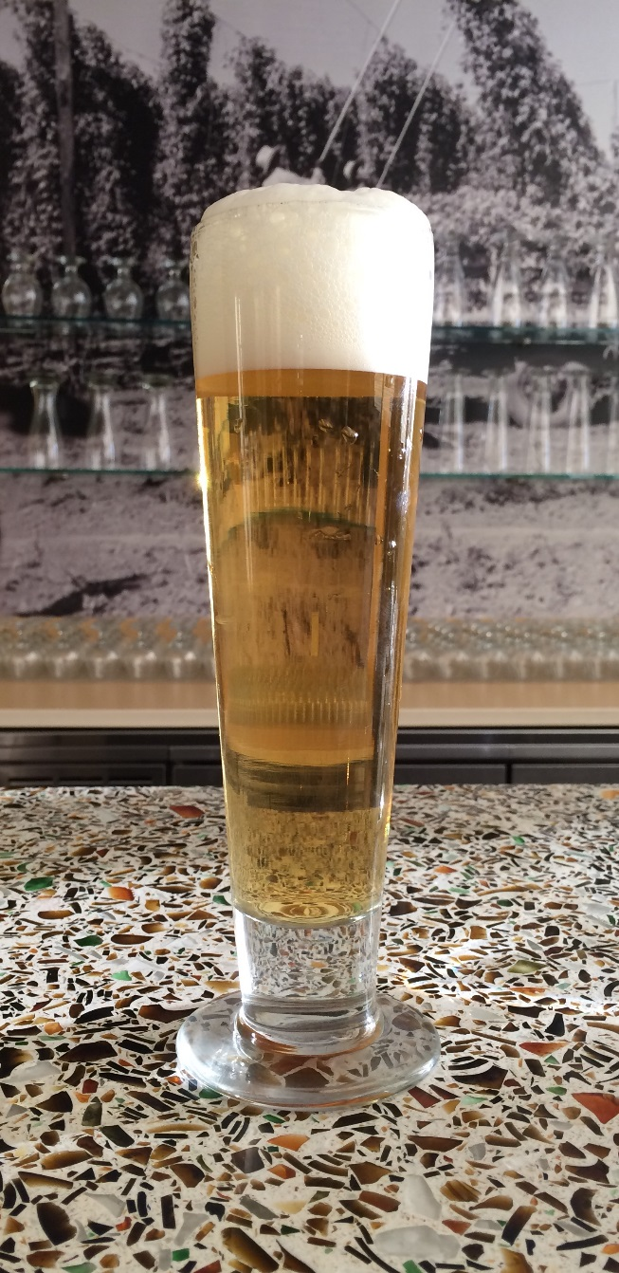
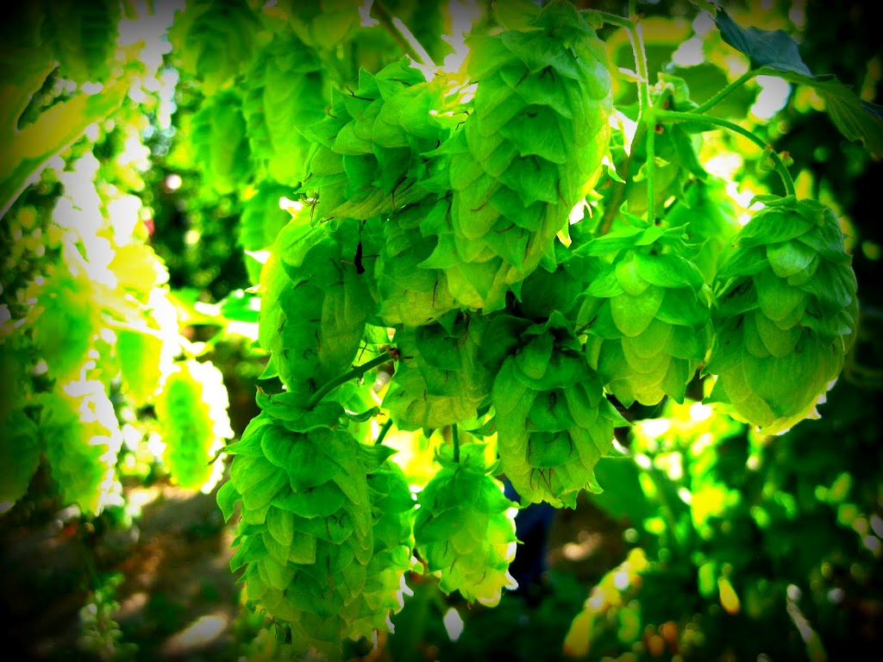
Questions

Slide 33
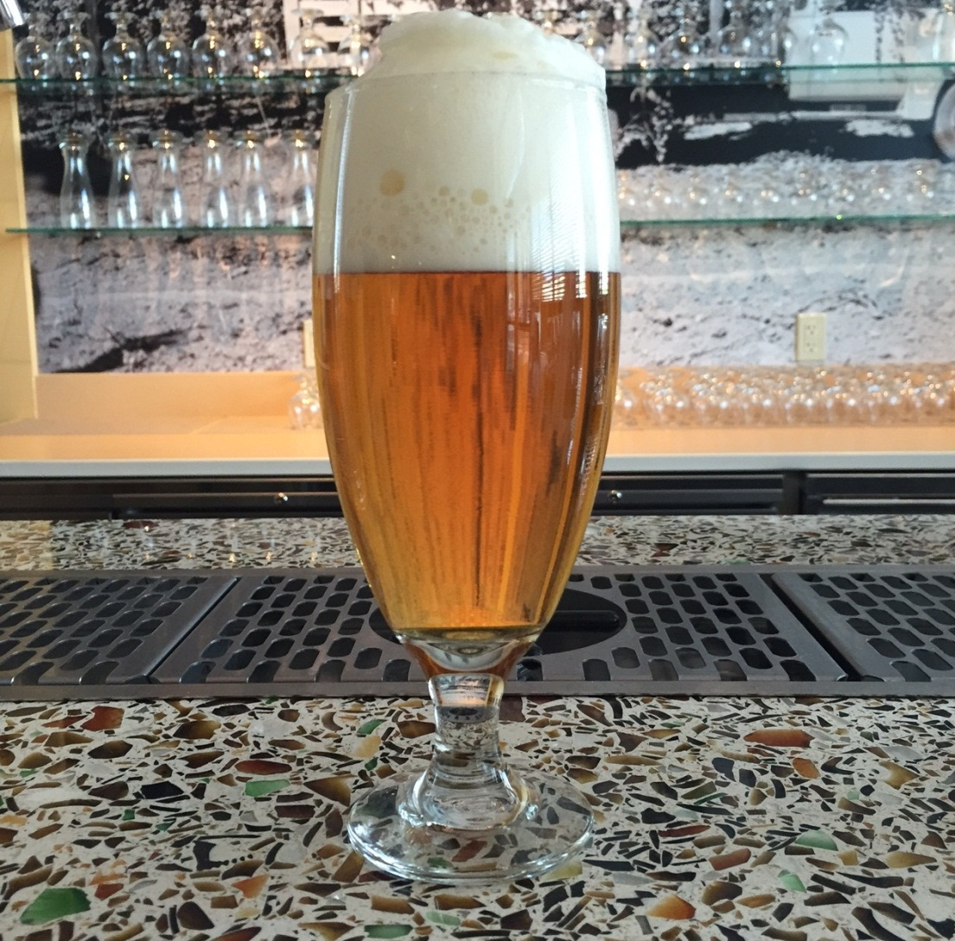
Thank You!

