Slide 1
Dr. strangebrew Or how I learned to stop worrying and love the spice rack
Pacific Northwest Homebrewers Conference 2017
Chip Walton

Slide 2
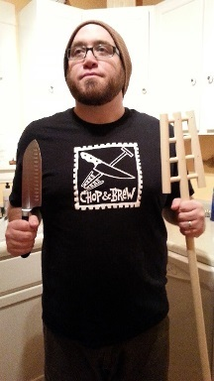
My background
Homebrewer & Craft Beer Geek from Saint Paul, MN
Former Newshound
Northern Brewer Homebrew Supply & Brewing TV
Chop & Brew
American Homebrewers Association Governing Committee
Summit Brewing Company
American Public Media/The Splendid Table
*** PS: I am NOT the world’s best (or most technical) homebrewer and proud of it!

Slide 3

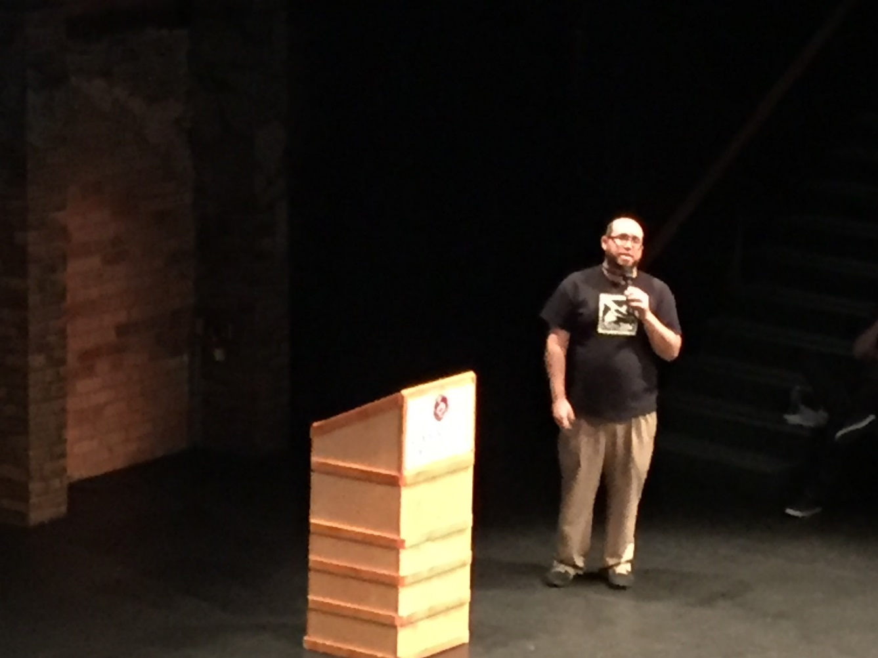
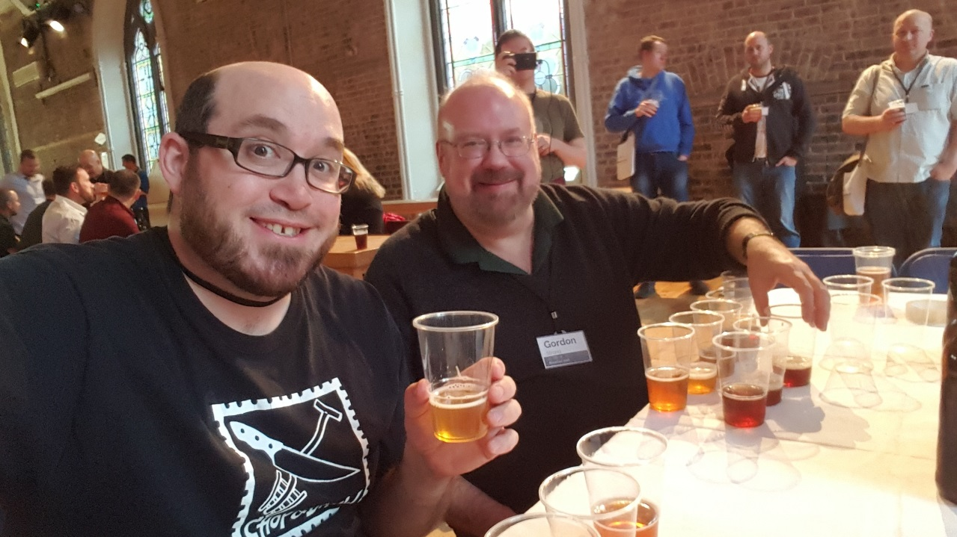
disclaimer

Slide 4
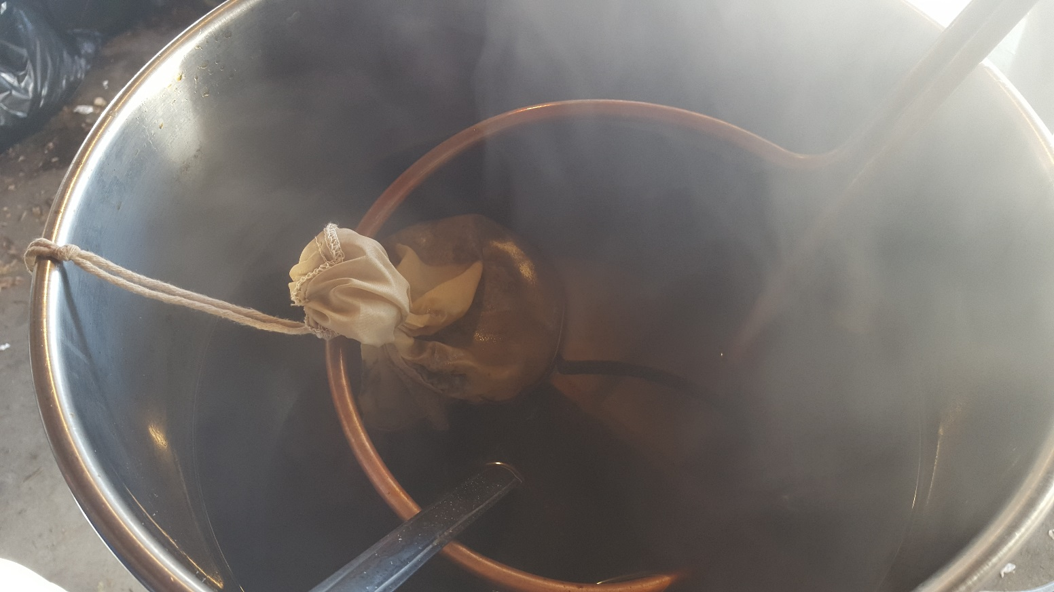
*dr. strangebrew or how I learned to stop worrying and love the spice rack**
** And beyond!
Fruit Bowl
Yard & Garden
Pantry
* Not a doctor

Slide 5
WHY brew strange?
ec-cen-tric:
Adj: (of a person or their behavior) unconventional and slightly strange
Adj: (of a thing) not placed centrally or not having its axis or other part place centrally
Quite literally: off-center beer for off-center people (Dogfish Head)
Pour a little out for the Reinheitsgabot!
Pushing the Boundaries of Flavor:
Accentuating and Elevating Characters of Malt, Hops, Yeast & Water
I like to homebrew beer that I cannot find or no one else is brewing
No Commercial Obligation
Why not?

Slide 6
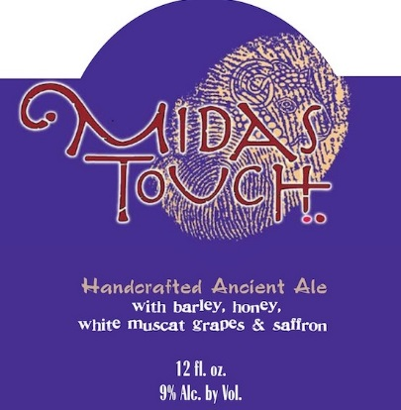
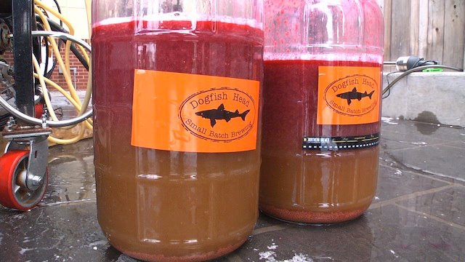
Strangebrewing in the u.s.: What aren’t craft brewers doing?
Dogfish Head (limited edition and Ancient Ales)
Positive Contact: Sweet & Sour Belgian ale with Fuji apple cider, slow-roasted farro, cayenne & fresh cilantro
Hellhound on My Ale – Super-Centennial Hopped IPA with lemon peel and flesh in whirlpool
Midas Touch: beer meets wine meets mead; an ancient ale brewed with honey, barley malt, white muscat grapes and saffron
Sah’tea: based on 9th century Finnish recipe that includes rye, juniper and black chai tea

Slide 7
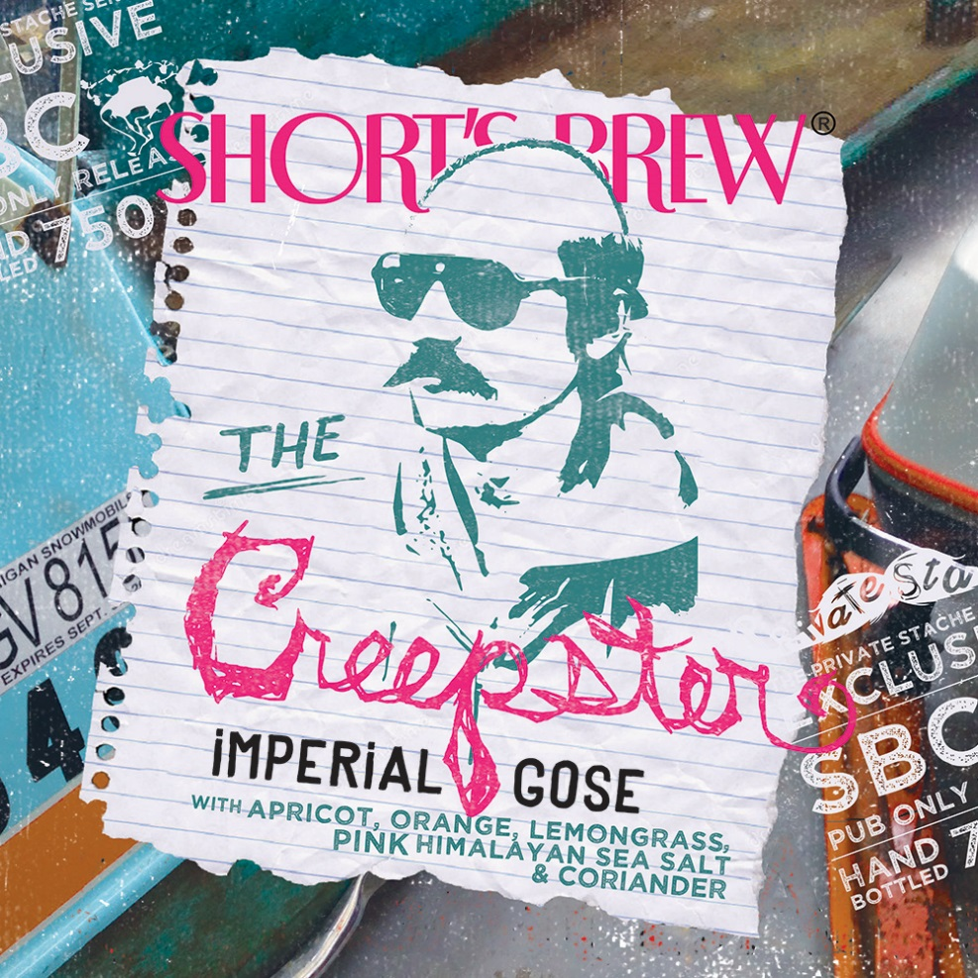
strangebrewing in the u.s.: What aren’t craft brewers doing?
Shorts Brewing Company
The Creepster: Imperial Gose with apricot, orange, lemongrass, pink Himalayan sea salt, and coriander
Black Licorice Lager: flavors of chocolate and roasted malt that complement additions of Madasgascar vanilla bean, anise, and fresh chocolate mint
Key Lime Pie: fresh limes, milk sugar/lactose, graham cracker and marshmallow fluff (Gold Medal, Fruit/Vegetable Beer – 2010, 2014 Great American Beer Festival)

Slide 8
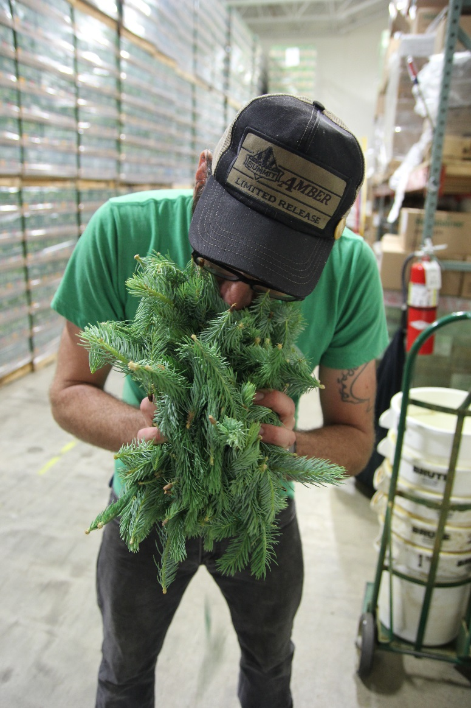
strangebrewing in the u.s.: What aren’t craft brewers doing?
Summit Brewing Company
Imperial Pumpkin Porter: organic pumpkins in the mash, sweet China cinnamon, ground nutmeg, ginger powder and cloves
Make It So: Extra Special Bitter with Earl Grey Tea
Herkulean Woods: Imperial California Common with early-season spruce tips and maple syrup in boil

Slide 9
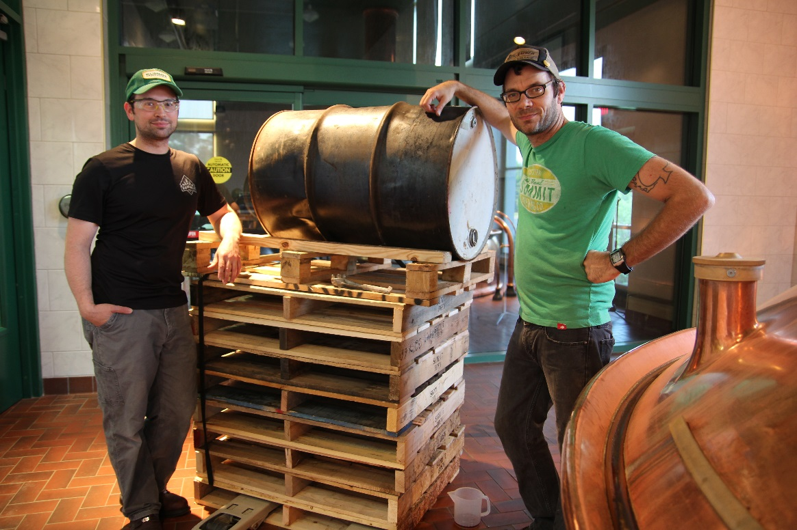
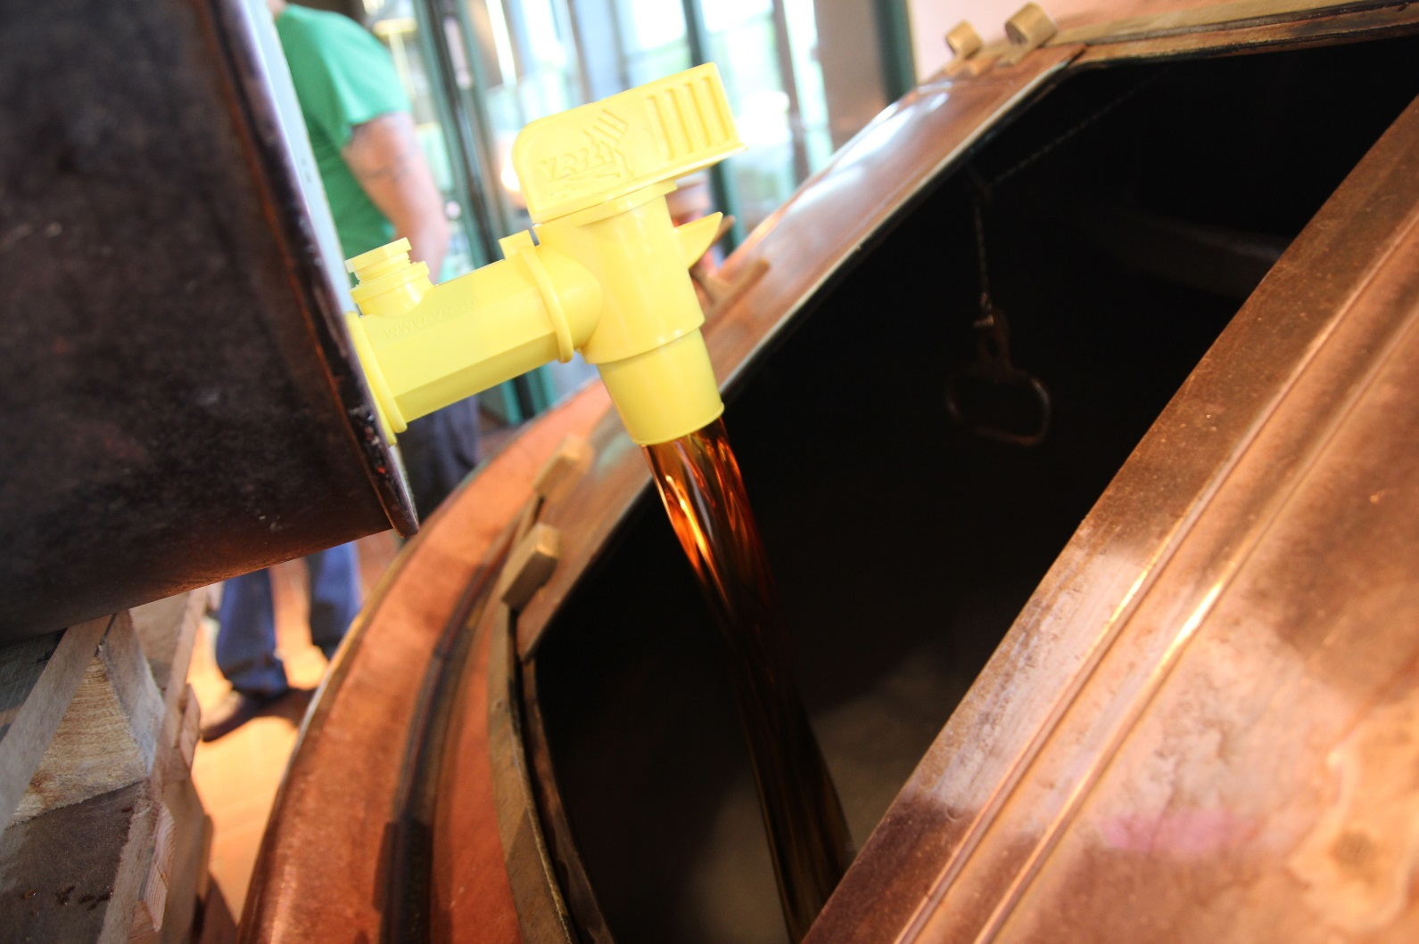
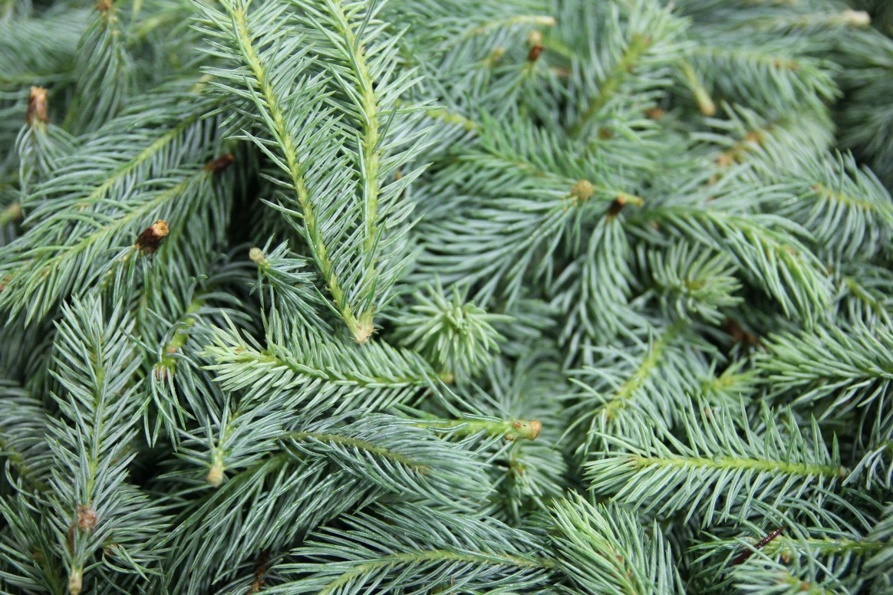

Slide 10
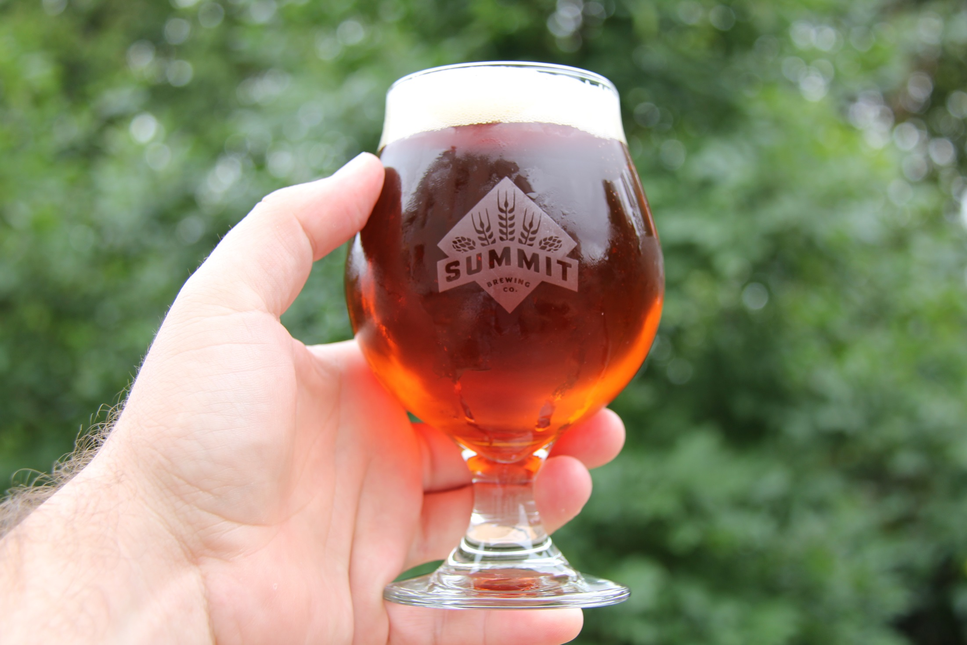

Slide 11
STRANGEBREWING: A SLIPPERY SLOPE
Welcome to Strangebrew Anonymous: My name Chip Walton… and I have a problem!
Started homebrewing in 2007, went right for the spice rack!
O’Rojo Spiced Irish Red
Saison with Grains of Paradise (from Drew Beechum)
Peppercorn Rye Bock (from Extreme Brewing)
Pedal Pusher: Belgian Witbier with Lavender and Rose Hips
I get antsy! Can’t leave well enough alone.
Brewing TV/Chop & Brew fed this experimental beast.
I have to do it for the sake of video, dammit!

Slide 12
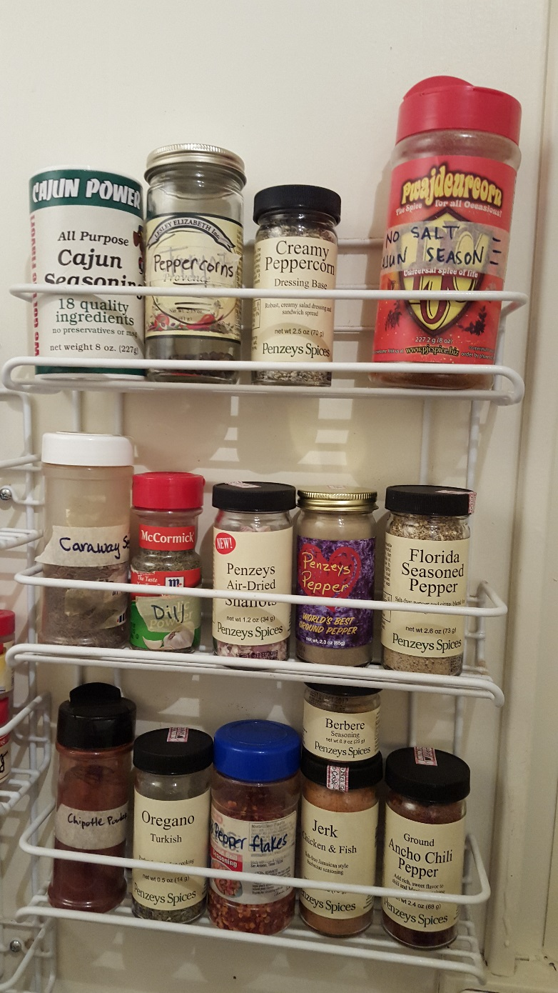
TO THE SPICE RACK!

Slide 13
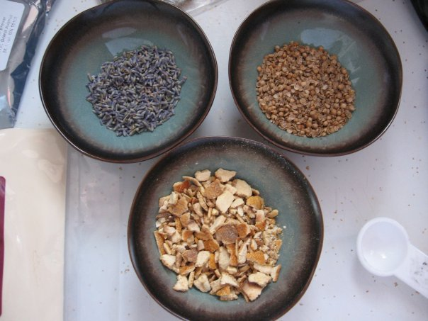
STRANGEBREWING: what are we talking about?
Spices – fresh, dried, whole, ground
coriander, Grains of Paradise, vanilla bean, chiles, cinnamon
8 flavors for each spice (Raghavan Iyer)
Whole, crushed: plain, toasted, sautéed in a fat, soaked in a liquid
Herbs – fresh, dried
Fruits – fresh, frozen, puree, syrups
Vegetables – fresh, frozen, puree, cooked
Coffee/Tea – ground/whole, hot/cold
Extract, All-Grain, BIAB

Slide 14
Things to consider WHEN STRANGEBREWING
Moderation in Experimentation
Sometimes the point is to make the eccentric ingredients nearly unnoticeable
You can always add more, but you cannot take anything back!
What is going to complement your Big Four ingredients?

Slide 15
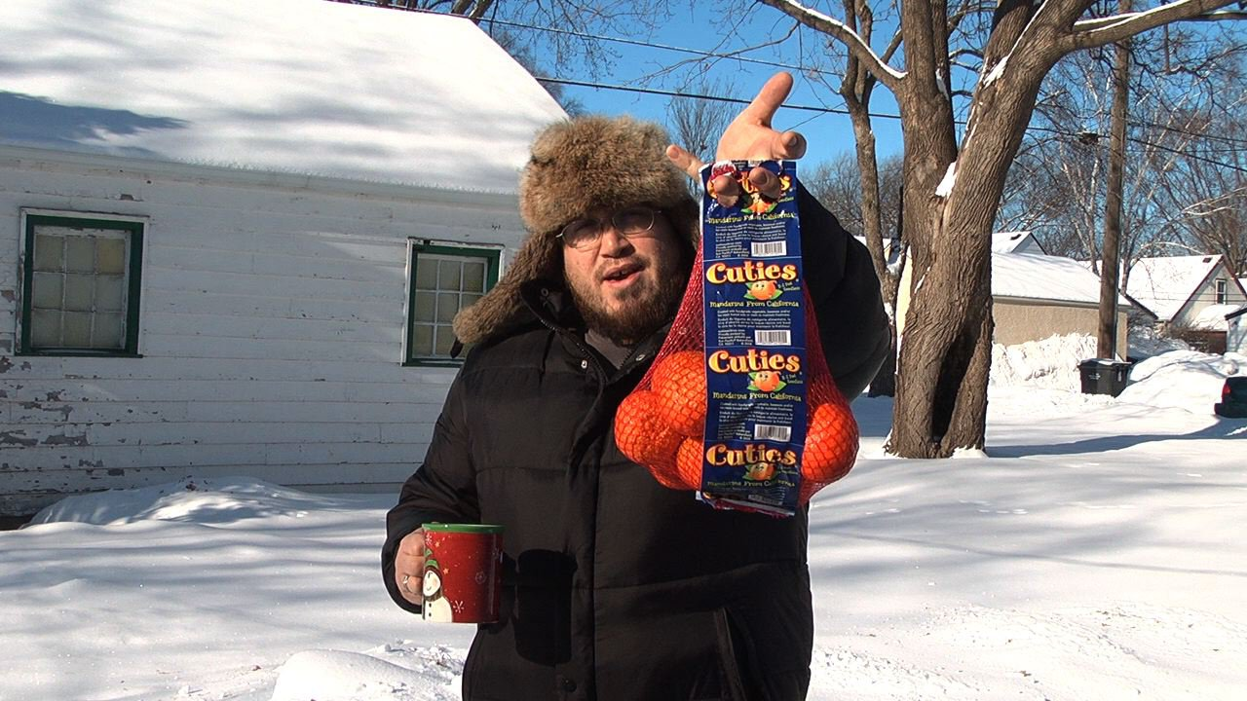
Clemifornia Commontine

Slide 16
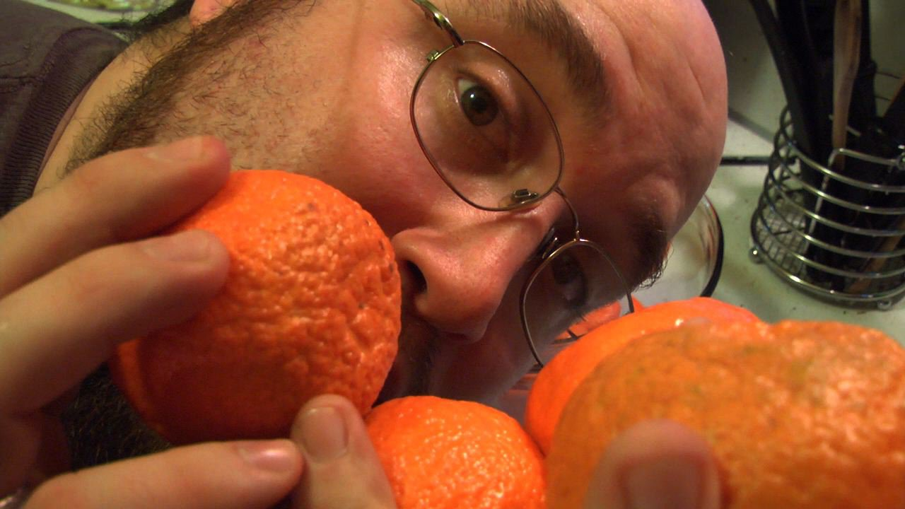
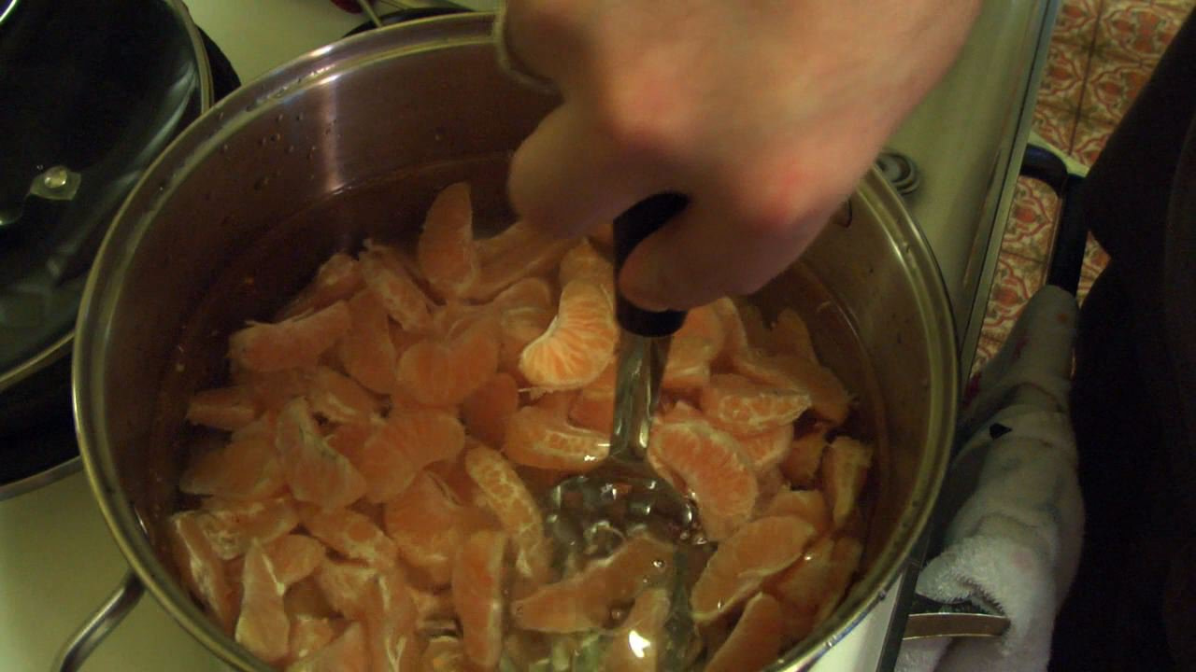
Clemifornia commontine
California Common with Clementines
Gold LME, C60, Northern Brewer hops, sweet orange peel and fresh fruit
What made it unique? Fruit steeped in hot water, lightly mashed, ice bathed
Liquid and solid added directly to primary fermentation (opposed to secondary)
Brew Day Video Brewing TV - Episode 29: Clemifornia Dreaming
Tasting Notes – fresh citrus, aromatized oil, orange cream soda, acidity/astringency from citrus fused well with the earthy hops, citrus fruit stands in for citrusy hops

Slide 17
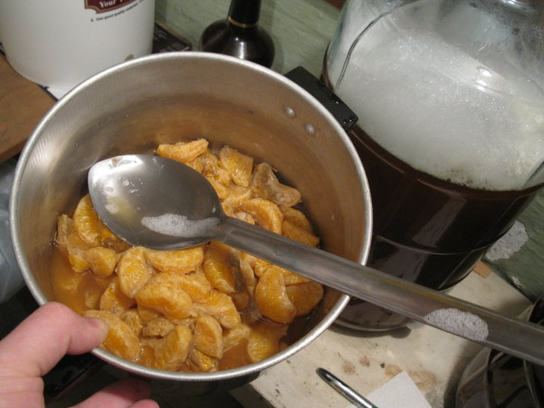
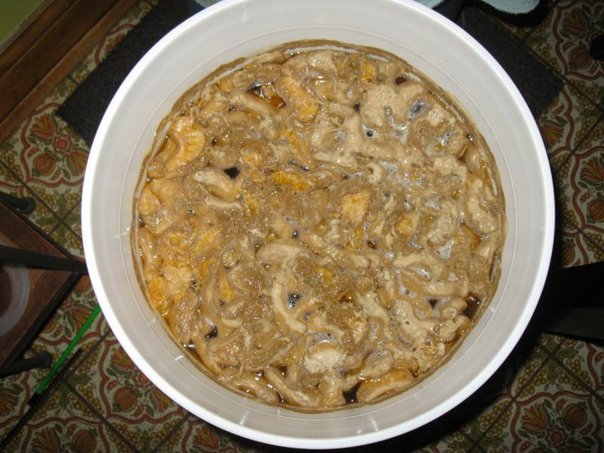
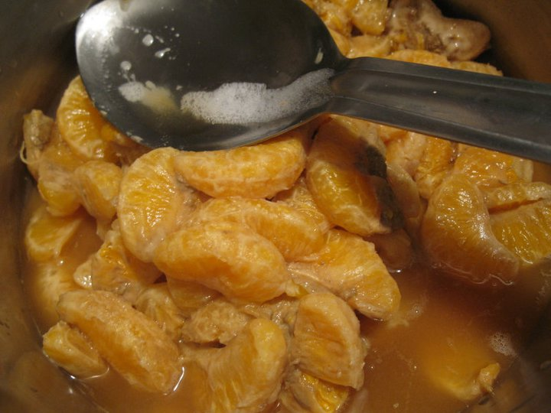

Slide 18
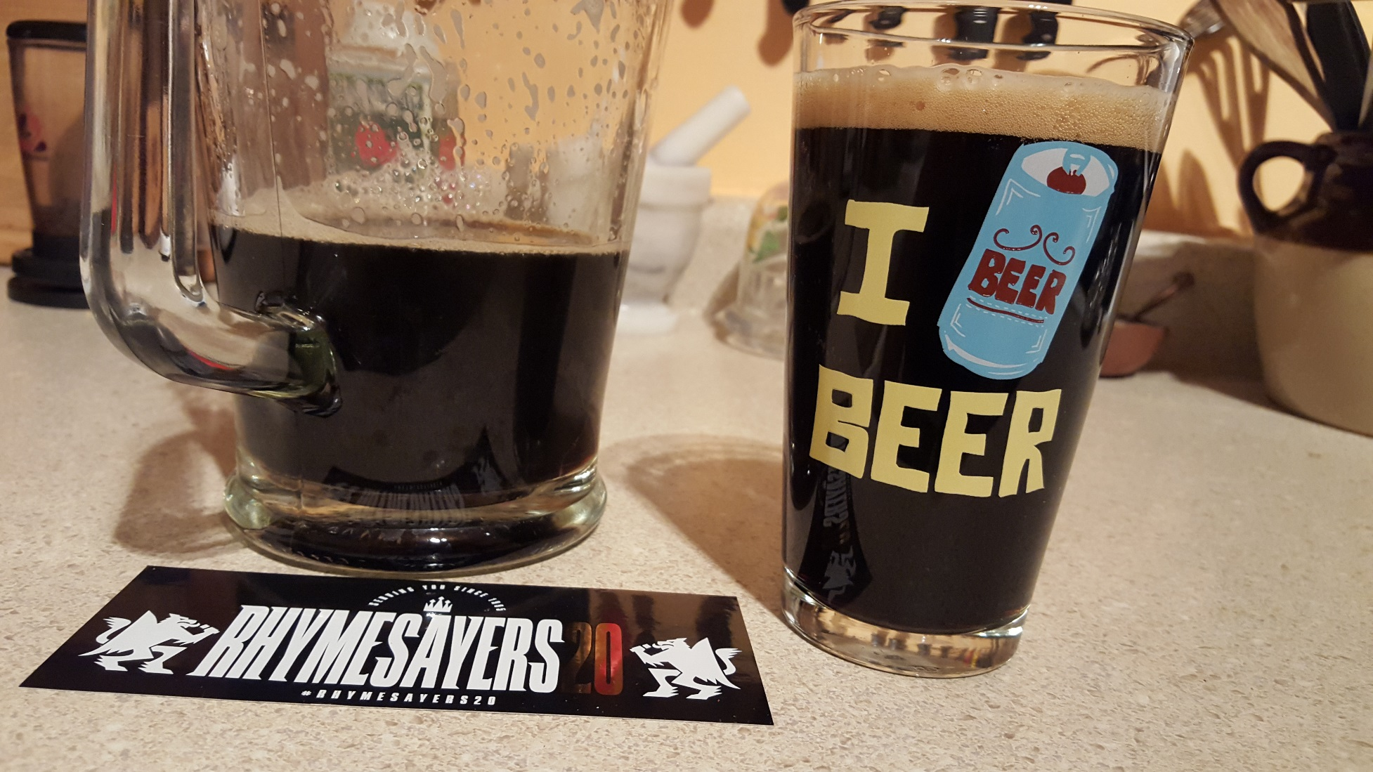
RSE: Rye Stout + espresso

Slide 19
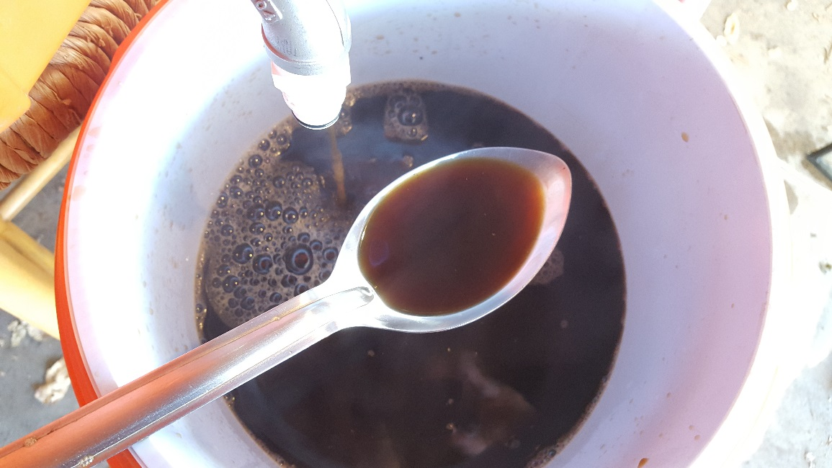
RSE: Rye Stout + espresso
All Grain recipe for Rye Stout with Espresso from Kris England.
Ground Espresso at Flame-Out (End of Boil)
Wort Allowed to Cool to 180F/88C before ground Espresso added and steeped in nylon bag
Kris England says you could add second bag of coffee instead of steeping longer (quantity more important than time)
If added to secondary as well, look at a ratio of 2:1 (boil:secondary)

Slide 20
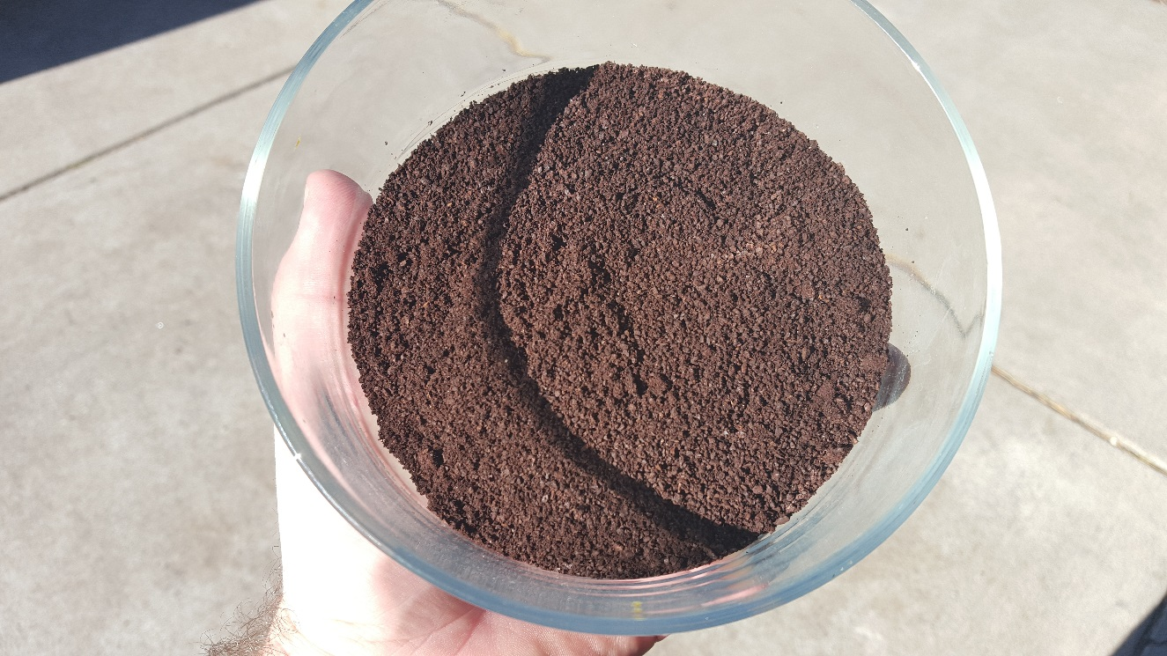
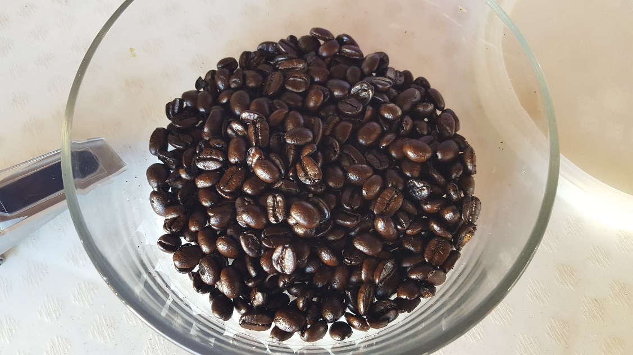
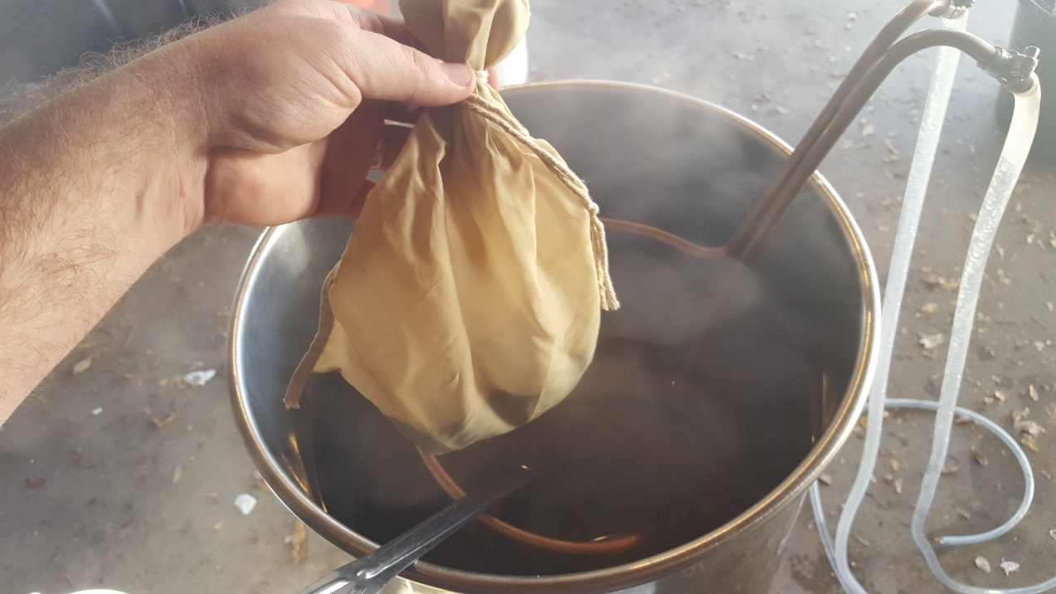
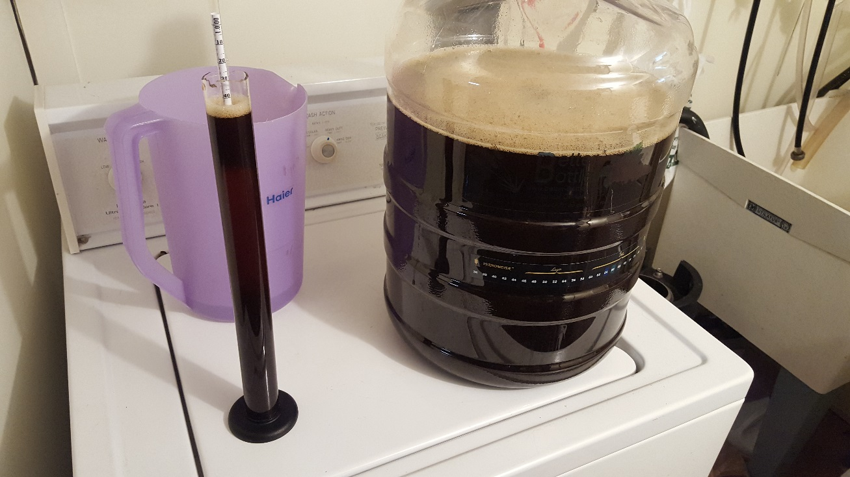

Slide 21
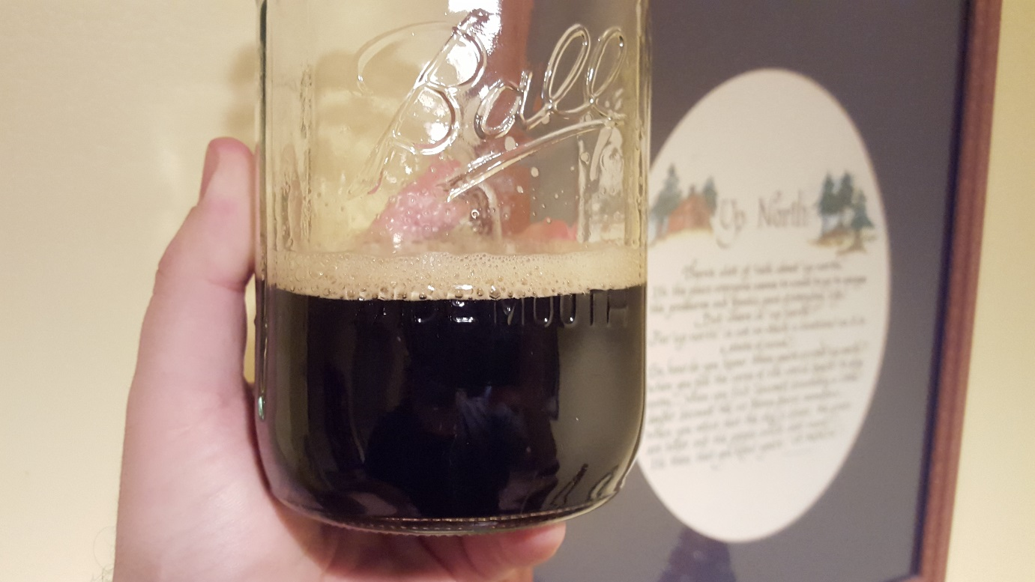
RSE: Rye Stout + espresso
Tasting Notes:
Roasty and dark toasty, chocolate and cocoa, some dark fruit from yeast, light and dry body (use more lactose)

Slide 22
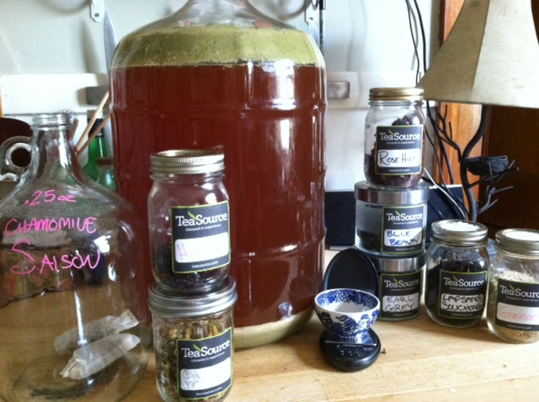
brewing with Tea
Substitute Tea for Aromatic Hops
Last 5-10 minutes of boil
Avoid using for long time on hot-side to avoid tannic astringency
Tea in Carboy
Primary
“Dry Tea” your homebrew in secondary
Add Tea as Concentrate at Bottling
Chop & Brew – Episode 38: Homebrewing with Tea
Blog by Jessica Hanley (F. H. Steinbart Co.)
http://www.teasource.com/blogs/beyond-the-leaf/64236547-water-malt-hops-yeast-and-tea

Slide 23
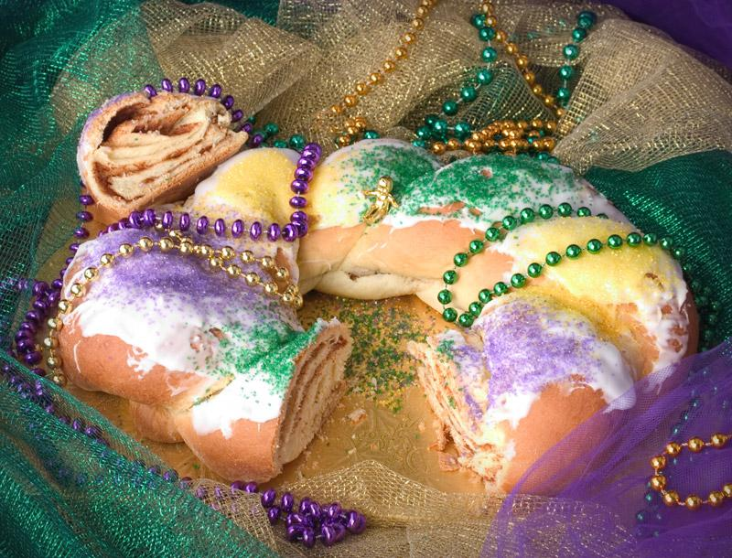
King cake ale
BIAB recipe with suggestions from Drew Beechum and Dan Murphy.
The Goal: a beer inspired by the flavors of a classic New Orleans Mardi Gras King Cake.
NOT a gimmicky beer with actual King Cake in the mash! (Even I have limits.)
What is a King Cake? Buttery pastry/cinnamon bread with lemon and citrus elements and sugary frosting on top

Slide 24
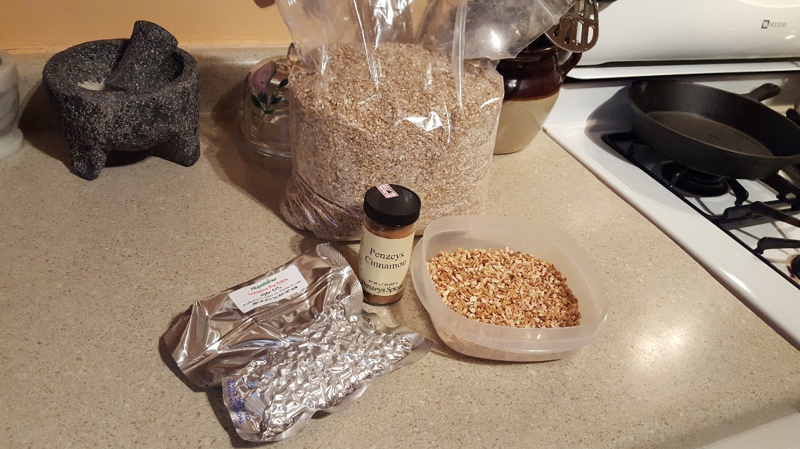
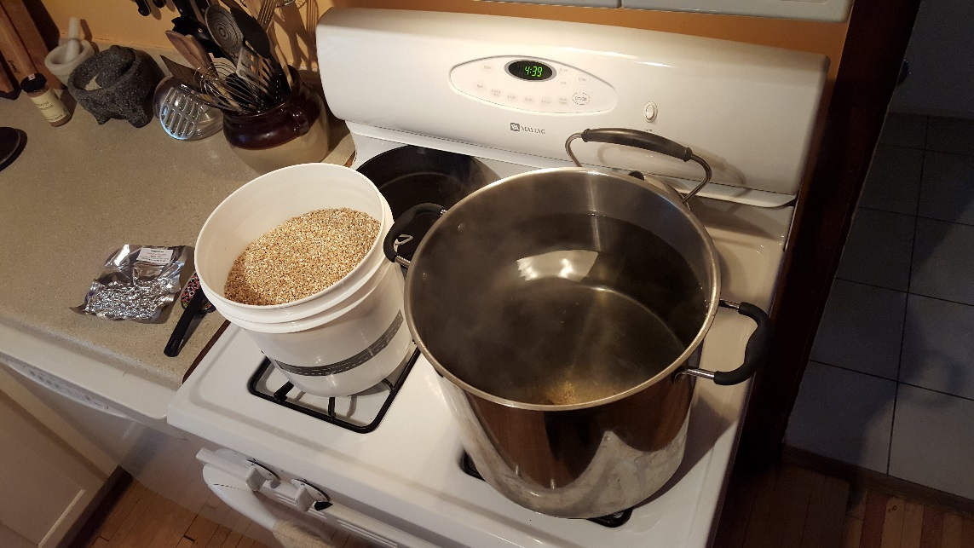
king cake ale
How to Achieve These Flavors: Doughy, Toasty, Buttery
English Golden Ale base w/ Barke Pils, Flaked Wheat, GNO, Aromatic
Lesser attenuative yeast (London ESB/Wyeast 1968)
Lemon/Citrus – Organic Lemon Peel and Lemondrop hops
Cinnamon – Next time will use Vietnamese Cinnamon, which has more spicy kick and some vanilla notes to it
Could’ve use Vanilla Beans in secondary, but didn’t go that far.

Slide 25
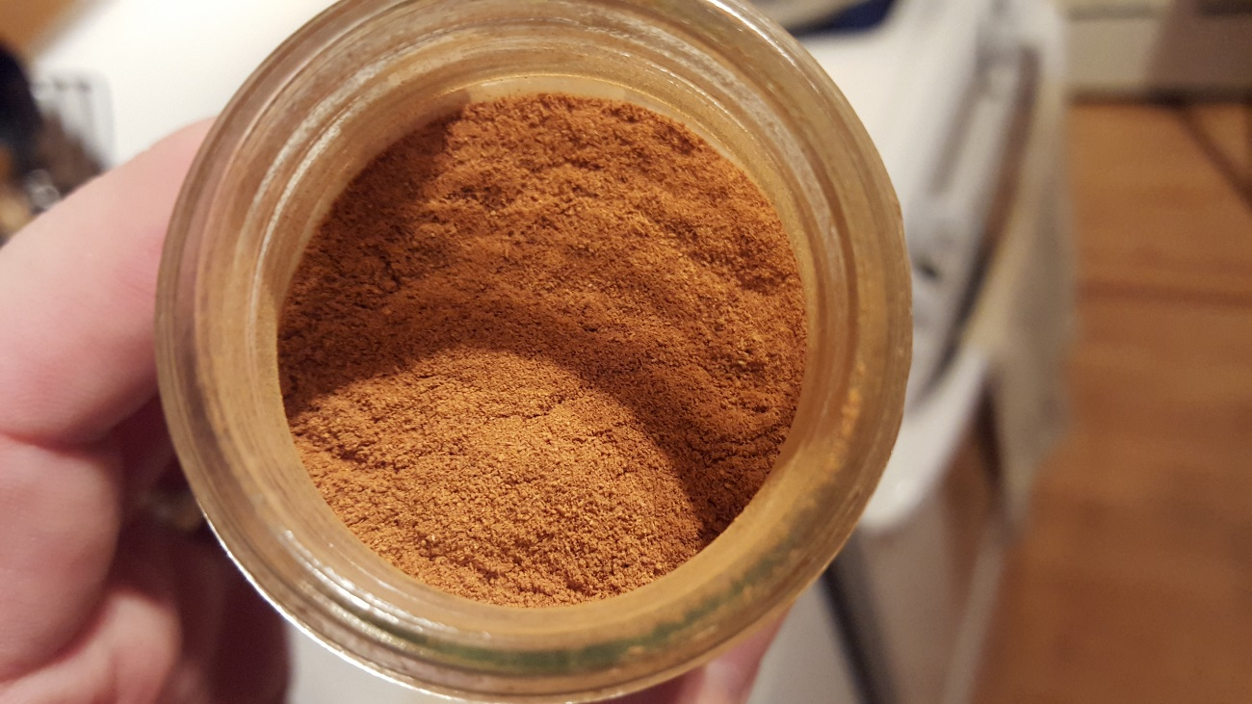
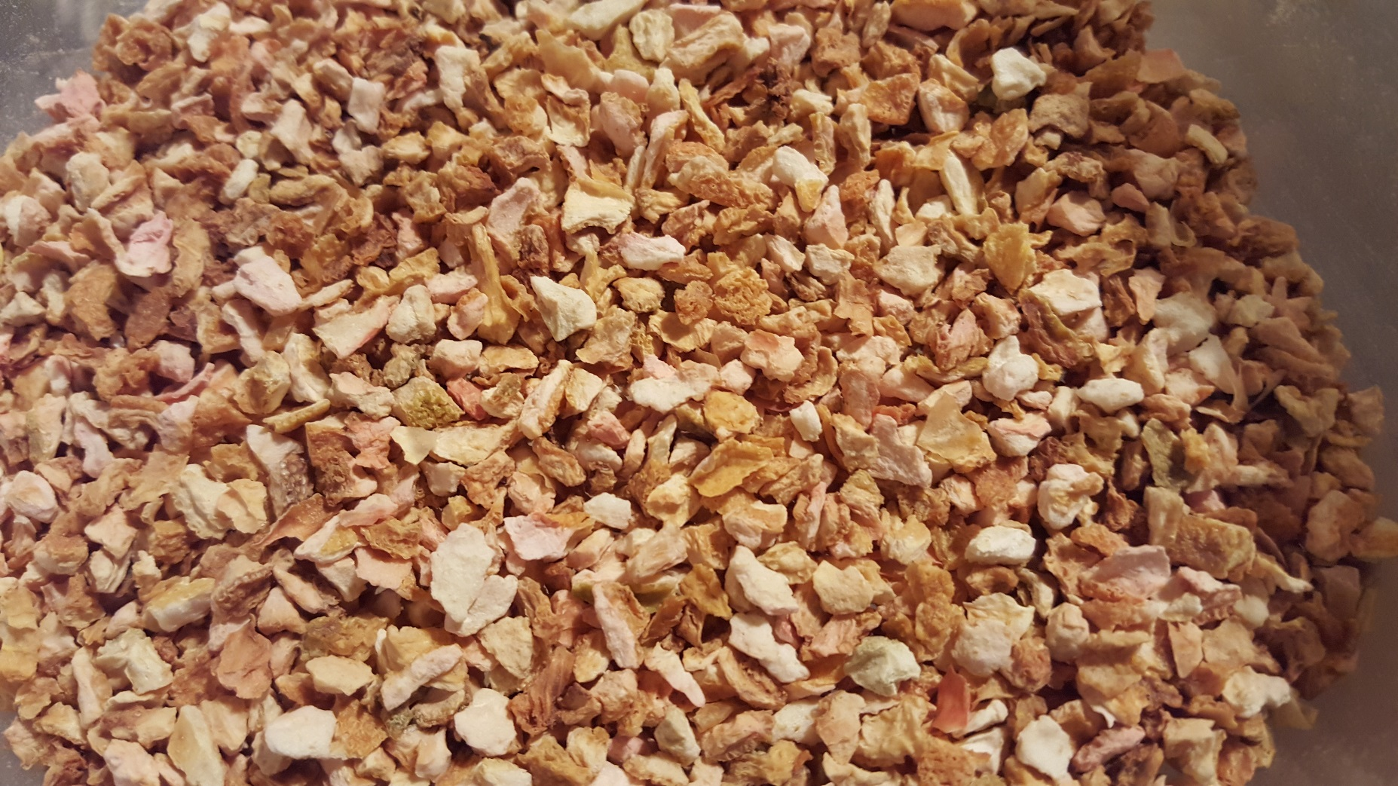
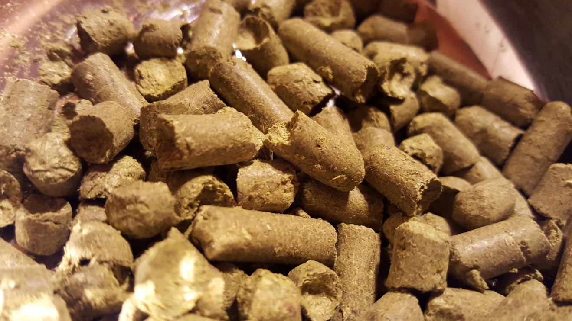

Slide 26
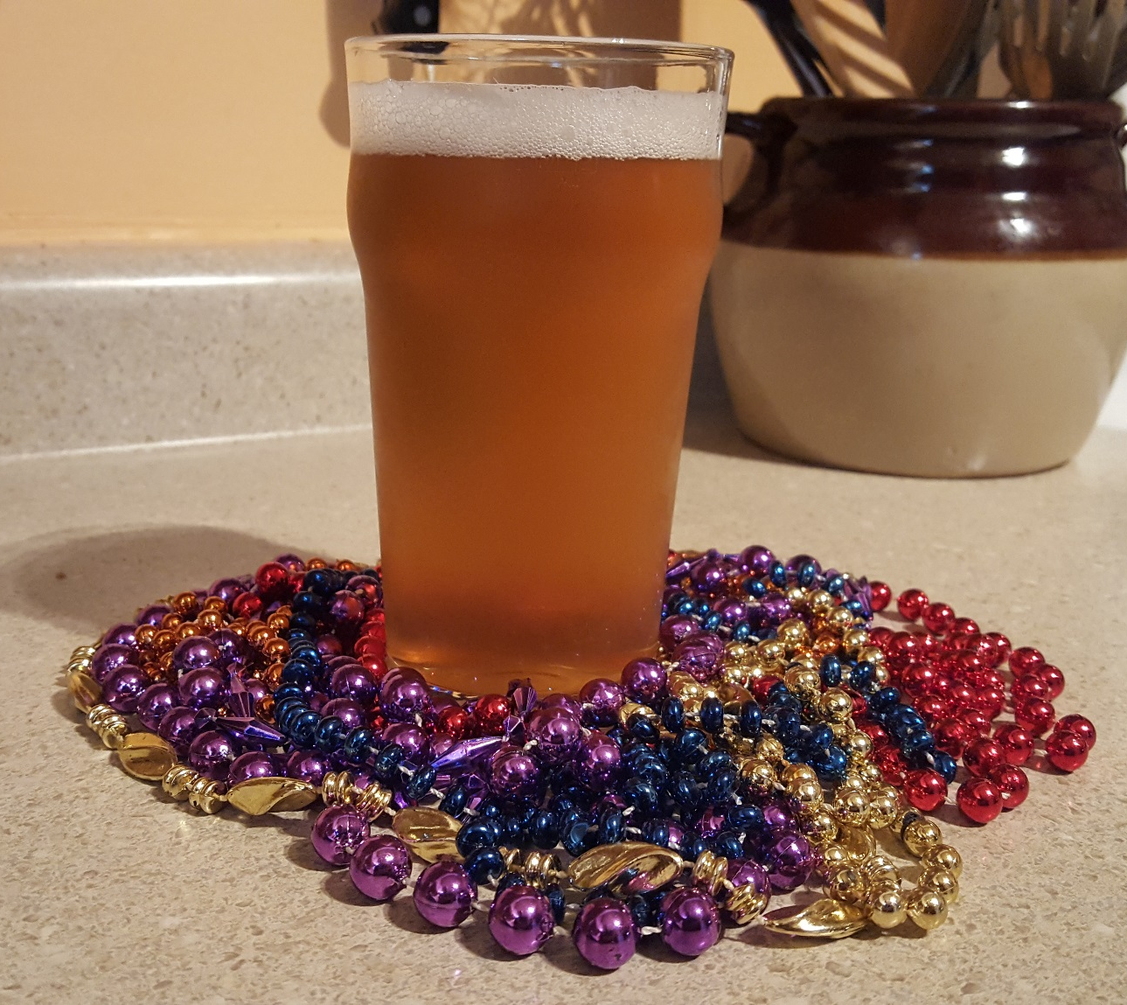
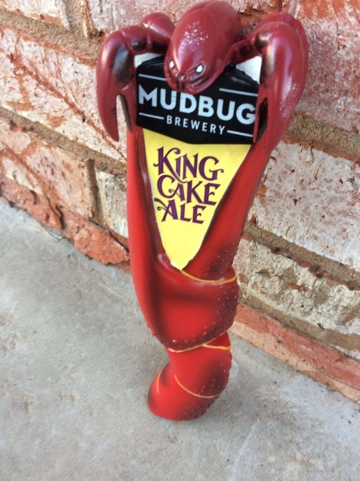
king cake ale
King Cake Ale 2.0
A bit sweeter:
Higher mash temp?
Richer malts?
Lactose?
Vanilla in secondary?
Mudbug Brewery King Cake Ale (Thibodaux, LA)
Maris Otter, Biscuit
Cinnamon, vanilla
Lactose
Oats/Wheat next year?

Slide 27
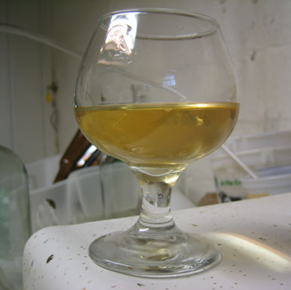
Dandelion wine
Dandelions
Orange & Lime Zest/Juice
Cane Sugar/Honey
Golden Raisins

Slide 28
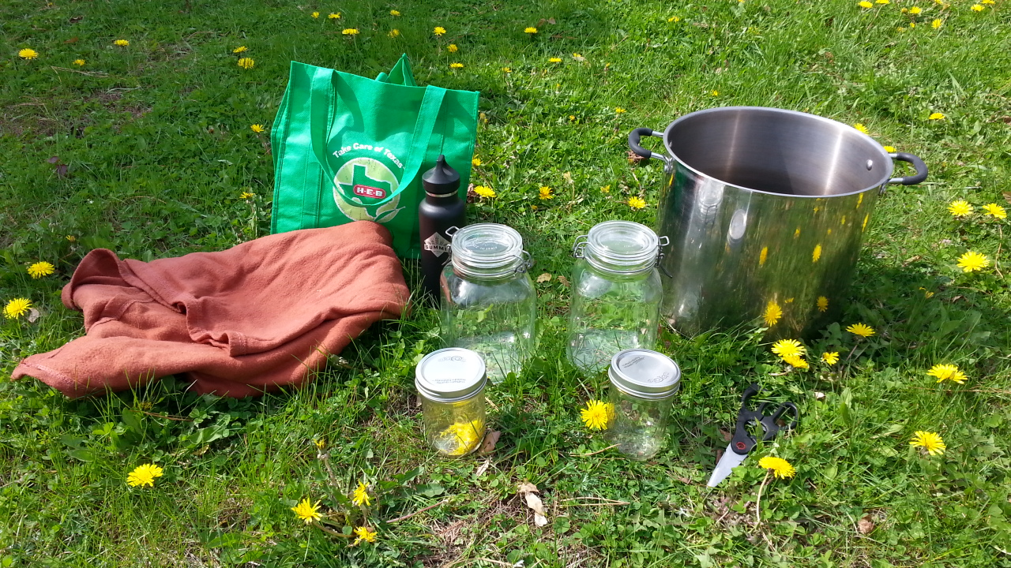
Dandelion wine

Slide 29
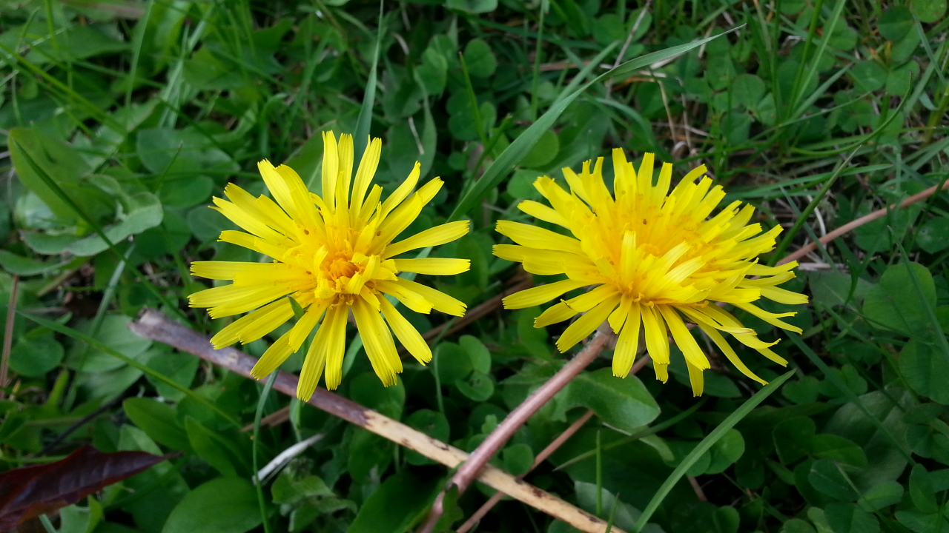
Dandelion wine

Slide 30
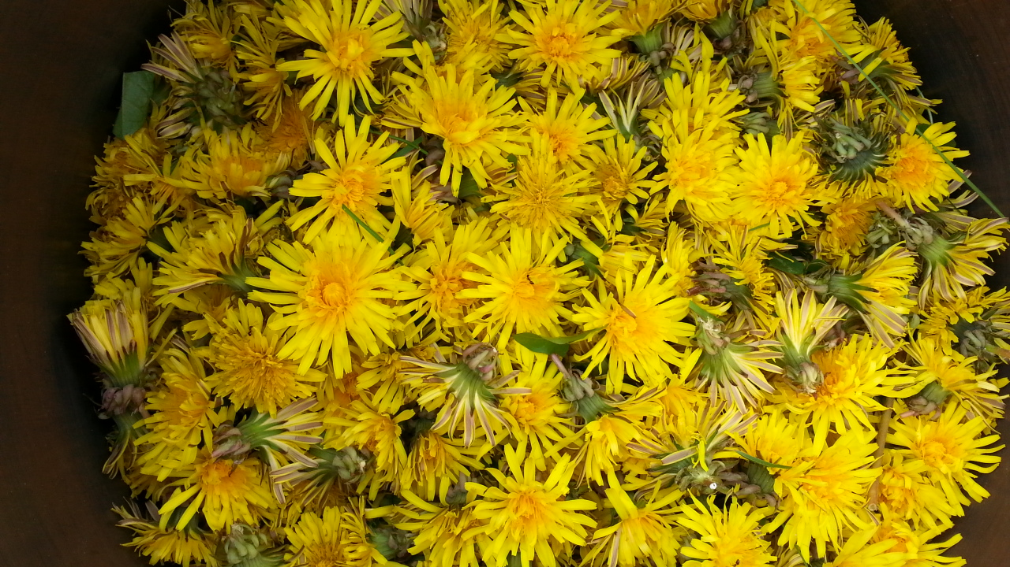
Dandelion wine

Slide 31
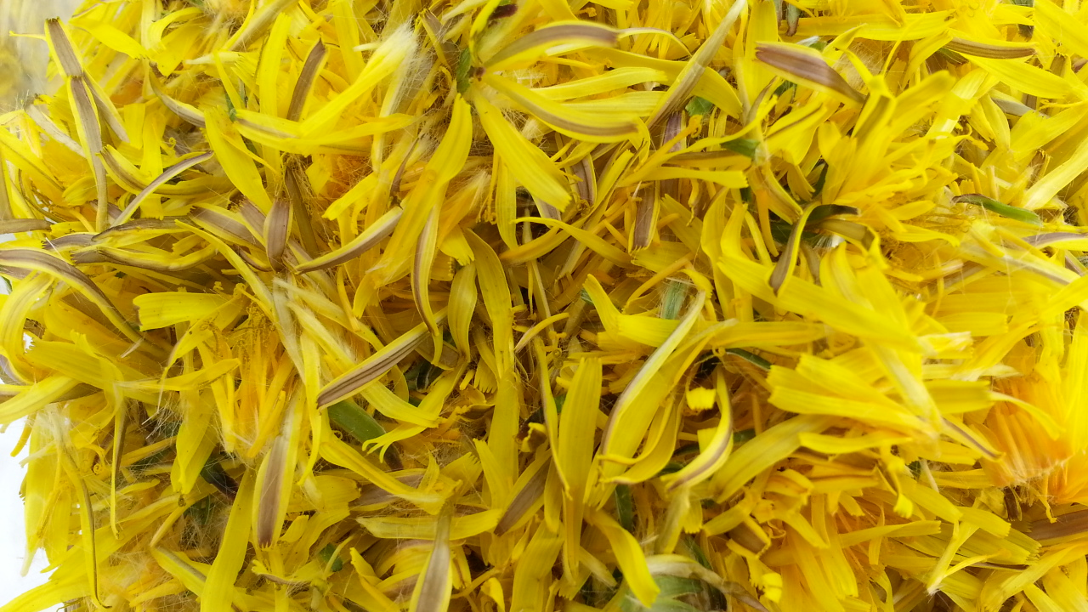
Dandelion wine

Slide 32
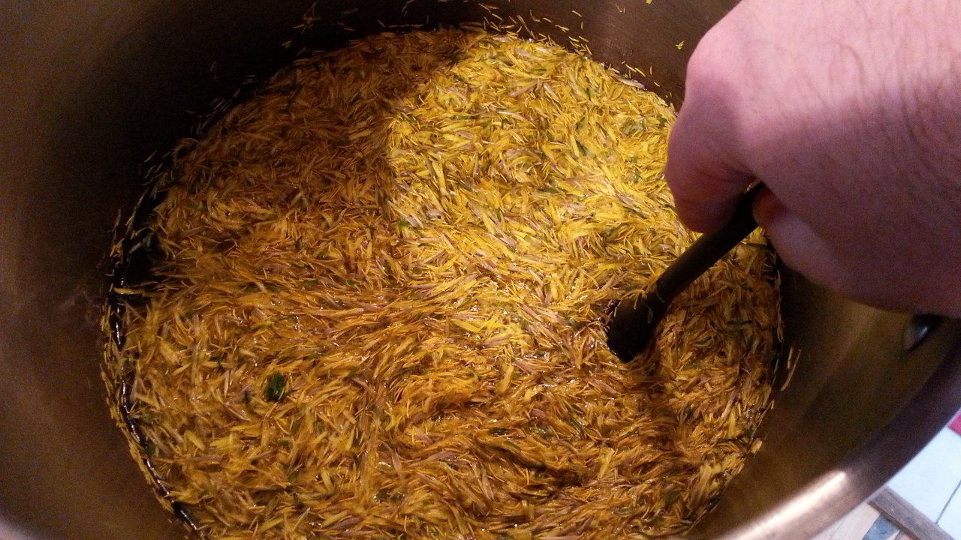
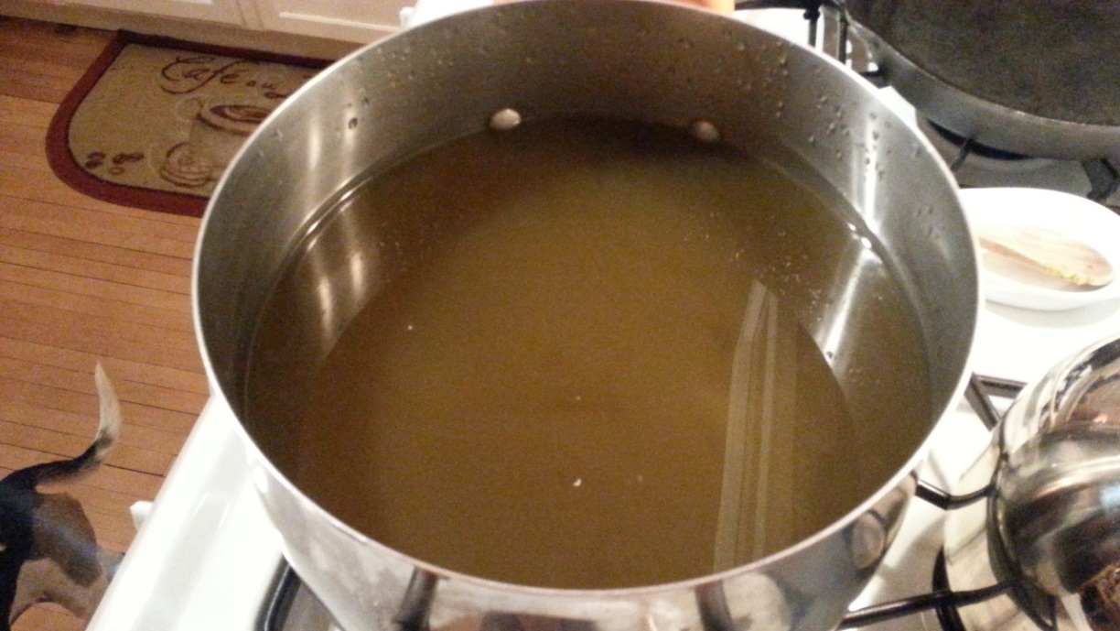
Dandelion wine

Slide 33
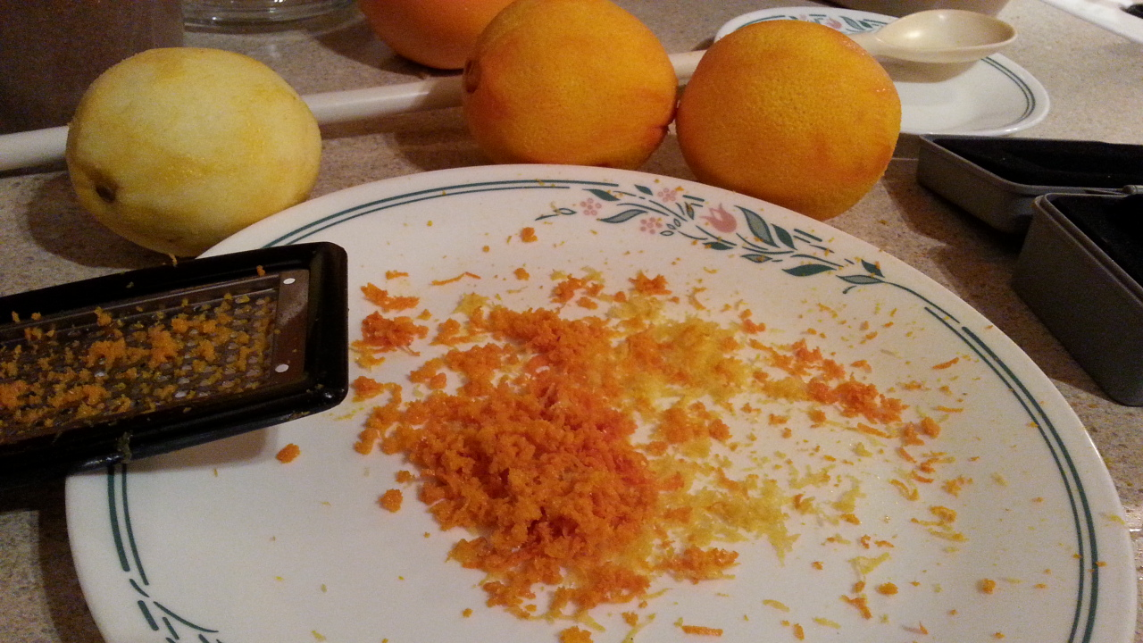
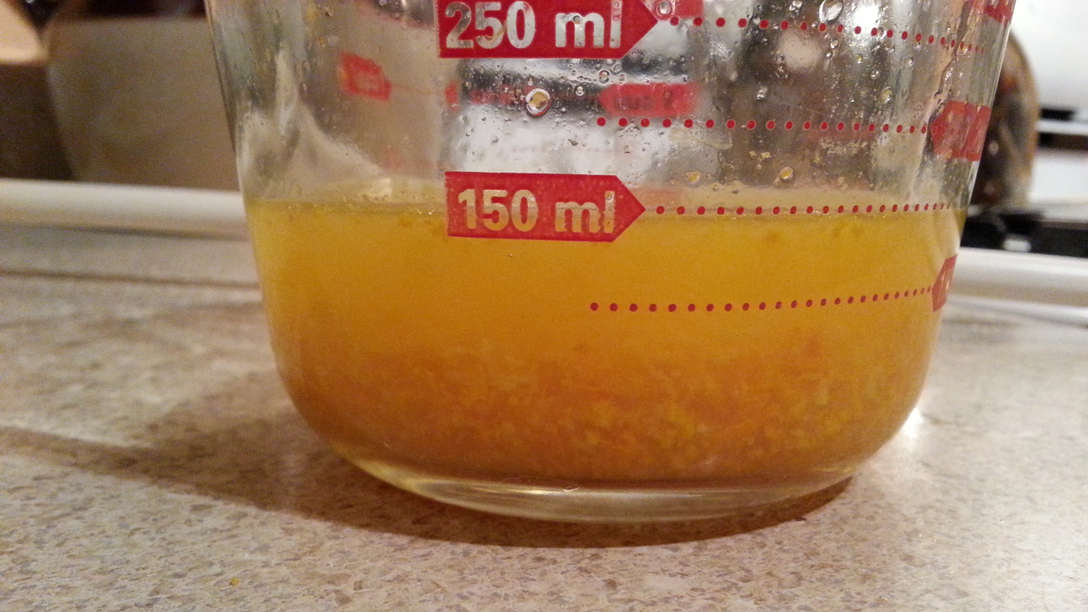
Dandelion wine

Slide 34
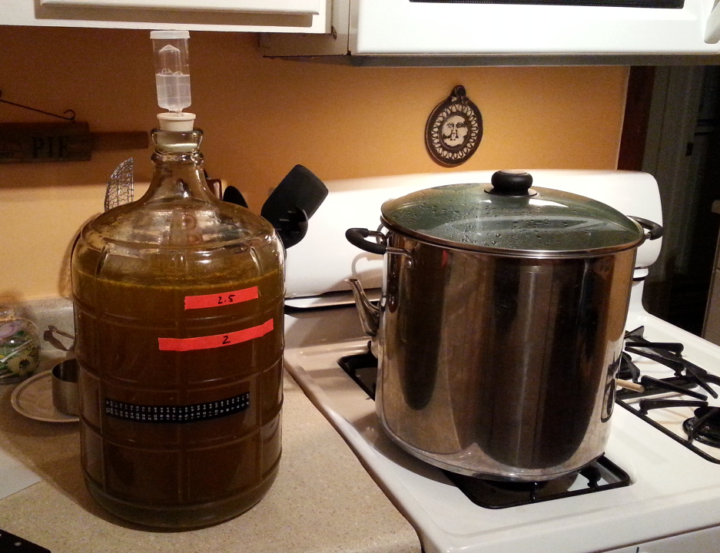
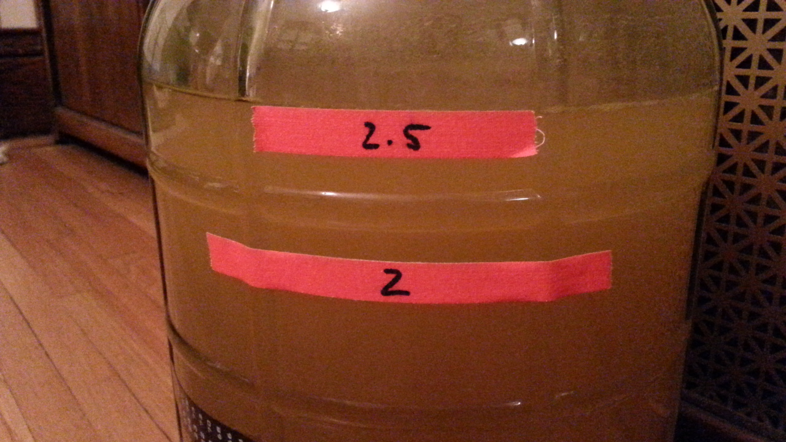
Dandelion wine

Slide 35
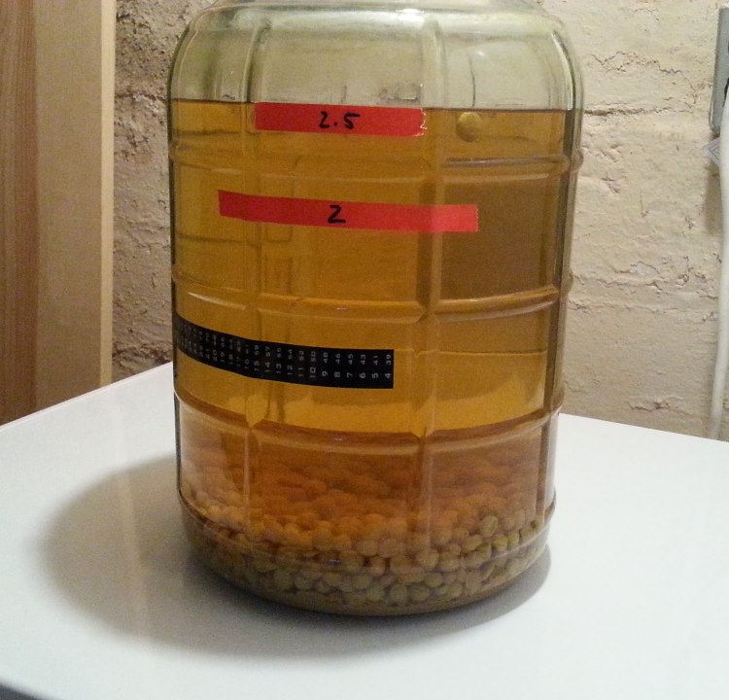
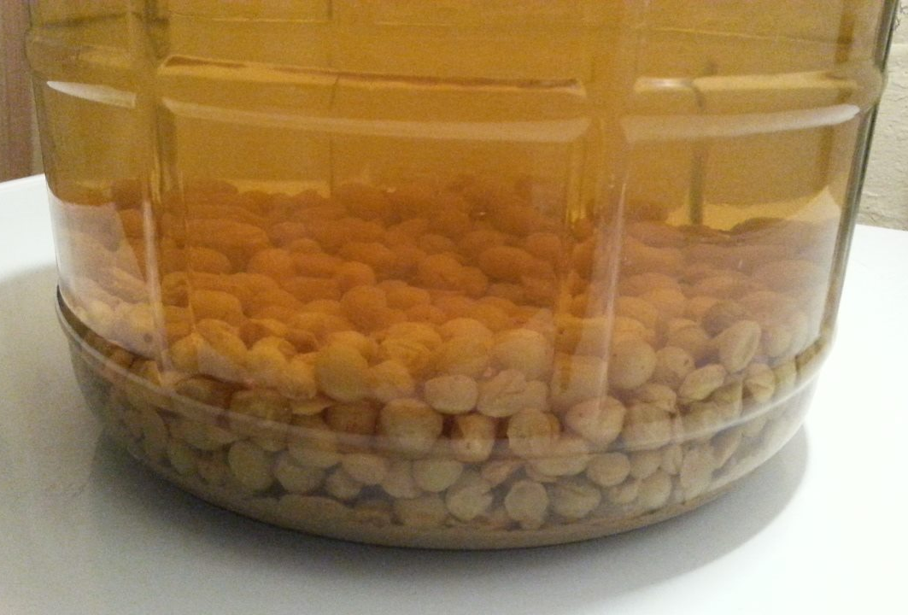
Dandelion wine

Slide 36
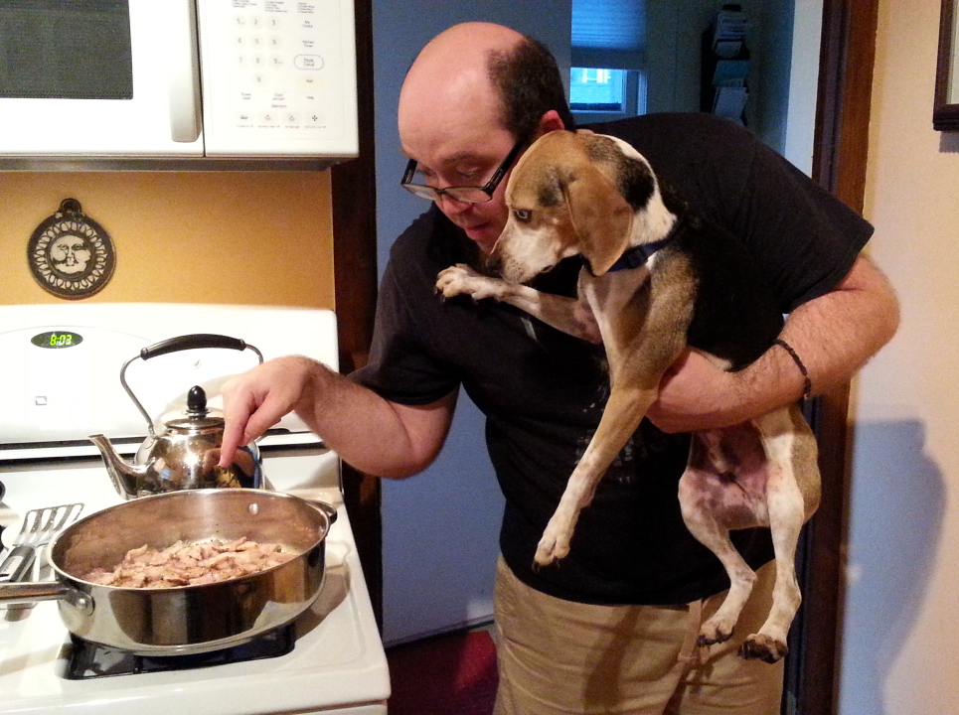

Dandelion greens and bacon

Slide 37
RAUCHGRAF: SMOKED GRAF
Graf?
Fermented wort/cider blend
Let’s smoke it!
Weyermann Munich II & Beechwood Smoked Malt
German Perle Hops
Cooled Wort + Apple Cider + Clean Ale Yeast
Tasting notes:
smoked apple sauce (add cinnamon to boil?), perfect for Thanksgiving

Slide 38

Chucklehead AKA the easy way
Extract recipe with pureed peaches, organic canned pumpkin, fresh ginger
Pils LME, Xtra Light DME
Carared Steeping Grain
Huell Melon hops
Short-aged on Beechwood chips (for extra fussiness)

Slide 39


Slide 40

Chucklehead aka the easy way

Slide 41

Chucklehead aka the easy way

Slide 42


Thai ginger Saison
Saison du Mistletoe with Thai Ginger Cascade Candi Syrup
Even when the spice of the yeast was fading in regular version; TGS had a black/white pepper kick that seems to preserve the funk.
Dry-hopped 2 gallons with Lemondrop hop for extra lemony ginger ale type snap.

Slide 43


Cooking with cascade candi syrups

Slide 44

Strange to-brew list
Oyster Stout
Meat, brine
Gose
Different salts and citrus
Hot Pepper Mead
Heat warning!
Gingerbread Porter or Stout
Ginger – fresh and powdered
Molasses
Black pepper and cayenne

Slide 45
STRANGEbrewing resources
Brewing TV – All for Brew, Brew for All!
I’ll vouch for Episodes 01-70, the rest… not so much.
brewingtv.com
youtube.com/brewingtv
Chop & Brew – Chop for Chop, Brew for Brew!
chopandbrew.com
youtube.com/chopandbrew

Slide 46
strangebrewing resources
Extreme Brewing by Sam Calagione (Dogfish Head)
Experimental Homebrewing by Drew Beechum & Denny Conn
These dudes will put ANYTHING into a beer!
Book AND Website – experimentalbrew.com
Sacred and Herbal Healing Beers by Stephen Harrod Buhner
Indigenous, historical, psychotropic and herbal healing beers of the world

Slide 47
Strangbrewing resources
Support American Homebrewers Association
Homebrew Con 2017: Minneapolis/Saint Paul, MN
Chop & Brew’s backyard!
June 15-17 @ Minneapolis Convention Center
June 10: St. Paul Summer Beer Fest
Pre-Conference: Brewery Tours, Taproom Bus Crawl, Daytrips to Duluth and New Ulm, MN; sports, live music, restaurants

Slide 48
strangebrewing resources
Audio & Slideshows from Past AHA National Homebrewers Conferences
Mitch Steele (2014): “The Use of Herbs, Spices and Other Botanical Ingredients in Today’s Beer Recipes”
Michael Tonsmeire (2015): “Brewing with Coffee: Approaches & Techniques from Dry-Beaning to Home Roasting”
American Homebrewer Association Website: homebrewersassociation.org
FIND THEM: Let’s Brew > Resources > Conference Seminars

Slide 49

WebsiteS/social media/contact
Chop & Brew
chopandbrew.com
facebook.com/chopandbrew
Twitter & Instagram @chopandbrew
chopandbrew@gmail.com
The Splendid Table
splenditable.org
splendidtable.org
facebook.com/splendid.table
Twitter & Instagram: @splendidtable

Slide 50

THANKS FOR HAVING ME!
Any Questions?

