Slide 1

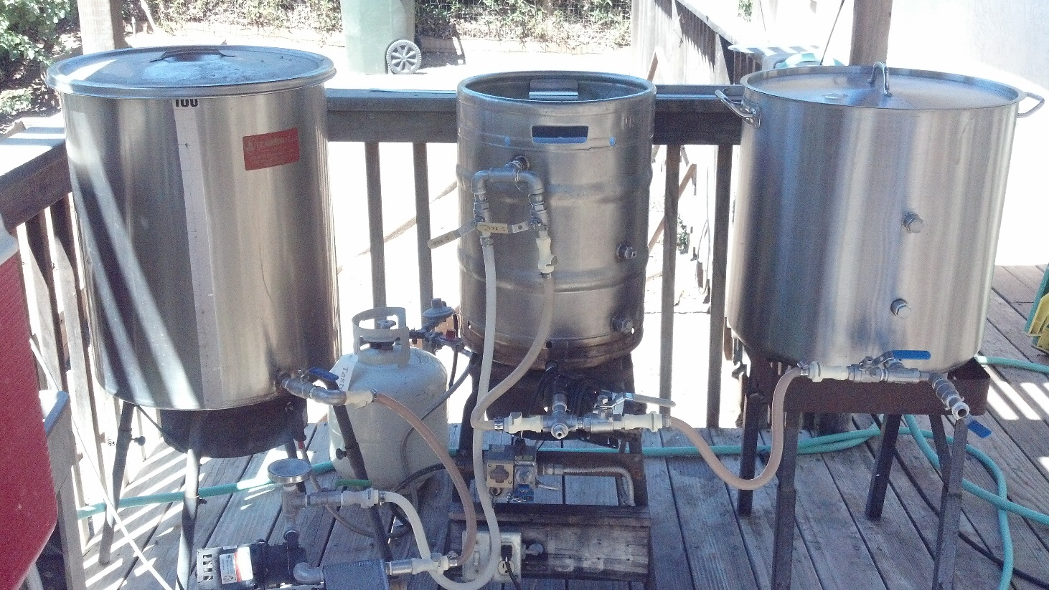
Brewing Consistency
Identifying and Controlling the Variables
Mike “Tasty” McDole

Slide 2
Why is brewing consistency important?
Make the recipe matter
  It’s the master plan
  Part of the record
Clone commercial beers
Create a sharable recipe
Beer repeatability
Beer quality
Detect the effect of hardware/process changes

Slide 3
Variables to control.
Ingredients
  Water
  Malt
  Hops
  Yeast
Process
  Milling
  Mashing
  Sparging
  Boiling
  Hop additions
  Whirlpool
  Knockout
  Fermentation
Cellaring

Slide 4
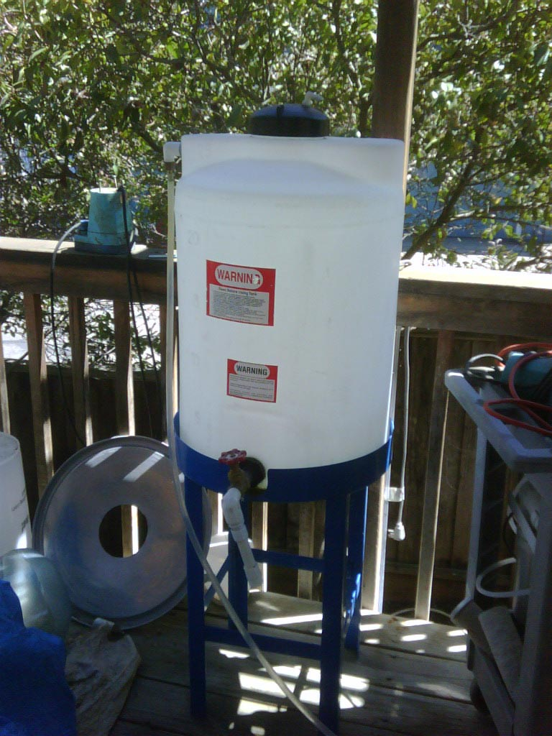
Ingredients - Water
Beer is over 90% water
  Consistently good tasting water
    Chlorine removal
  Water Report
  Hardness – Salt Additions
  Dilution
  RO

Slide 5
Ingredients - Malt
Freshest possible
Highest quality
If possible, check your potential extract

Slide 6
Ingredients - Hops
Know your alpha
Freshest possible
Buy in bulk
Store correctly

Slide 7
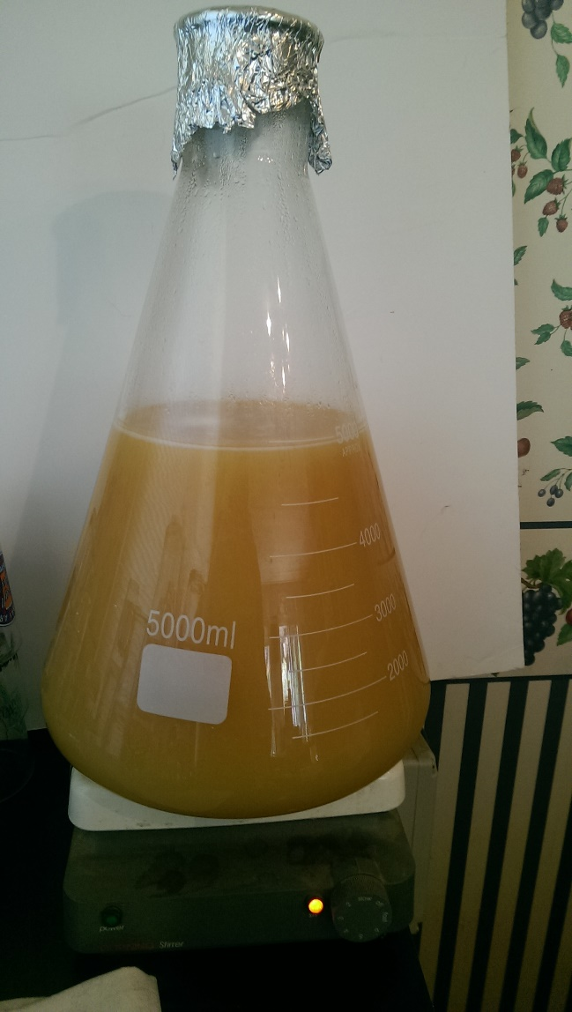
Ingredients- Yeast
Starter
  Active
  Oxygenated
  Appropriately sized
  Consistent cell count

Slide 8
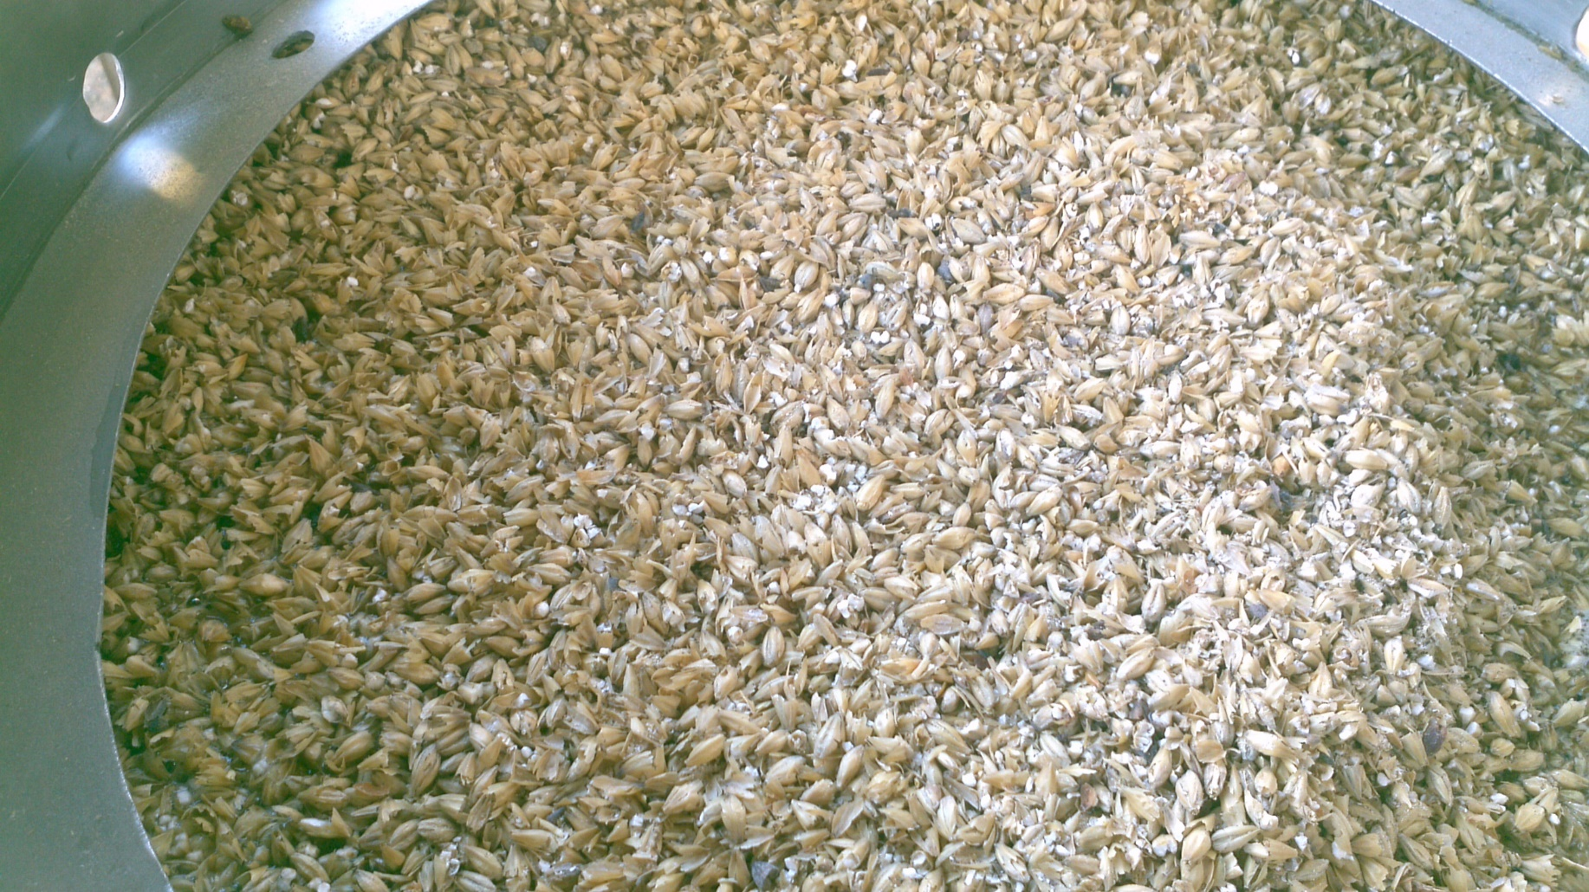
Process - Milling
Consistency
Lauterability

Slide 9
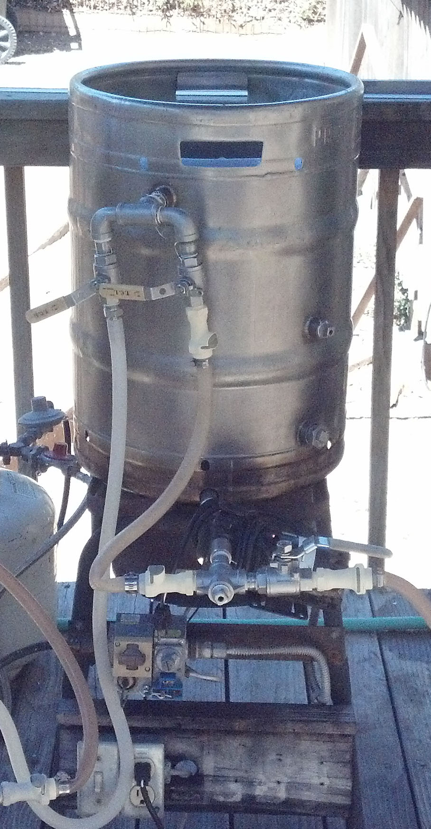
Process - Mashing
Dough-In
  Strike Temperature
  Grist Temperature
Water-Grist Ratio
Temperature Control
Ph
Vorlauf

Slide 10

Process - Sparging
Runoff Rate
  Consistent
  Checking it

Slide 11
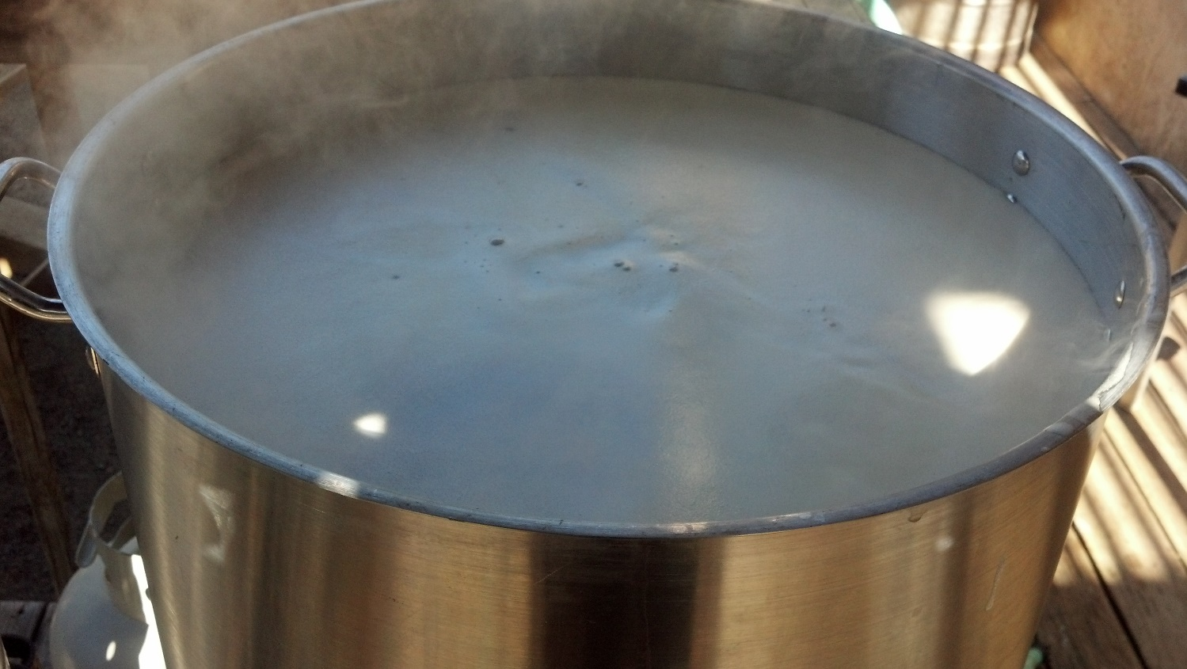
Process - Boiling
Boil Off Rate
  Burner Rating
  Ambient Conditions
Pre-Boil Gravity
  When it’s low
    Boil until it’s right (make less beer)
    Add Malt Extract/Sugar
    Make a different beer
  When it’s high
    Add water
    Make more beer or reduce volume
    Make a different beer

Slide 12
Process – Hop Additions
Stick to the recipe
Loose are bagged

Slide 13
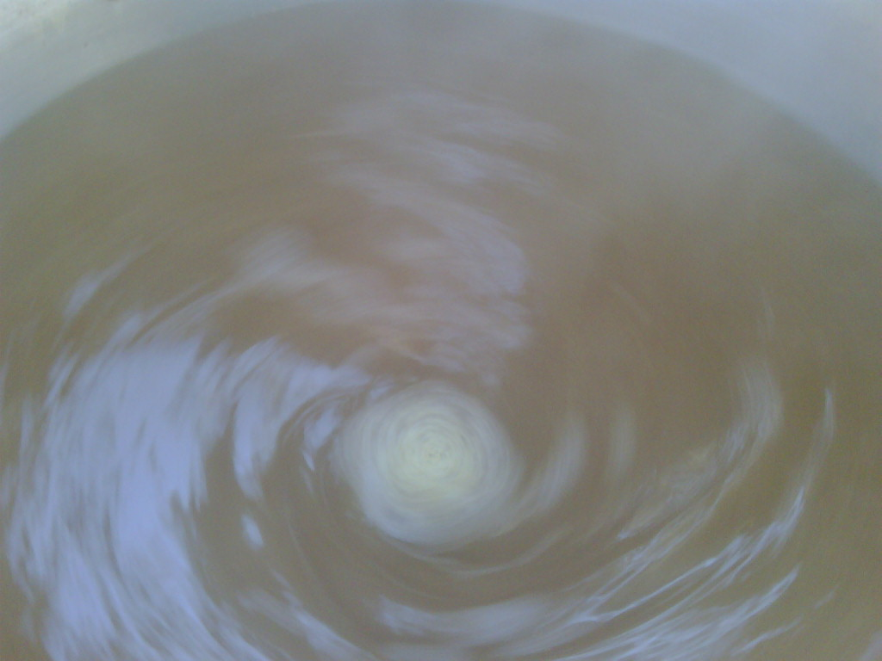
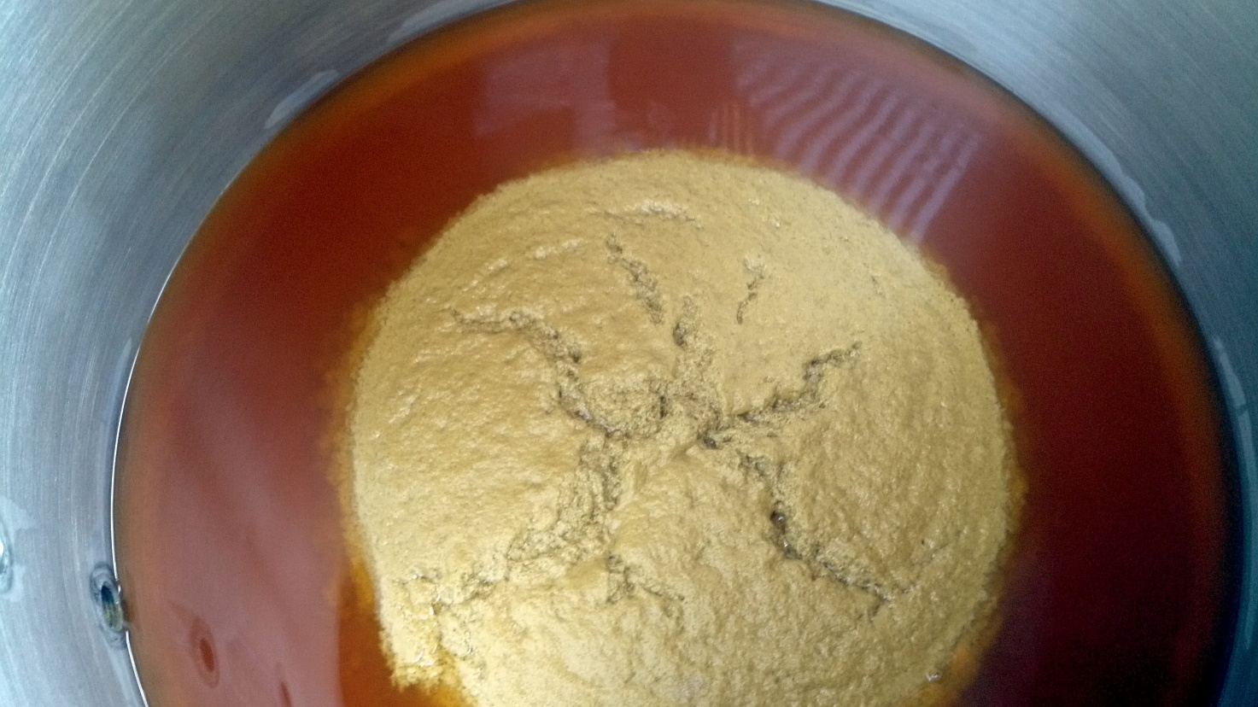
Process - Whirlpool
Length
Effectiveness

Slide 14
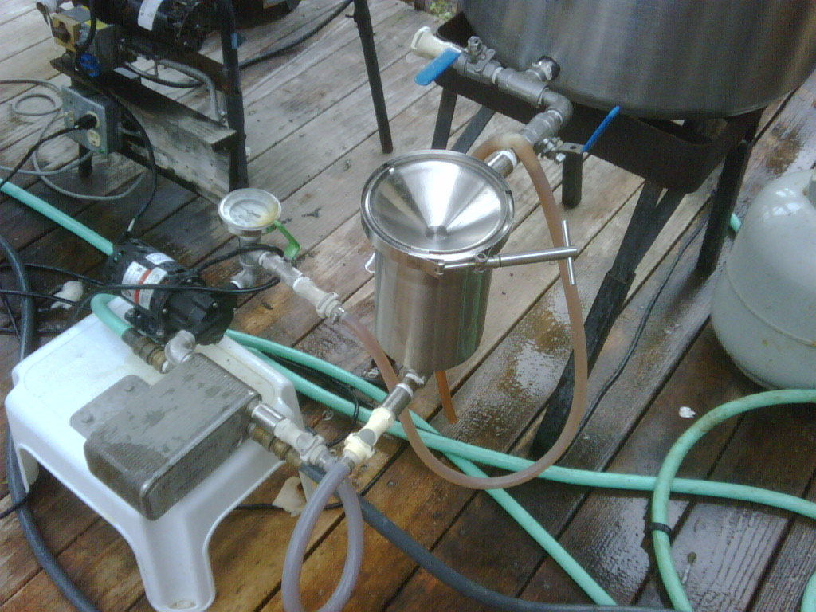
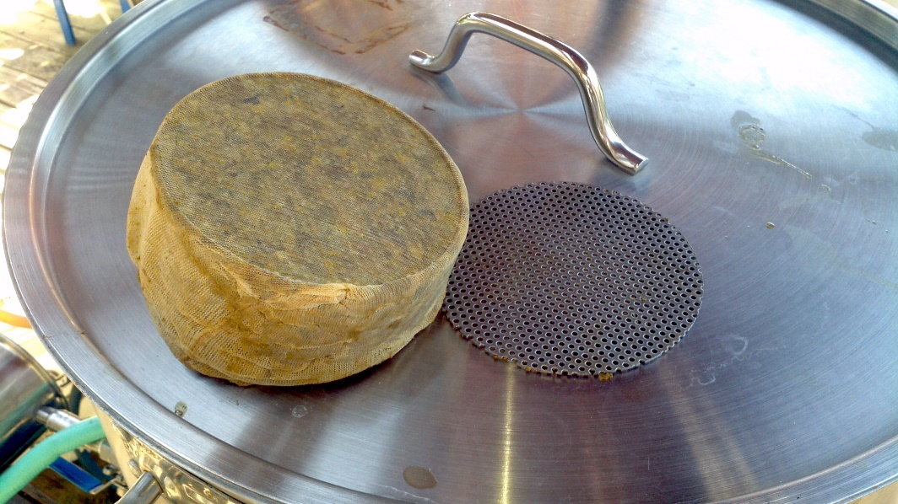
Process - Knockout
Length
Temperature

Slide 15
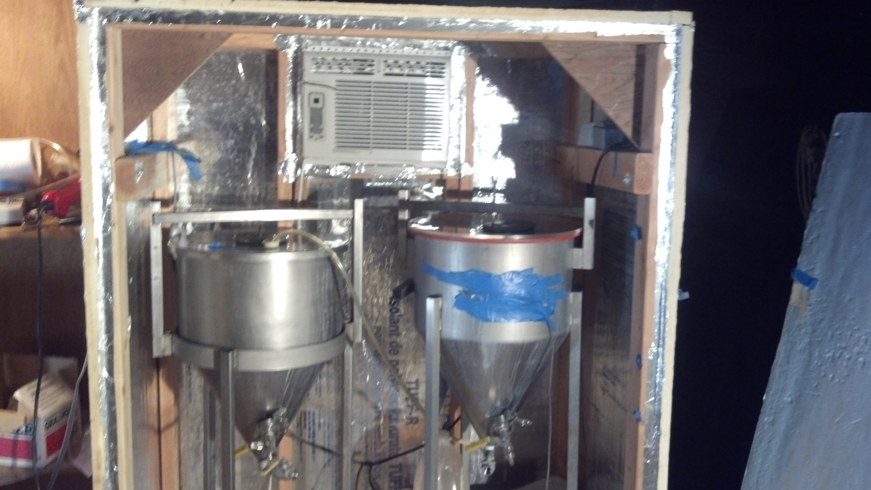
Process Fermentation
Oxygenation
Temperature Control
Documented profile

Slide 16
Cellaring
Beer is meant to be clear
Conditioning
Treat it like milk

Slide 17


The End
Questions?

Slide 18


Slide 19
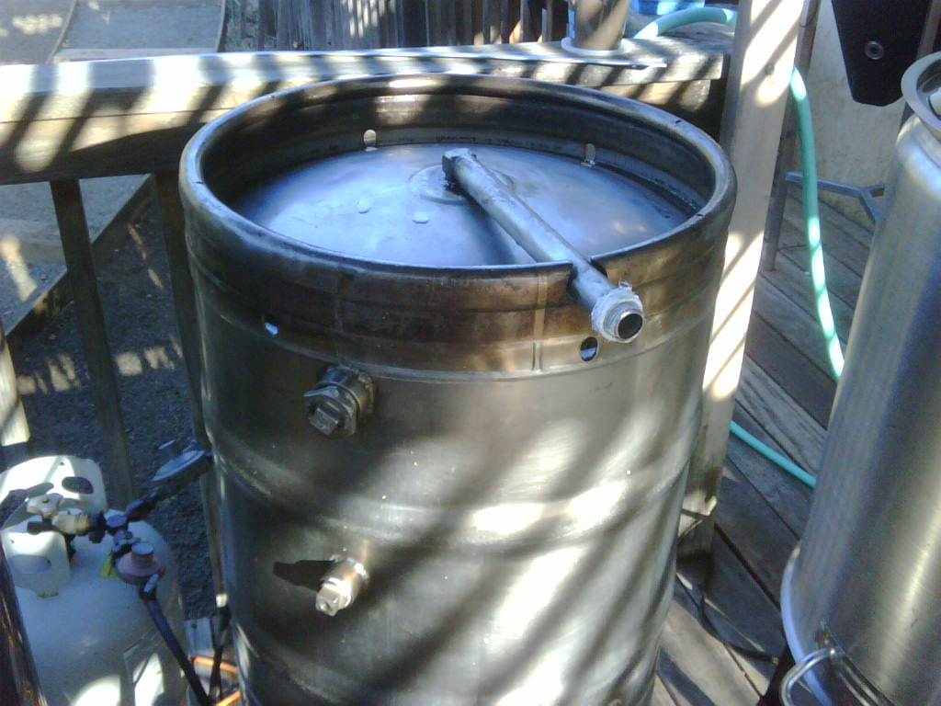
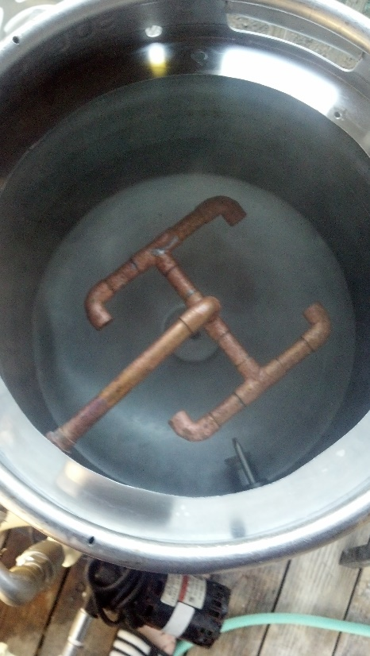
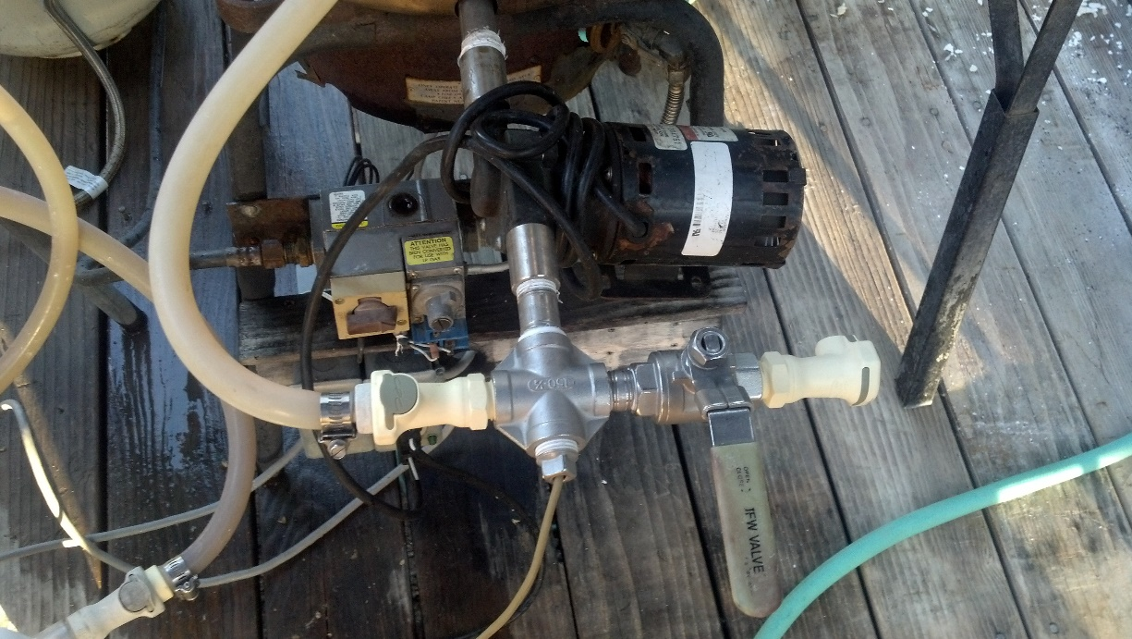

Slide 20
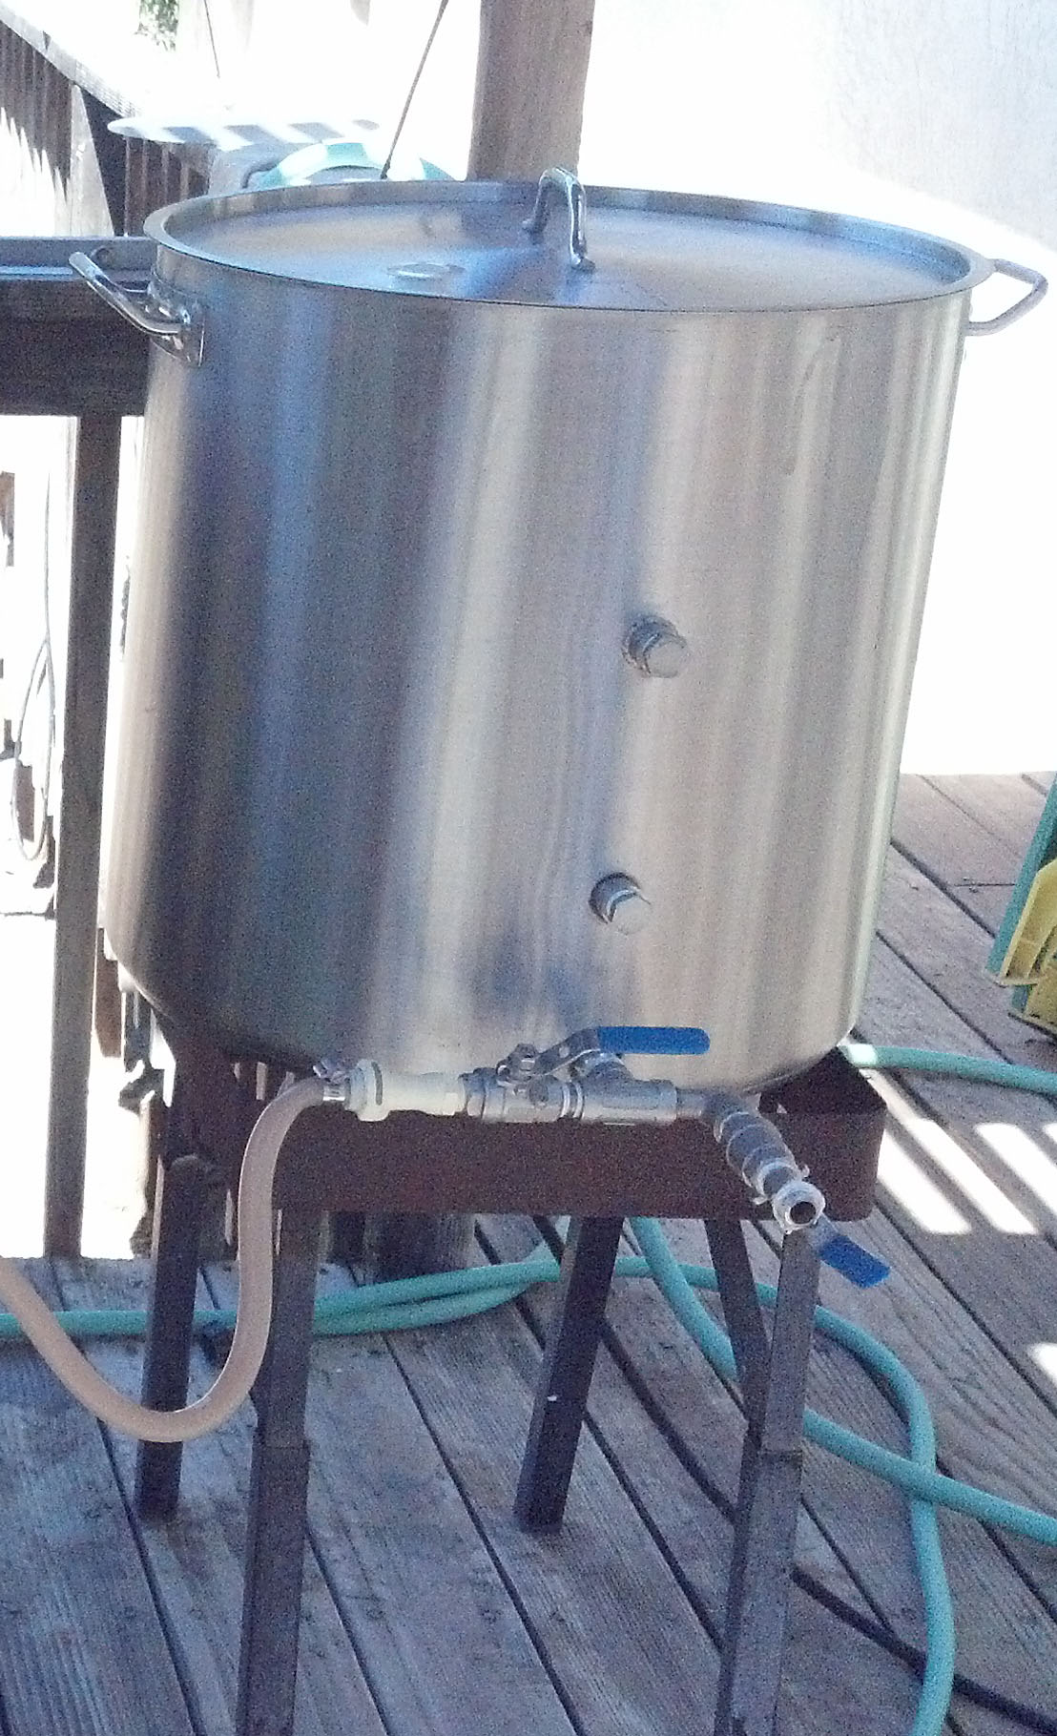
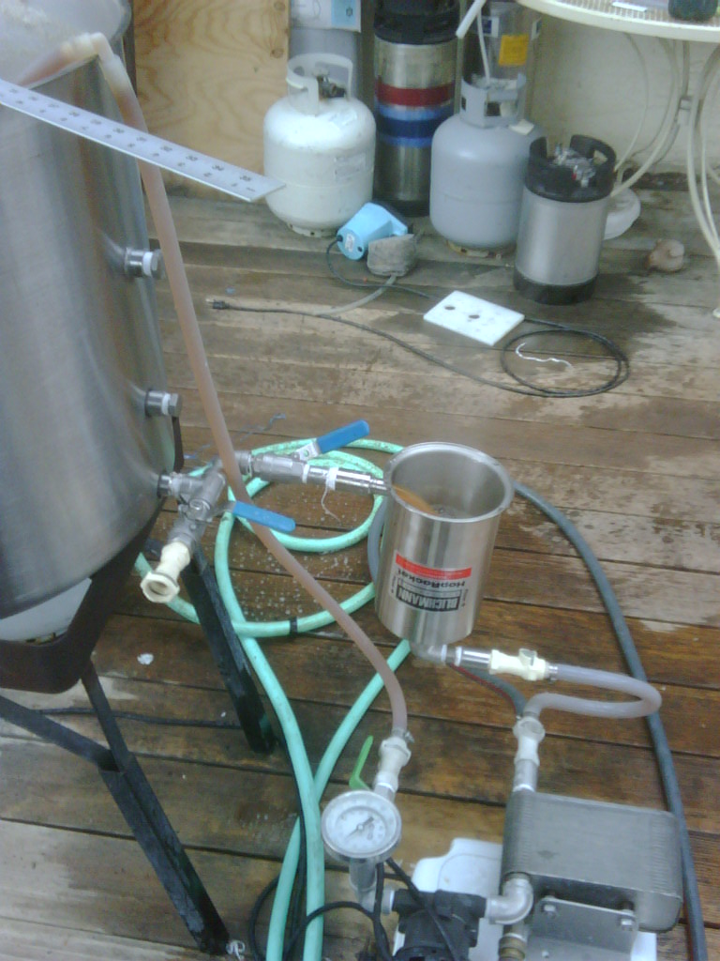

Slide 21
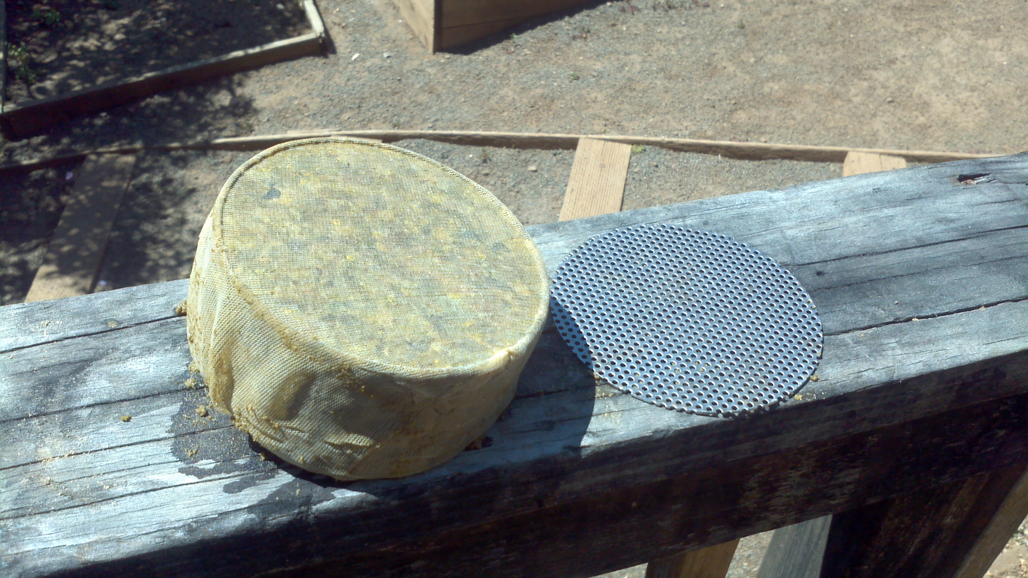

Slide 22
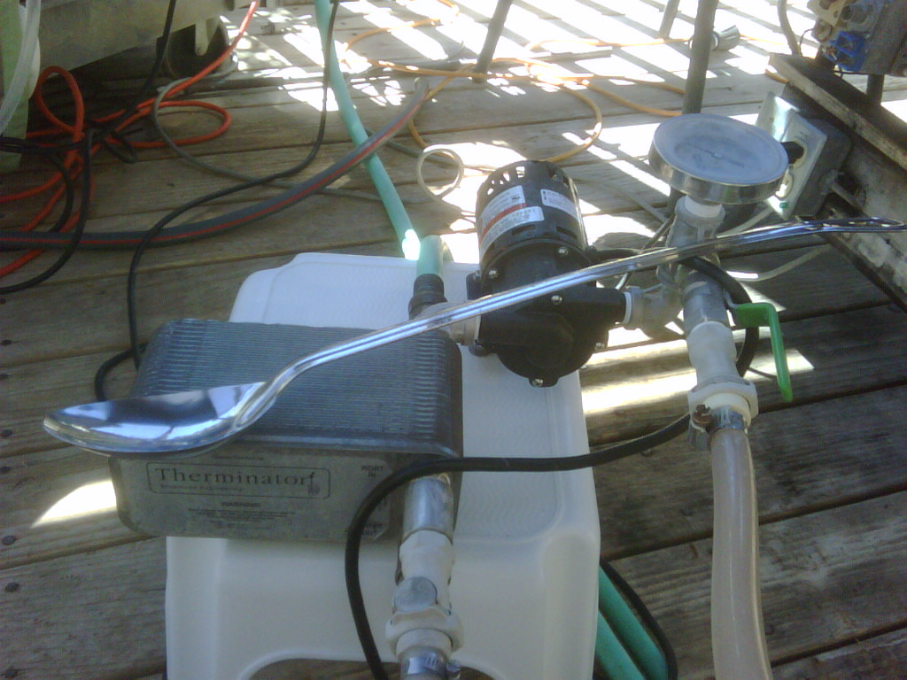

Slide 23



