Slide 1


Brewing Award-Winning Beer with Extract
Alex Brehm
Oregon Brew Crew
@BrehmBucks

Slide 2
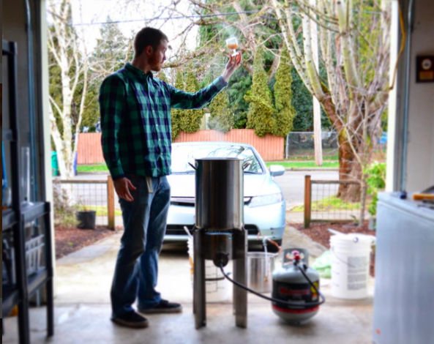
Establishing Credibility Who is Alex?
Speech & Debate Instructor/Coach at Lower Columbia College (Longview, WA)
Oregon Brew Crew Education Chair
BJCP Instructor (Certified)
Notable Award-Winning Extract Beers:
B.O.S. Salem Ale Works Summer Homebrew Competition 2015 (American Pale Ale)
3rd B.O.S. & 1st People’s Choice Stout Bout 2016 (Tropical Stout)
B.O.S. Heart of Cascadia 2016 (Rye IPA)
Three 2016 MCAB Qualifiers + one NHC Second Round

Slide 3
You brew? Extract or All-Grain!?
Extract is bad because:
Tastes bad (“extract twang”)
Has low fermentability
LME sticks to the can, caramelizes in the kettle
You can’t make light-colored beers with extract
Limited styles of beer you can brew
Extract is expensive
All-grain is good because:
Duh.
Notes:
When I tell someone that I homebrew, 90% of the time their first question is “extract or all grain?” As if that is some sort of marker of skill.
We almost exclusively brew with extract. In fact, first all grain brew was on SAW commercial system brewing our BOS winning APA.
My purpose is not to attack all-grain brewing. Rather, prove that you can make great beer with extract and convince you to prioritize other upgrades before switching to all grain.

Slide 4
Today’s Agenda:
What is extract?
Ten steps to brewing better extract beer
In defense of extract
Discussion

Slide 5
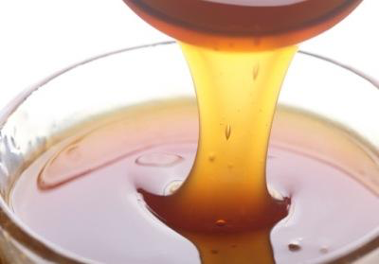
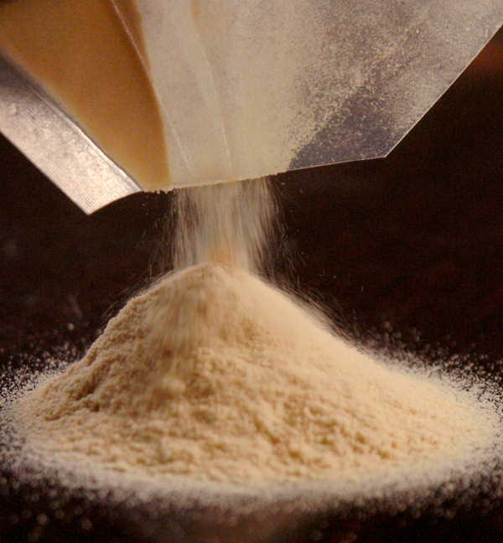
What is Extract?
Malt extract: sugary liquid or powder produced by converting sugars in malted barley
When all-grain brewers mash, they are creating extract
Liquid (LME): ~20% water
1 lb Malt = .75 lbs LME
Dry (DME): ~3% water
1 lb Malt = .6 lbs DME

Slide 6
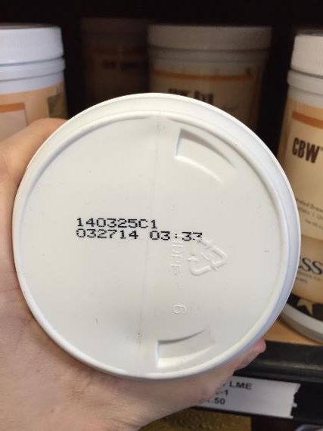
#1: Use Fresh Extract
Buy Fresh
Buy Bulk
Brew Fresh
Notes:
Why bulk? Usually fresher. Also cheaper. Steinbarts has 3.3 lb jar for $11.50, 3.3 bulk for $8.25 (70% the cost)
Extract can get infected, extract can get stale. Don’t give it the opportunity.

Slide 7
#1: Use Fresh Extract
Buy Fresh
Buy extract (especially LME) from homebrew shops that are high traffic and move extract quickly
Buy LME in bulk rather than pre-packaged cans or jars
Brew Fresh
Refrigerate LME, brew with it quickly
Use DME within a few months of opening package
Notes:
Why bulk? Usually fresher. Also cheaper. Steinbarts has 3.3 lb jar for $11.50, 3.3 bulk for $8.25 (70% the cost)
Extract can get infected, extract can get stale. Don’t give it the opportunity.

Slide 8
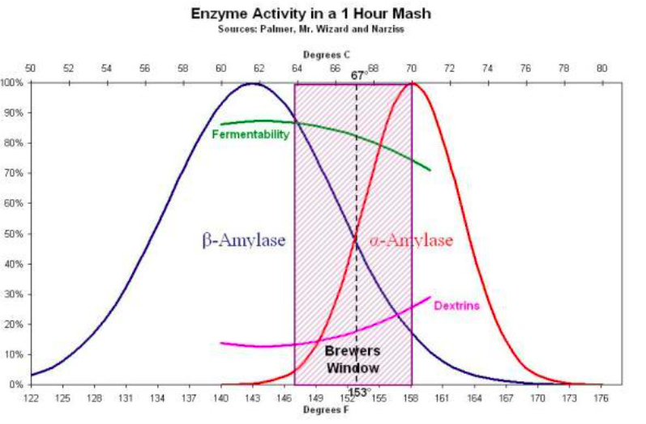
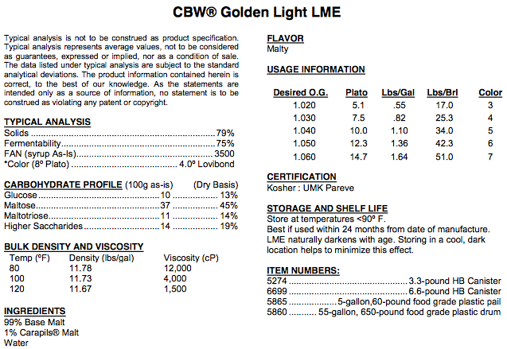
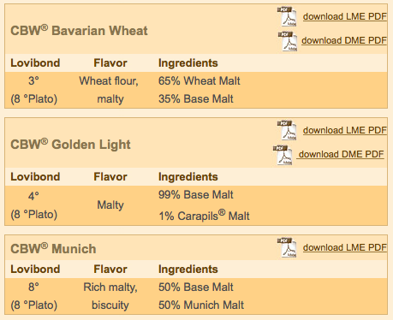
#2: Know Your Extract
Buy the right extract
What type of base malt are you replacing?
Once you’ve bought extract, know what it is
What grains were used to make the extract?
How fermentable is it?
What does all this mean for your brew?
Notes:
To answer these questions, check manufacturer’s website

Slide 9
#3: Mini-Mash
Try to mash something
Improve your brewing science education
Increases beer styles available
Gives you more control over fermentability
Allows you to use grains such as Munich, Vienna, Biscuit, and adjuncts
In general, mash 2 lb grain per 1 gallon capacity
6 quart kitchen pot – 3 lb mash
2 gallon cooler– 4 lb BIAB mash
5-gallon kettle – 10 lb BIAB mash
Notes:
Why mash like this?
Cheap ($13)
No modifications necessary
Ability to make any type of beer that has 3 lbs specialty grain or less
(not going into diastatic power) 14 oz 2 row, 12 oz 6 row
I find either of these mashing options preferable to “steeping grains”

Slide 10
#4: Water Additions
*This is not a beginner topic. If water stresses you out, disregard this step (for now).
Malt extract already has water additions
If you treat your whole water supply, you will end up over-treating your water
Do some water additions, but keep it simple
Hoppy styles: add a bit of Gypsum to mash
Malty styles: add a bit of Calcium Chloride to mash
Notes:
Use brew water websites if you like. I typically just add .25 tsp per gallon water

Slide 11
#5: Compensate for decreased fermentability
How fermentable do you want your wort to be?
What was the mash temp of the recipe you are following?
What % fermentability does that correspond with?
Notes:
I don’t have time to get into calculating fermentability

Slide 12
#5: Compensate for decreased fermentability
How fermentable do you want your wort to be?
What was the mash temp of the recipe you are following?
What % fermentability does that correspond with?
How can you hit that target?
Extract is fixed at 75% (or is it?)
Do your mini mash at a low temp (~148°F)
Notes:
I don’t have time to get into calculating fermentability

Slide 13
Converting a Grain Bill The Basics
Jamil’s American Amber Ale (Brewing Classic Styles pp. 137-138)
Recipe says to mash at 154° F (~80% fermentable wort)
All Grain
1 lb Munich Malt
.75 lb Crystal 40
.5 lb Crystal 120
.5lb Victory Malt
9.25 lb British Pale Ale Malt
Extract + 4 lb Mini-Mash
1 lb Munich Malt
.75 lb Crystal 40
.5 lb Crystal 120
.5 lb Victory Malt
1.25 lb Mecca Grade Lamonta Malt
(or a boring UK base malt)
Mash at 147° F (~87% fermentable wort)
6 lb Light Liquid Malt Extract (8 lbs)
(75% fermentable wort)
For the Math Nerds:
This grain bill is 33% grain, 67% extract. Overall fermentability is:
(.33 x .87) + (.67 x .75) = 78.96% fermentable

Slide 14
#6: Sugar Additions
Okay, so you did a mini-mash and your wort still isn’t fermentable enough. Now what?
Many sugars (corn, cane, candi, maple syrup, etc.) are 100% fermentable
Replace malt extract with 100% fermentable sugar for increased fermentability of your wort (within reason)
When should I add sugar?
Doesn’t need an extended boil
Does need to be sterilized
Add either at flameout or high krausen
Notes:
High krausen needs to be sanitized

Slide 15
Converting a Grain Bill Using Sugar
Extract + 4 lb Mini-Mash
1 lb Munich Malt
.75 lb Crystal 40
.5 lb Crystal 120
.5 lb Victory Malt
1.25 lb Mecca Grade Lamonta Malt
(or a boring UK base malt)
Mash at 147° F (~87% fermentable wort)
6 lb Light Liquid Malt Extract (8 lbs)
(75% fermentable wort)
Extract + Mini-Mash + Sugar
1 lb Munich Malt
.75 lb Crystal 40
.5 lb Crystal 120
.5 lb Victory Malt
1.25 lb Mecca Grade Lamonta Malt
(or a boring UK base malt)
Mash at 147° F (~87% fermentable wort)
5.5 lb Light Liquid Malt Extract (7.3 lbs)
(75% fermentable wort)
.5 lb Organic Cane Sugar
(100% fermentable)
For the Math Nerds:
This grain bill is 33% grain, 61% extract, and 6% sugar
(.33 x .87) + (.61 x .75) + (.06 x 1.00) = 80.5% fermentable (ding ding ding!)
Notes:
BYO Jan/Feb 2009
41% Grain
52% Extract
7% Sugar

Slide 16
#7: Adding Extract
Why do brewers boil wort?
Drive off DMS
Precipitate out proteins
Isomerize hops
Sterilization
Maillard Reactions
Extract has already been boiled, so…
Add it with 10 minutes in the boil to:
Sterilize
Dissolve
Prevent excessive caramelization
But also know your options and know your extract
Notes:
I don’t have time to get into calculating fermentability

Slide 17
#8: Adjust Hop Schedule
Adding extract late means boil gravity is lower
Low boil gravity leads to increased hop utilization…
…at least for the first 50 minutes
Rules of thumb:
60 minute additions: reduce by 30%
20-30 minute additions: reduce by 15%
I don’t actually recommend using rules of thumb. Stop being a cheap-ass and buy BeerSmith for $30. It will calculate this shit for you.
Notes:
Rules of thumb are RULES OF THUMB

Slide 18
Converting the Hop Schedule (AKA, plug this shit into BeerSmith and see what comes out)
Jamil’s American Amber Ale (Brewing Classic Styles pp. 137-138)
Original Recipe
60 min - .6 oz Horizon (31.7 IBU)
15 min - .25 oz Centennial (1.8 IBU)
15 min - .25 oz Cascade (1.2 IBU)
0 min - .25 oz Centennial (0 IBU)
0 min - .25 oz Cascade (0 IBU)
Mini-Mash + 10 min Extract + Late Sugar
60 min - .5 oz Horizon (30.1 IBU)
15 min - .11 oz Centennial (1.9 IBU)
15 min - .11 oz Cascade (1.3 IBU)
0 min - .25 oz Centennial (0 IBU)
0 min - .25 oz Cascade (0 IBU)

Slide 19
#9: Practice Good Brewing Procedures
These are not exclusive to extract, but do lead to better beer
Clean and sanitize thoroughly
Make yeast starters, pitch big
Aerate your wort
Control temperature of fermentation
Notes:
High krausen needs to be sanitized

Slide 20
#10: Enter Competitions
It’s really really hard to “brew award-winning beer with extract” if you don’t enter competitions.
Plan to enter every beer you brew in at least two competitions
BJCP.org
HomebrewersAssociation.org
Notes:
High krausen needs to be sanitized

Slide 21
Revisiting why extract is “bad”
Tastes bad (“extract twang”)
I don’t believe this is a real thing
Lots of extract beers are bad because lots of inexperienced brewers make them
Avoid by:
Using fresh extract
Aerating your wort
Pitching lots of healthy, viable yeast
Good sanitation practices
Don’t make the same mistakes you made on your first few batches

Slide 22
Revisiting why extract is “bad”
Has low fermentability
This one’s true... but not crippling
~75% fermentability is similar to mashing at 158F
Avoid by:
Doing a partial mash at 147-150F
Adding <10% of simple sugar (to replace LME)

Slide 23
Revisiting why extract is “bad”
LME sticks to the can, caramelizes in the kettle
LME will do this if you let it…
Don’t let it!
Avoid by:
Pre-dissolving all LME in hot wort before adding to kettle
Adding LME late in the boil to limit caramelization

Slide 24
Revisiting why extract is “bad”
You can’t make light-colored beers with extract
LME darkens with age
Avoid by:
BUYING fresh extract
Buying BULK whenever possible
BREWING with your extract as promptly as possible

Slide 25
Revisiting why extract is “bad”
Limited styles of beer you can brew
You can brew any beer with a 2-row, pilsner, wheat, or Munich base with Briess extract. Even more base malt extracts are available if you expand to other companies.
Avoid by:
Do a mini-mash. This allows you to use several pounds of specialty grains.
Even if you don’t want to mini-mash, steep some specialty grains to broaden the styles available to you.

Slide 26
Revisiting why extract is “bad”
Extract is expensive
True. But not as true as you think.
1 lb malted barley = .75 lb LME = .6 lb DME
Steinbart’s costs:
1 lb Great Western 2-row: $1.05
.75 lb LME: $1.87
.6 lb DME: $2.40
Avoid by:
Mini-mash
Use LME over DME when possible (if $ is primary concern)
Buy LME bulk, don’t buy pre-packaged cans
SAVE money on hops when you increase utilization by adding your extract late
Notes:
I’ve heard people say things like “extract is 4 times more expensive than grain”
All Grain pale: 42 cents/12 oz bottle
Extract pale: 50 cents/12 oz bottle

Slide 27
Why should I brew with extract?
Maybe you shouldn’t
Great “gateway” into brewing
Higher per-batch costs, but lower startup costs
Consistent product
Eliminate one variable while learning other aspects of brewing
Not spatially demanding
100% of our brew day takes place on our stove and countertop
If nothing else, don’t fear extract.
Notes:
Extract brewing is not for everyone, BUT

